Slide 1
Review and Approval Process Training: Best Practices and New Republishing Steps
October 27, 2026

Slide 2
Welcome
Presented by Jessica Van Heuveln, Qualtrics Product Owner and CX Program Manager
Notes:
Introduce yourself
Link to the Event wher eyou can find the slide deck,

Slide 3
Agenda
Welcome
Reflecting on Our First Year
Celebrating Excellence Across Iowa
---------- Start Recording ----------
The Review & Approval Process
New Republishing Steps (preview — live Nov. 4)
Sensitive Data Policy
Best Practices & Common Mishaps (Demonstration)
Top and New Guides
Support Options
Open Forum
Notes:
Run through the agenda quickly then move into Welcome. Mention the recording and where the slides/agenda link will be shared.
Different audiences
Sit back take some notes

Slide 4
Reflecting on Our First Year
The Enterprise Qualtrics Program
October 2025 – October 2026
Notes:
Quick note of pride before we get into the mechanics — the team has genuinely moved a lot in a year.

Slide 5
A Year of Growth, By the Numbers
In its first year, the program moved from launch to a governed, self-service model available to every State agency.
24
330
96%
agencies on the platform, with 522 users
surveys and forms from 17 agencies; 245 published, 85 in flight
of service tickets closed (925 of 963)
Notes:
These are the program's own headline numbers — same three the Executive Briefing leads with.

Slide 6
Adoption by Agency
522 users total across 24 agencies; 330 surveys and forms. DOC, DOM, HHS, DE, and DIAL hold 65% of users. DOC, HHS, DE, DOM, and IWD account for 234 of 330 forms (71%). 7 agencies with users have not yet submitted a survey or form.
24 of 24
23 of 24
24 of 24
on EX
on DX
on CX
Notes:
Five agencies account for about two-thirds of users. Coverage tiles show every agency is on EX and CX; DX coverage is 23 of 24 by design (IDB excluded).

Slide 7
CX, DX, and EX at a Glance
Highlights from the State's enterprise experience programs, all delivered under one master contract.
CX: Surveys & Forms
DX: Digital Experience
EX: Employee Experience
330
20.1M
24 of 24
surveys and forms from 17 agencies; 245 published, 85 in flight
sessions on DX sites, Jul 2025–Oct 2026
agencies on EX
522 users across 24 agencies, with named approvers and champions in each. CX usage is essentially universal because every DX site runs the Accessibility Workflow, built on CX technology.
11,939 Feedback Tab submissions in the same period (excluding Accessibility). 23 of 24 agencies — DXA, the Feedback Tab, and Dashboards run on every migrated site except one.
All State of Iowa employees take part in the Engagement / Pulse Survey. Onboarding and offboarding workflows were implemented this year.
Notes:
Three programs, one contract. CX is the volume story, DX is the reach story (20 million sessions), EX is full coverage — every agency, every employee.

Slide 8
Self-Service & Communication
Self Service
93 training pages: 10,084 views, 7,248 sessions, 76% engaged.
23 training videos: 2,911 views.
The four launch recordings drew 1,198 views, versus 102 live attendees.
925 of 963 service tickets closed — a 96% close rate.
86 office hours held, with 774 total attendee entries.
Average attendance per session rose from 5.7 to 11.2
Communication
Bulletin subscribers grew from 338 to 603 — up 78% — with zero unsubscribes.
Click-through rate rose from 1.9% to 3.2%.
25 bulletins and 13 Highlight Stories published.
Notes:
These are the program's own headline numbers — same three the Executive Briefing leads with.

Slide 9
Celebrating Excellence
Across Iowa
Highlighting Agency Wins and Innovation

Slide 10
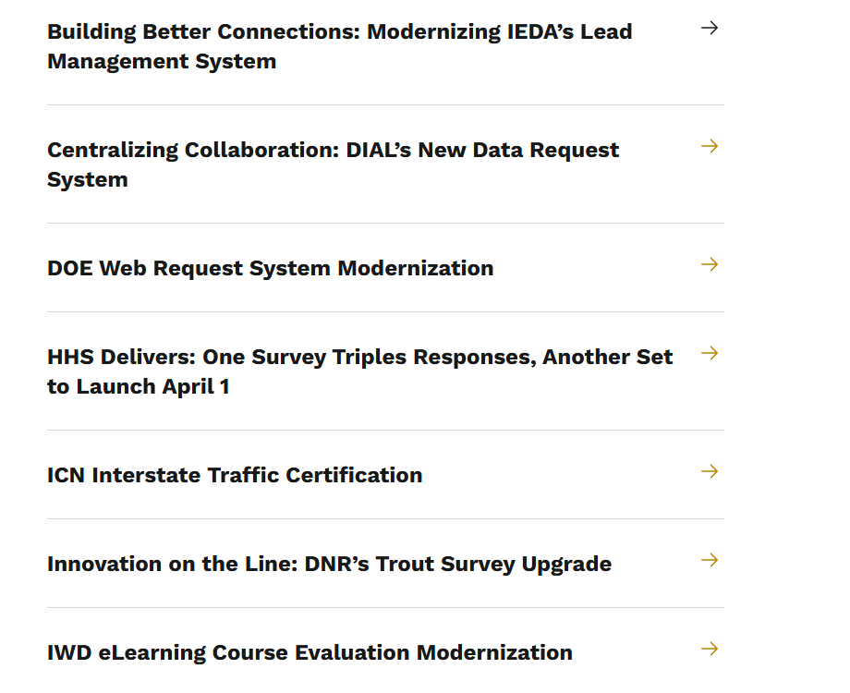
Highlight Story
Showcasing how agencies use Qualtrics to solve problems, improve processes, and deliver better, data driven services across the state.
Qualtrics Highlight Stories

Slide 11
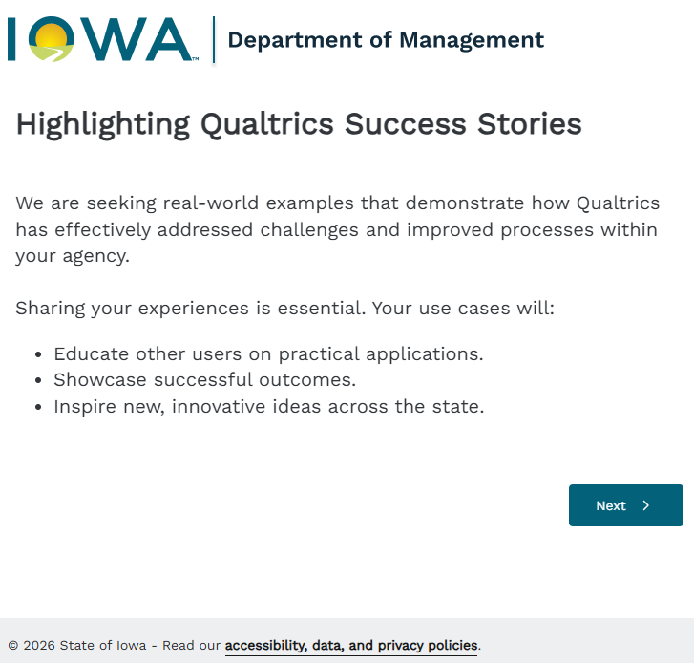

Tell Us Your Story
We know there are more success stories out there. We want to hear from you next.
Sharing your experiences is essential. Your use cases will:
    Educate other users on practical applications.
    Showcase successful outcomes.
    Inspire new, innovative ideas across the state.
Highlighting Qualtrics Success Stories Form
Notes:
Share your story --
Pay it forward concept

Slide 12
Start Recording
Permission, Posting, and Q/A Expectations
Notes:
Set the stage: this is the backbone everything else hangs off of. Keep it high-level here — detail comes next.
Call me out
I make mistakes
Questions in feedback
Demo break

Slide 13
The Review & Approval Process
How a survey gets from draft to live
Notes:
Set the stage: this is the backbone everything else hangs off of. Keep it high-level here — detail comes next.

Slide 14
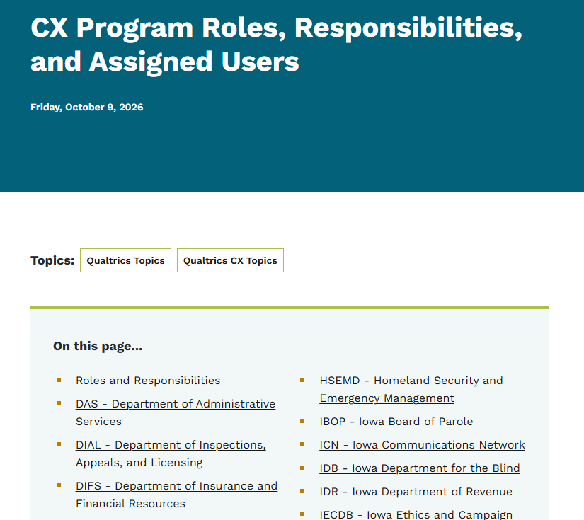
Don't Skip Your Agency's Process
🔗CX Program Roles, Responsibilities, and Assigned Users
Every agency’s process is different — if yours has its own intake or IT approval step, keep following it; this review doesn’t replace it, just adds a check for accessibility, security, and brand before final sign-off
Not sure what your agency’s process looks like? Start with your Agency Approver
Don’t know who that is? Ask your Agency CX Champion — or visit CX Program Roles, Responsibilities, and Assigned Users, to find the right person
Notes:
Emphasize and cx Program Roles and responsiblitesl

Slide 15
Five Steps to Draft to Live
1
2
3
4
5
→
→
→
→
Build & Edit
Request
Choose Your Path
Review
Approve & Publish
Create and edit your survey as the creator.
Click Publish, select Jessica from the approver dropdown (just triggers the workflow), add notes, and request approval.
Complete the intake form and pick Comprehensive or Streamlined.
Our AI review tool — used on both paths — and our team review your survey.
Your agency’s approver decides. If approved, you’re both notified and the survey goes live.
Get in the queue sooner rather than later — the earlier you submit, the more time the review team has to work with you before launch.
Notes:
This is the at-a-glance version — the next few slides go deeper on each piece.
Mickey Mouse

Slide 16
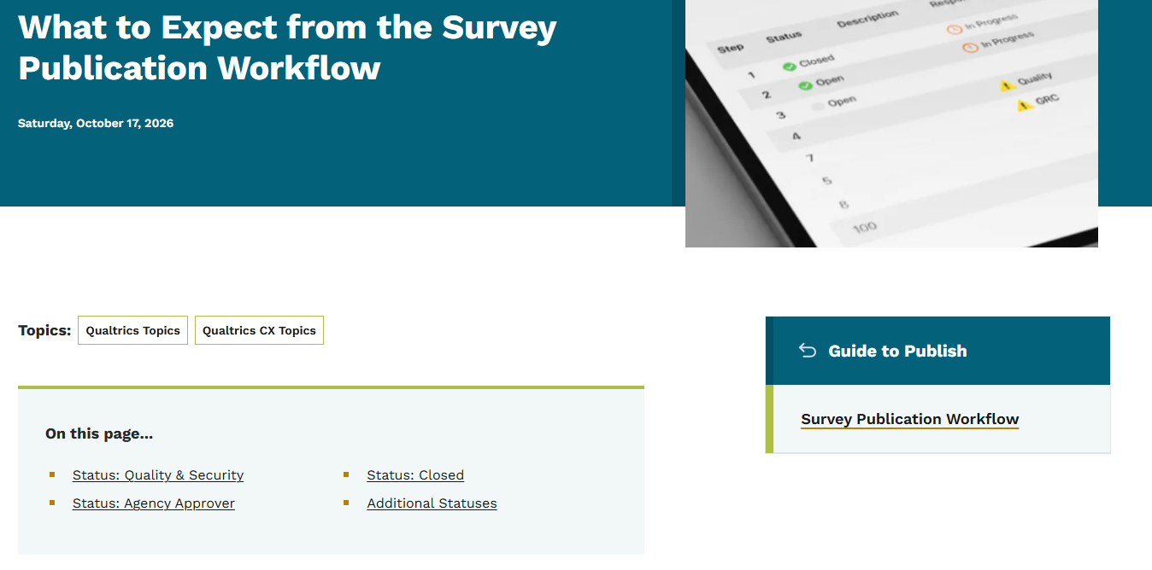
How a Survey Gets Published
🔗What to Expect from the Survey Publication Workflow and Guide to Publish
Every survey moves through the same six stages on its way to going live.
Status: Quality & Security
  1. Request to Publish — you submit a formal request, starting the review
  2. Intake (Choose your Review Path) — you define your survey’s purpose; select your review path
  3. Qualtrics + IA Security & Quality review — AI and security review
  4. Service Delivery actions — settings applied, migrated to the right account and other infrastructure best practices
Status: Agency Approver
  5. Approve/Deny — your agency makes the final call
Status: Closed
  6. Finalize and Distribute — Congrats your published, -- now time distribute or we tell you why it was declined by your agency
Notes:
Walk through the six steps left to right. This is the map we'll refer back to all session.

Slide 17
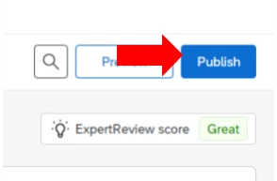
Request to Publish – Step 1
Status: Quality & Security
🔗What to Expect from the Survey Publication Workflow and Guide to Publish
Step 1: Click Publish
  In the Survey Editor, click Publish in the top right corner. This kicks off the approval workflow. It doesn't publish your survey yet.
❗You’ll only ever click the blue Publish button once per survey. Starting November 4, every update after that goes through the new republish option instead.

Slide 18
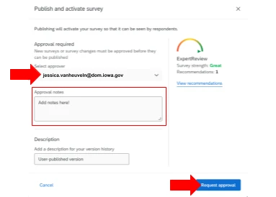
Request to Publish – Step 2
Status: Quality & Security
🔗What to Expect from the Survey Publication Workflow and Guide to Publish
Step 2: Select Jessica and Add Notes
  Select Jessica from the approver dropdown.
  It simply kicks off the workflow. Your agency's actual designated approver reviews and signs off later.
❗Selecting Jessica doesn’t mean she’s your approver — it’s just what triggers the process. You’ll only ever click the blue Publish button once per survey. Starting November 4, every update after that goes through the new republish option instead.
Notes:
Emphasize: Comprehensive isn't 'extra credit' — it's the right call for anything public-facing.

Slide 19
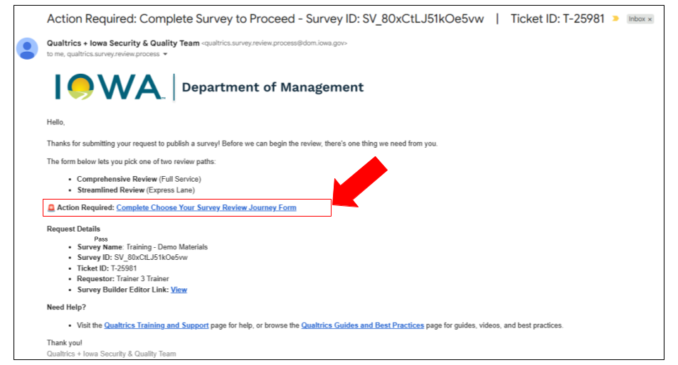
Intake - Choosing Your Review Path
Status: Quality & Security
🔗What to Expect from the Survey Publication Workflow and Guide to Publish
Step 3: Complete the Choose Your Path Form
After you request approval, you'll get an email (hour later) asking you to complete the Choose Your Path form.
This is where you pick your review lane:
Comprehensive Review (Full Service): recommended for public-facing or constituent surveys; full accessibility, theming, and methodology feedback; includes one extra Listen Understand Act (LUA) section
Streamlined Review (Express Lane): a good fit for internal or low-risk surveys, or agencies with their own strong review process; security only
❗Both paths include an AI review
Notes:
Emphasize: Comprehensive isn't 'extra credit' — it's the right call for anything public-facing.

Slide 20
Intake - Choosing Your Review Path
Status: Quality & Security
🔗What to Expect from the Survey Publication Workflow and Guide to Publish
Both paths ask the same core questions:
Security Overview: could any of your responses include an 8-digit number, or a number between 12 and 26 digits long? Think Social Security numbers, Medicaid IDs, bank account numbers, driver's license numbers.
Protected Data Categories: which apply, CJIS, FERPA, FTI, HIPAA, PII, or None.
Issues and Tips Panel: did your Issue and Tips Panel show a Sensitive Data Request warning?
Launch Date: your expected launch date.
Primary Audience: constituents, internal staff, partner organizations, or other.
Distribution: how the survey will be distributed, and whether it will be posted on a State of Iowa website.
Long-Term Ownership Check: is this survey long-term, public-facing, used with a QR code, used programmatically, or handling sensitive data? Your answer here determines whether it should move to a dedicated service account.
Platform Features: which platform features your project uses.
Comprehensive only: one extra section before submitting, Listen Understand Act (LUA), what you're capturing (Listen), the why behind it (Understand), and what you'll do with it (Act). Streamlined skips this and goes straight to submission.
❗ Demonstration
Notes:
Communiaiton
Launch date

Slide 21
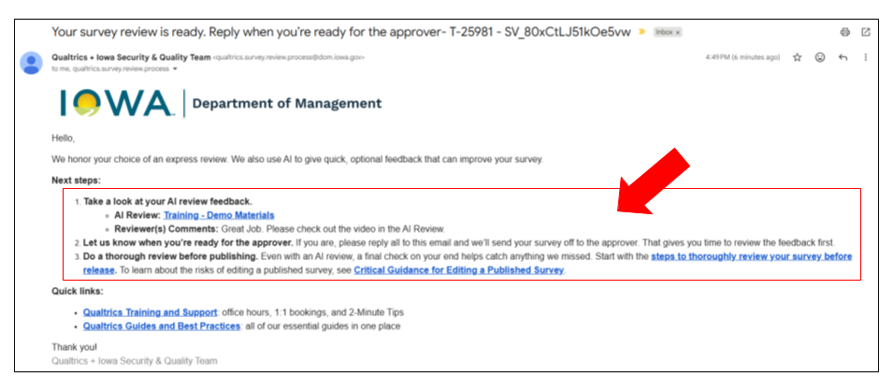
Qualtrics + IA Security & Quality review
Status: Quality & Security
🔗What to Expect from the Survey Publication Workflow and Guide to Publish
Step 4: Your Survey Is Reviewed
Your survey goes to the Qualtrics and Iowa Security & Quality Team, with help from our AI review tool — used on both review paths
You’ll get an email with your AI review results and reviewer comments
First time through? You may get a short video walking through your specific survey’s feedback
❗Both paths include an AI review
Notes:
Inform us when you are done reviewing please inform us you rea ready to send to approver.

Slide 22
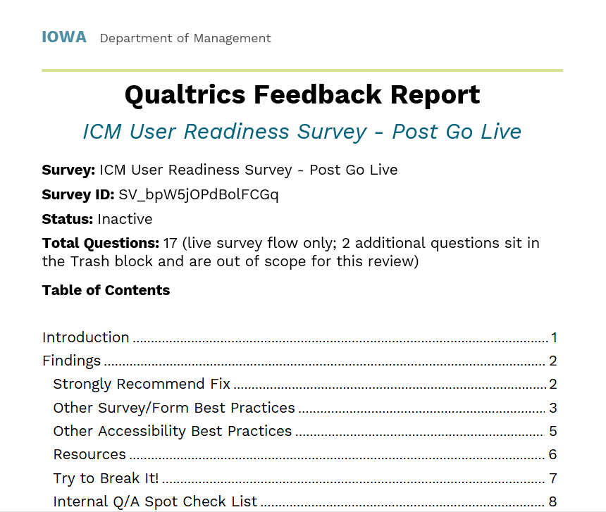
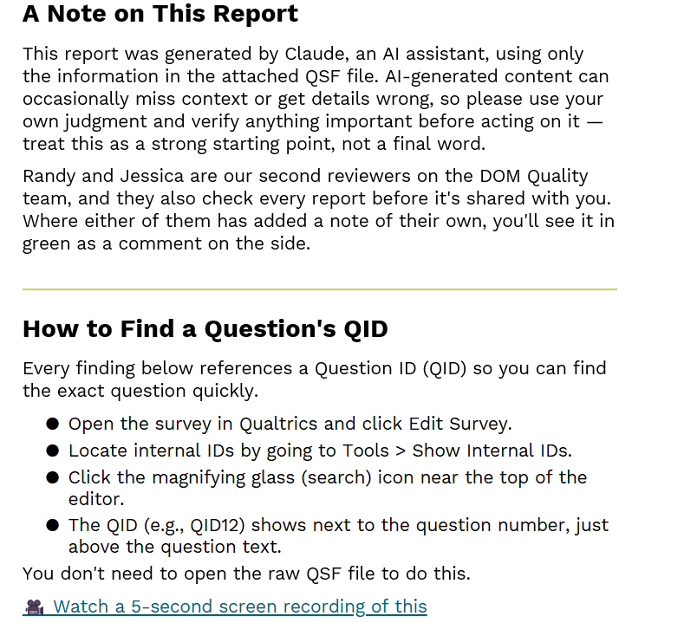
AI - Review
Status: Quality & Security
🔗What to Expect from the Survey Publication Workflow and Guide to Publish
❗ Demonstration

Slide 23
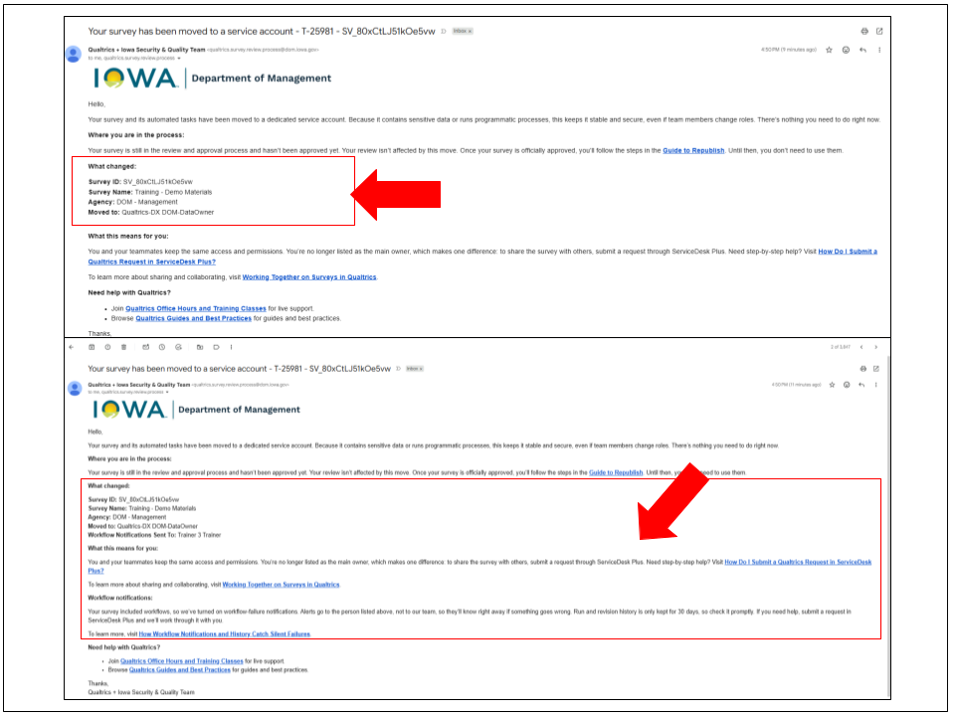
Service Delivery Actions
Status: Quality & Security
🔗What to Expect from the Survey Publication Workflow and Guide to Publish
Step 4: Your Survey Is Reviewed
If your survey handles sensitive data or runs automated processes, it moves to a dedicated service account
You and your team keep the same access and permissions — you’re just no longer listed as the main owner
Sharing the survey with someone new now goes through a ServiceDesk Plus request
Notes:
Programmic
Sensitive/Protected data

Slide 24
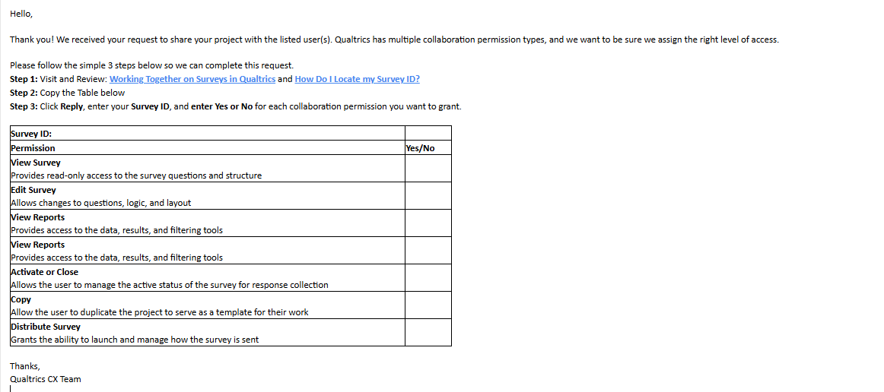
Collaboration
Status: Quality & Security
🔗How Do I Locate my Survey ID?, Working Together on Surveys in Qualtrics, and Guide to Publish
Sharing the survey with someone new now goes through a ServiceDesk Plus request
Notes:
Side rail afer you go live --

Slide 25
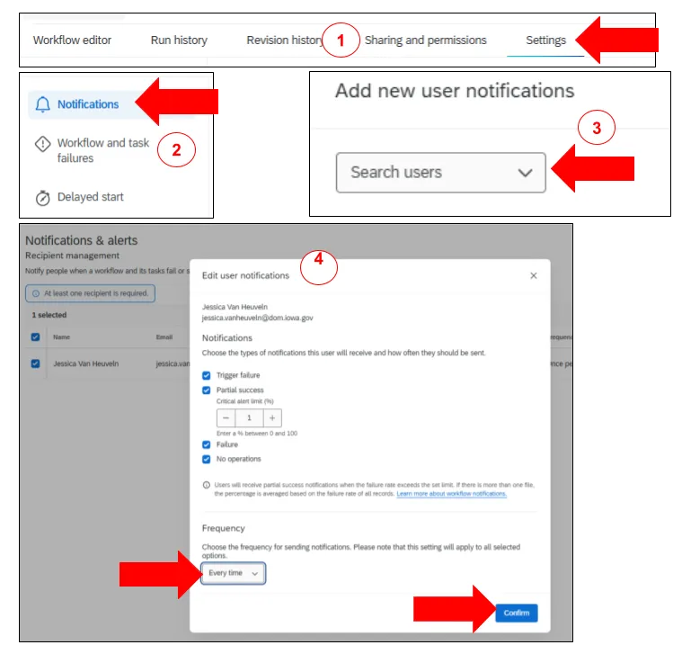
Workflow Notifications
Status: Quality & Security
🔗How Workflow Notifications and History Catch Silent Failures, What to Expect from the Survey Publication Workflow and Guide to Publish
We confirm notifications are on — but failure alerts go to the workflow’s recipients, not our team, so we only hear about a failure if you tell us
Stuck on a failed workflow? Bring it to Qualtrics Office Hours and Training Classes or submit a ServiceDesk Plus request and we’ll work through it with you
Don’t wait too long — run history is only kept for 30 days, so reach out while it’s still there
Notes:
Notitifion
You are the data Owner of the survey
Resource

Slide 26
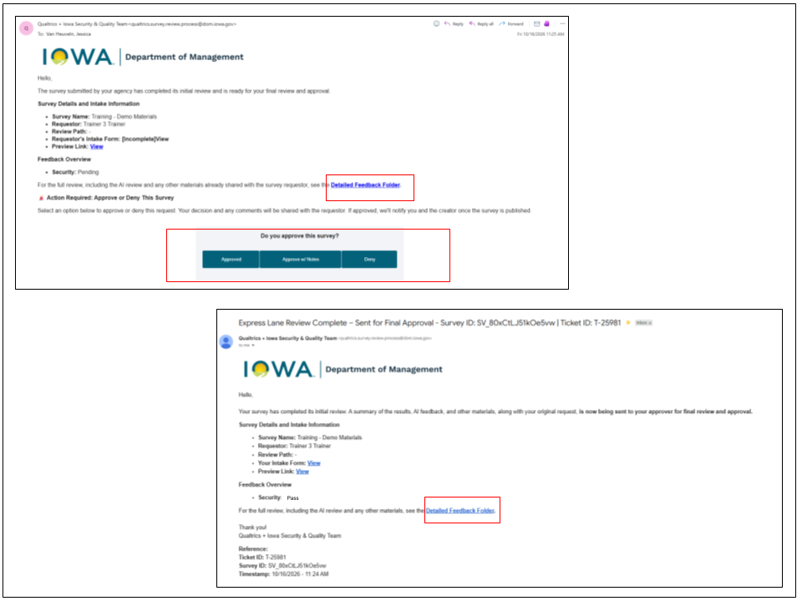
Approve/Deny
Status: Approver
🔗What to Expect from the Survey Publication Workflow and Guide to Publish
Step 5: Your Approver Reviews and Decides
Your approver sees everything you did — survey name, review path, your Choose Your Path answers, AI review results, any personalized video, full feedback, and a preview link.
The preview link lets them walk through the survey itself (including mobile view), with an Ignore Validation option to skim required fields quickly
They choose Approve, Approve with notes, or Deny
Notes:
Feedback will also to the approver.

Slide 27
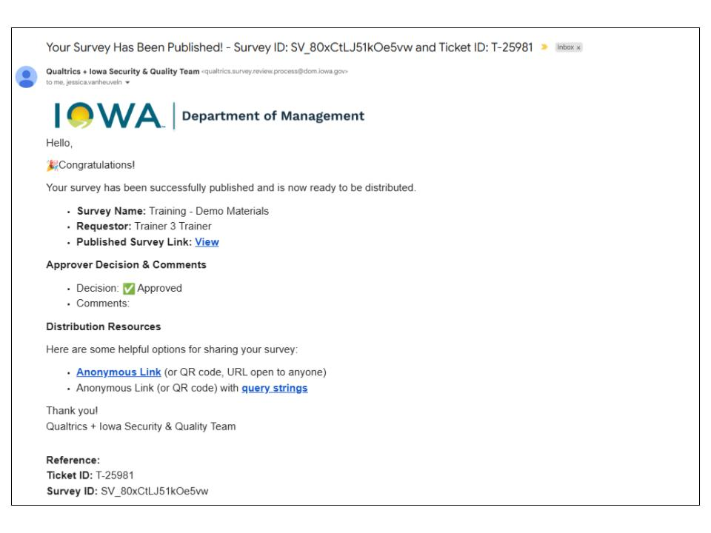
Finalize and Distribute
Status: Closed
🔗What to Expect from the Survey Publication Workflow and Guide to Publish
Step 6: You’re Notified Either Way
Approved: you and your approver both get a confirmation email, plus your distribution links (anonymous link, and anonymous link with query strings)
Denied: you get an email explaining why

Slide 28
Three Statuses You Might See
Status: Testing, Denied, or Republish
🔗What to Expect from the Survey Publication Workflow and Guide to Publish
Denied — your agency approver didn’t sign off. Revise and resubmit when ready.
Republish — your last request is already being processed by the Quality & Security Team.
Testing — the preview window covers most surveys, but a handful of complex projects need a published version to test properly.

Slide 29
Collaboration
Status: Closed
🔗How Do I Locate my Survey ID?, Working Together on Surveys in Qualtrics, and Guide to Publish
Sharing the survey with someone new now goes through a ServiceDesk Plus request
Notes:
Side rail afer you go live --

Slide 30
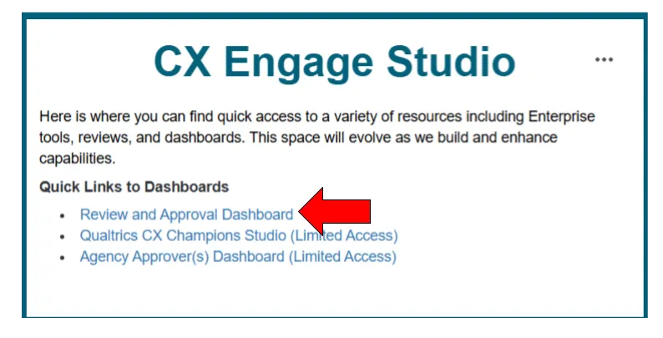
Track Your Survey’s Status Anytime
🔗 CX Studios and Review and Approval Dashboards and Guide to Publish
Review and Approval Dashboard — see surveys currently in review, their status, and what’s left to do
Agency Approvers Dashboard — built for your agency’s approvers, showing what’s waiting on their review
❗ Demonstration
Notes:
Resource

Slide 31
New Republishing Steps
Previewed today — live November 4, 2026
Notes:
IMPORTANT: this process is not live yet. Frame this clearly as a preview of what's coming, not a demo of something you can do today.

Slide 32
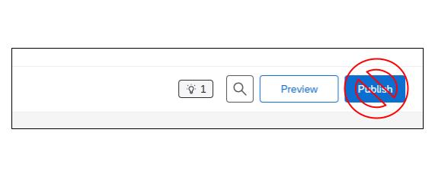
Don’t Use the Publish Button
🔗Guide to Republish
In the Survey Editor, there’s a Publish button in the top right corner. Do not use it to republish.
That button is only for publishing a survey for the first time.
If you use it to request a republish, we won’t accept it.

Slide 33
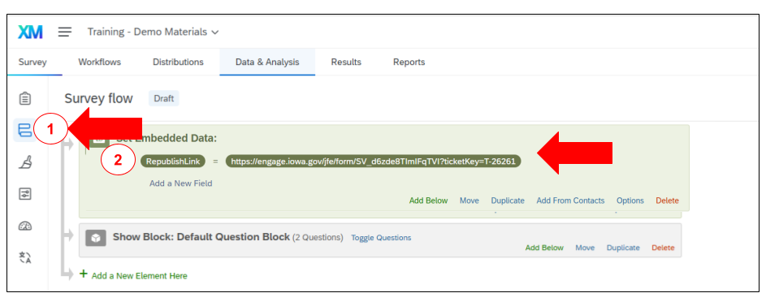
Finding Your Republish Link
🔗Guide to Republish
Open your survey and click Survey Flow on the left side.
Look for a field called RepublishLink. Don’t delete it.
Copy the link next to it.
Open that link in a new tab.
Republish Link is unique per survey
❗ Important Notes:
You may be prompted to sign in with SSO (Okta). This is Qualtrics’ Survey Authentication feature, which confirms the identity of who’s requesting the republish. If you can’t get in: submit a Qualtrics Request in ServiceDesk Plus for help.
This Republish Link is tied to this specific survey. Please do not use a link from a different survey and request republishing. Each survey has its own unique republish link.
Notes:
You will see this already in place
This Republish Link is tied to this specific survey. Please do not use a link from a different survey and request republishing. Each survey has its own unique republish link.

Slide 34
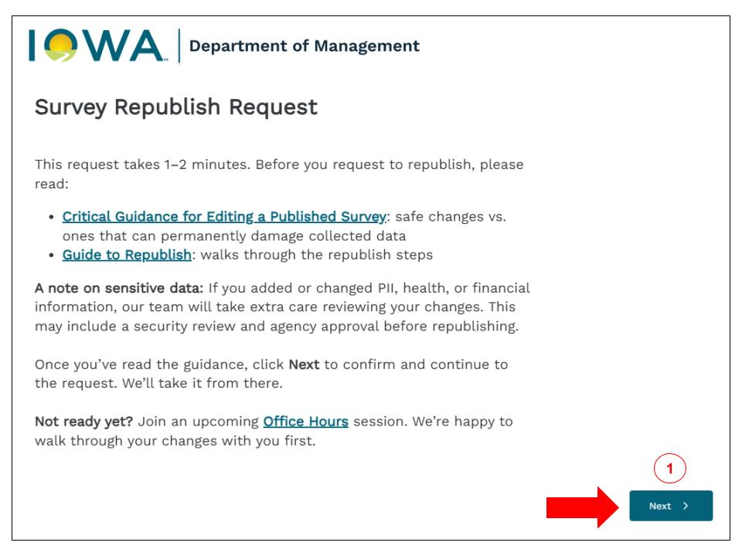
Read the intro screen
🔗Guide to Republish
You’ll see a short welcome screen. It links to two things worth reading first: the Critical Guidance for Editing a Published Survey page and this guide. Click Next when you’re ready.

Slide 35
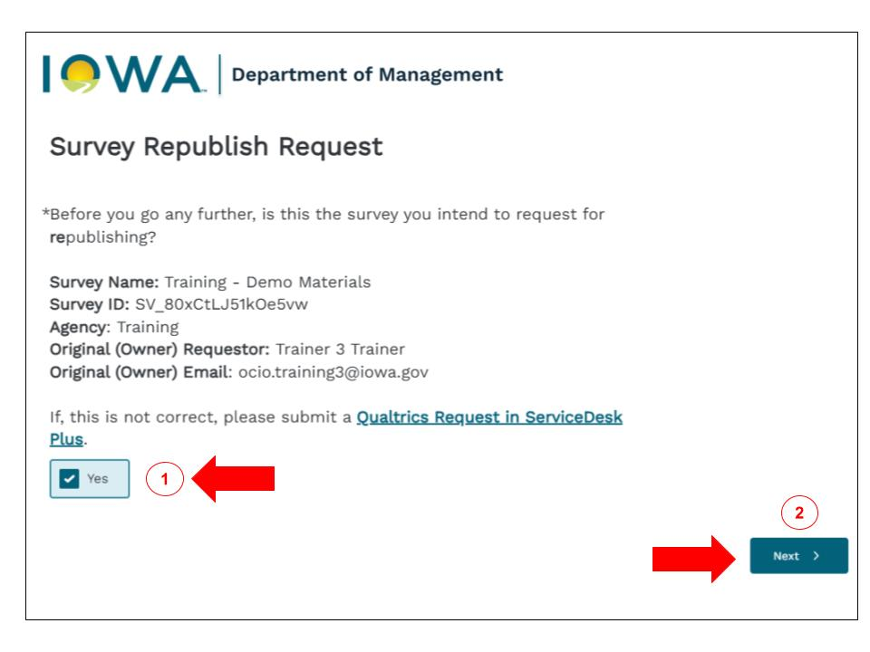
Confirm it’s the right survey
🔗Guide to Republish
You’ll see your survey’s name, ID, and agency. Check it’s correct, select Yes, then click Next.

Slide 36
If You Can’t Republish Yet
🔗Guide to Republish
If your status is... | What it means | What to do
Quality & Security | Your survey is going through internal review, accessibility, theming, methodology, and security checks. | Submit a Qualtrics SD+ Request if you need your status changed to Testing
Approved - Pending Publish | Something didn’t complete properly after approval. This is a technical issue and should be rare. | Submit a Qualtrics SD+ Request
Republish | Your last republish request is already being processed. | Wait for your confirmation email. If it’s been a while, submit a Qualtrics SD+ Request
Denied | Your survey was not approved by your agency approver. | Submit a Qualtrics SD+ Request

Slide 37
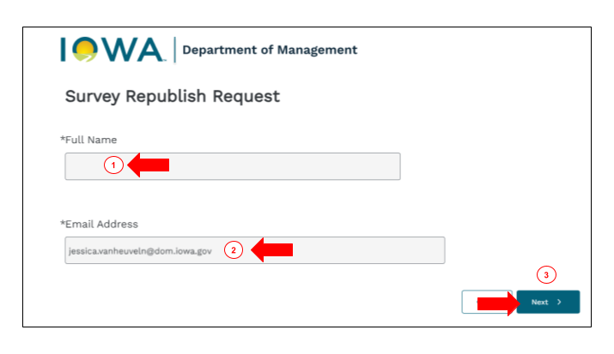
Verify your name and email
🔗Guide to Republish
Verify your full name and email address.
Then click Next.
Notes:
Okta Creditianls don't match, you won't be to go through

Slide 38
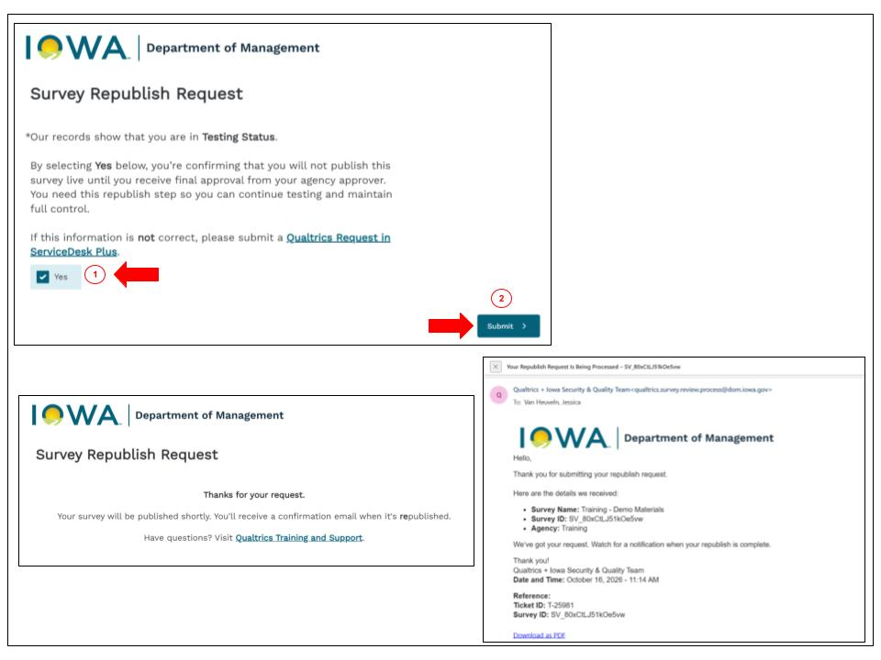
Answer ONE Question.
Status: Testing
🔗Guide to Republish
If you’re in Testing status, you’ll see one quick question confirming you understand your survey won’t go fully live until your agency approves it. Select Yes and hit Submit. You’re done.

Slide 39
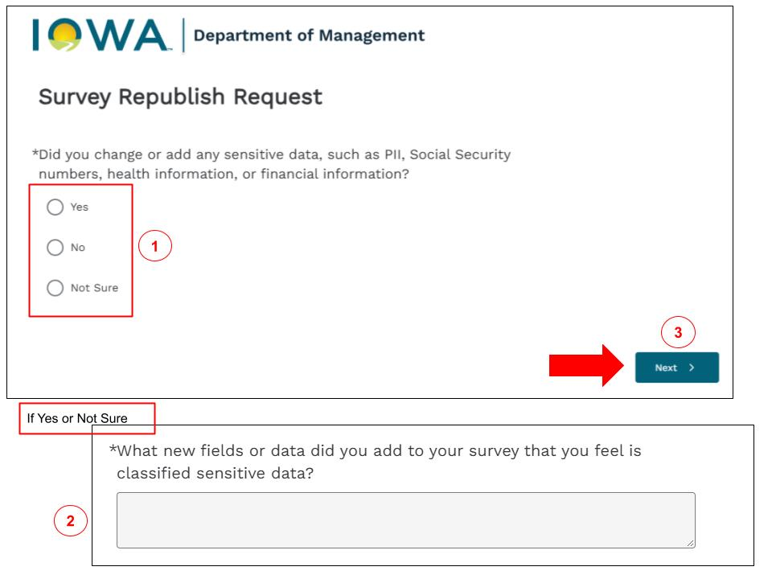
Answer a few questions. – Sensitive Data
Status: Closed
🔗Guide to Republish
Did you add or change any sensitive data? Think: Social Security numbers, health info, financial info.
Choose Yes, No, or Not Sure.
If you pick Yes or Not Sure, tell us exactly what you added.

Slide 40
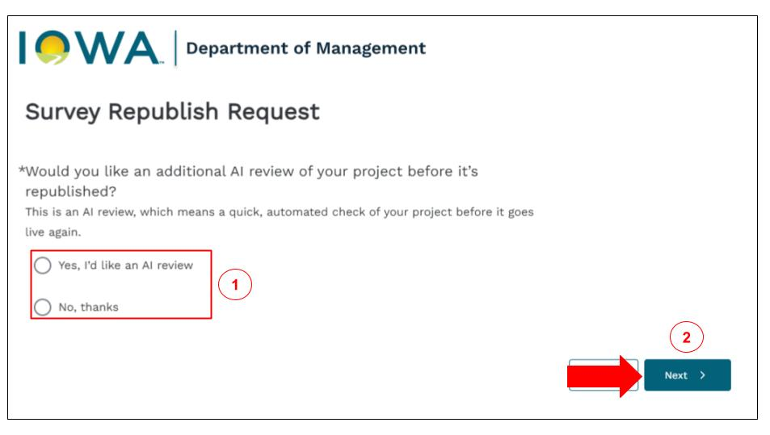
Answer a few questions – AI Review
Status: Closed
🔗Guide to Republish
Want an AI review before you republish? This is a quick automated check of your survey.
Choosing this adds a little time, since we wait on the AI review first.
If you don’t need it, pick No, thanks.

Slide 41
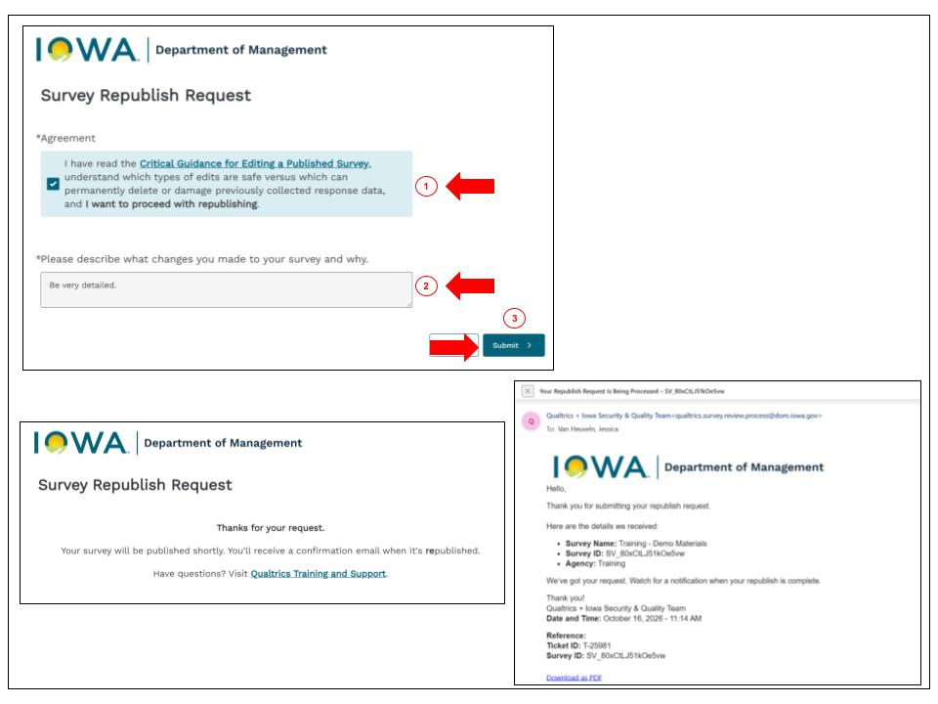
Answer a few questions – Read Critical Guidance
Status: Closed
🔗Guide to Republish
Confirm you’ve read the Critical Guidance and describe your changes.
Check the box confirming you understand which edits are safe and which can damage your collected data.
In the text box, describe what you changed and why. Be specific. For example, “I removed Question 4, a multiple-choice question” tells us a lot more than “I made some edits.”
Click Submit.
Notes:
Support model – The fire is for you... not for us...

Slide 42
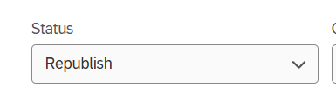
Processing the Request
Status: Republish
🔗Guide to Republish
Once submitted, your request moves into Republish status for processing.
Notes:
Stauts is not only for you but for us...

Slide 43
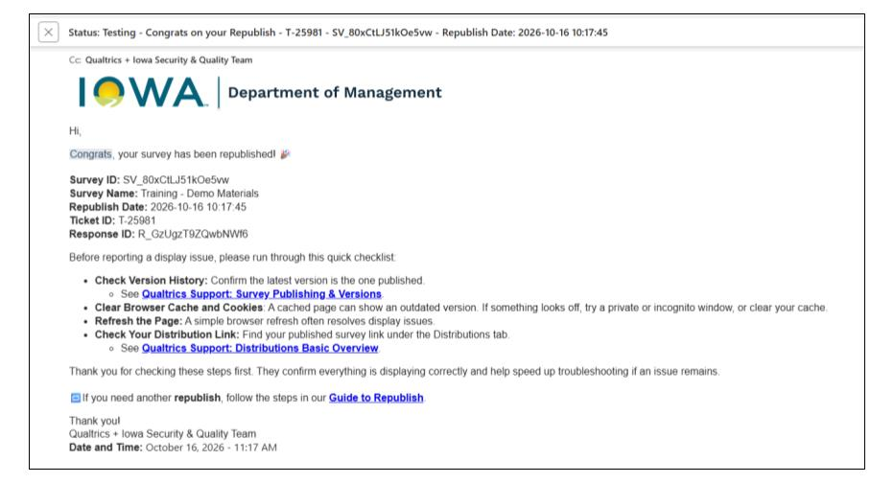
What Happens Once You’re Live Again
Status: Testing or Closed
🔗Guide to Republish
Once your survey is republished, you’ll get a congrats email with the exact date and time it went live
Your survey then returns to its previous status
  For example, back to Testing if that’s where it started
Notes:
Owner - permission

Slide 44
Sensitive Data Policy
Why, What, Discover, and Report
Notes:
Land this clearly — sensitive data questions come up constantly on the help desk.
Senstive Data policy does not mean it is classifed as protected data it is a tool wihout qualtrics.

Slide 45
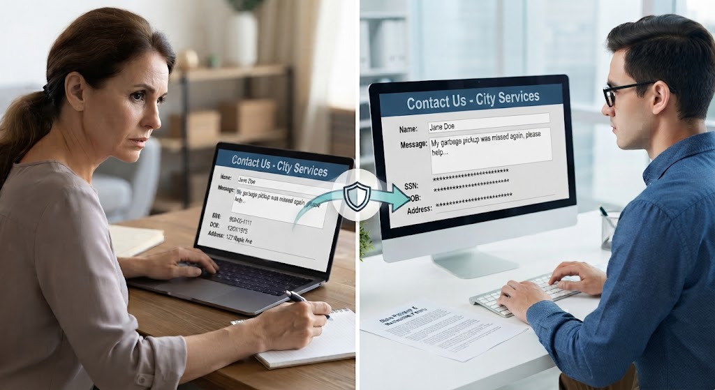
Why This Policy Exists
🔗Guide to Reporting Unidentified or Missed Sensitive Data
Notes:
Picture a constituent filling out a simple Contact Us form. It only asks for a name and a message, but they want to make sure their issue gets taken seriously. So they add their Social Security number, their date of birth, maybe their home address, anything they think will help their case.
None of that was asked for. None of it needs to sit in a survey response.
This is exactly the moment the policy is built for. The response gets flagged, the sensitive data gets redacted, and that constituent’s information stays protected, even when they didn’t think to protect it themselves.

Slide 46
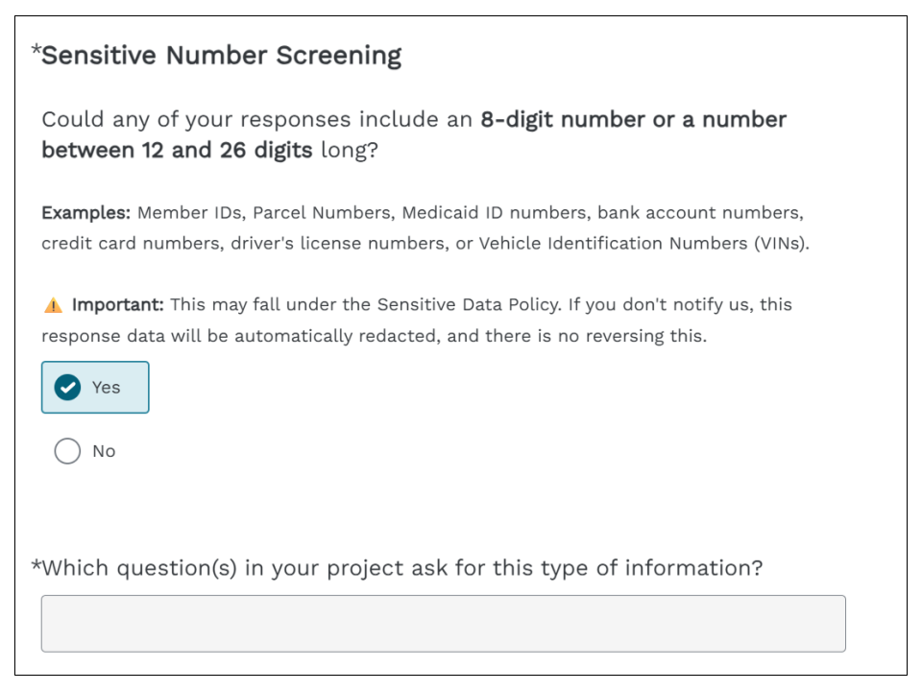
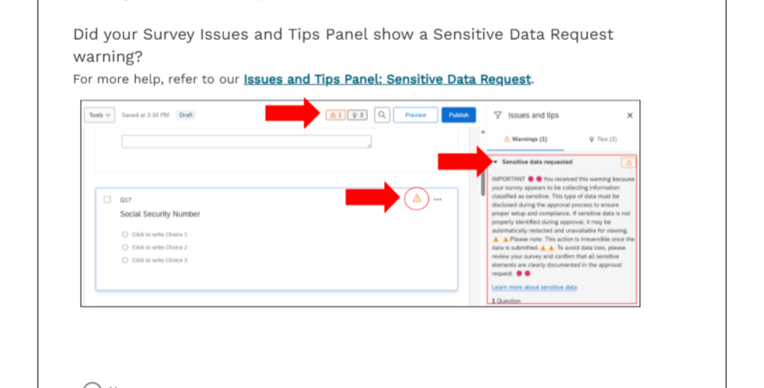
What Is the Sensitive Data Policy?
🔗Guide to Reporting Unidentified or Missed Sensitive Data
The Sensitive Data Policy is a built-in Qualtrics check for certain kinds of personal information, like Social Security numbers and Tax IDs
That’s why the Choose Your Path form asks about things like 8-digit or 12-to-26-digit numbers, and why the Issues and Tips panel warns you when a question gets flagged
Notes:
That’s why the Choose Your Path form asks about things like 8-digit or 12-to-26-digit numbers, and why the Issues and Tips panel warns you when a question gets flagged
The goal is to catch as much as possible before a survey goes live, so the after-the-fact reporting in this guide is the exception, not the rule

Slide 47
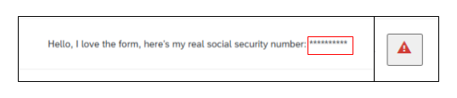
Important Note
🔗Guide to Reporting Unidentified or Missed Sensitive Data
Once a redaction happens, it can't be undone. If you spot a risk, report it right away - the sooner we know, the sooner we can stop it before anything gets redacted.
Notes:
That’s why the Choose Your Path form asks about things like 8-digit or 12-to-26-digit numbers, and why the Issues and Tips panel warns you when a question gets flagged
The goal is to catch as much as possible before a survey goes live, so the after-the-fact reporting in this guide is the exception, not the rule

Slide 48
If You Find It First
🔗Guide to Reporting Unidentified or Missed Sensitive Data
If you find red triangles like the ones in the screenshot above while reviewing your data analysis, and it hasn't already been added to the exception list:
Open a ServiceDesk Plus request to report it.
Our team reviews your report and schedules a short meeting with you to discuss next steps and outline an action plan.

Slide 49
If We Find It First
🔗Guide to Reporting Unidentified or Missed Sensitive Data
From time to time, our team runs a data steward audit across live surveys. If that audit flags sensitive data in your survey that hasn't been exempted:
You'll get an email letting you know what was found and that it's been added to the exception list for now.
Any new responses that fall into this category are no longer redacted while the exception is in place.
You'll receive an invite to a short meeting (typically 15 minutes) with the Qualtrics team to go over what was found and agree on next steps.
Either way, you're covered. The exception list keeps things moving while we sort it out, and the follow-up meeting is just a conversation to figure out next steps, not a penalty.

Slide 50
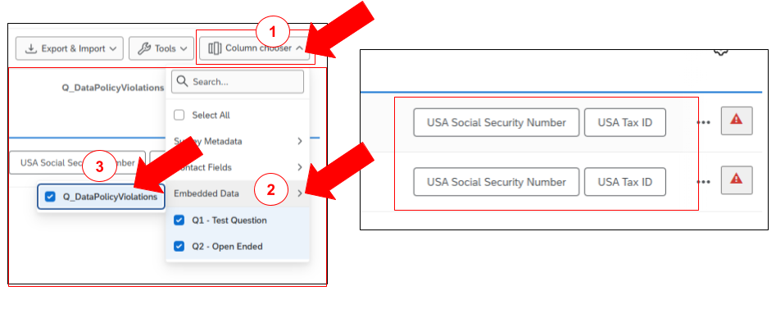
Want to Learn More?
Locating Sensitive Data Policy Violations
🔗Guide to Reporting Unidentified or Missed Sensitive Data
In the Data & Analysis tab, click Column chooser.
In the dropdown, go to Embedded Data.
Check the box next to Q_DataPolicyViolations.

Slide 51
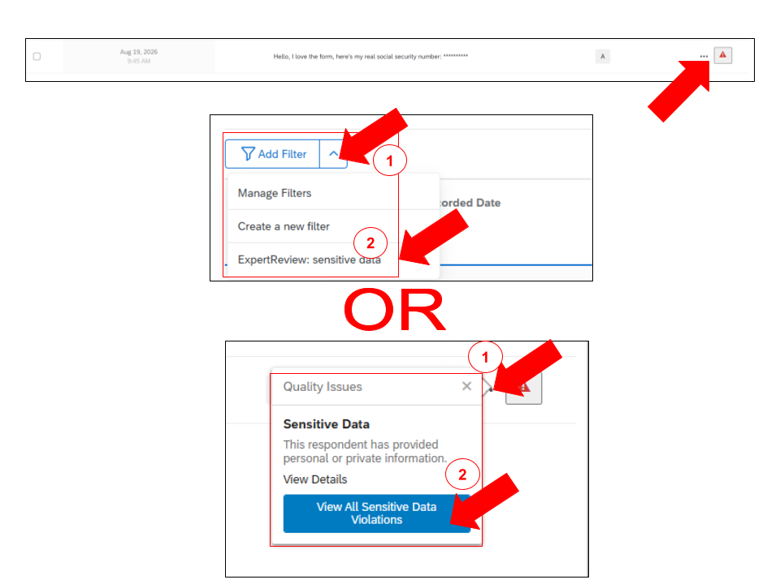
Want to Learn More?
Filtering Data Policy Violations
🔗Guide to Reporting Unidentified or Missed Sensitive Data
Option 1: Filter by sensitive data
  Click the Add Filter dropdown.
  Select ExpertReview: sensitive data from the list.
Option 2: Click the red triangle directly
  Click the red warning triangle icon next to a flagged response.
In the Quality Issues popup, under Sensitive Data, click View All Sensitive Data Violations to see every flagged response at once.

Slide 52
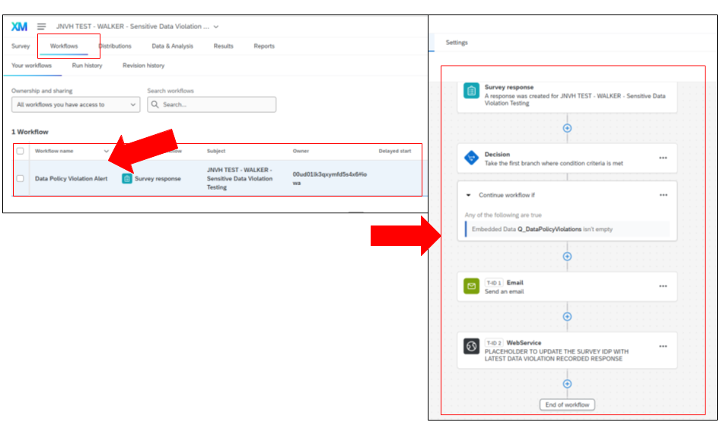
An Alert System Is on the Way
Filtering Data Policy Violations
🔗Guide to Reporting Unidentified or Missed Sensitive Data
Still in scoping and building. A new workflow is coming that will alert you directly when red triangles show up, so you don’t have to catch them manually.

Slide 53
Best Practices & Common Mishaps
Small habits that prevent big headaches
Notes:
Show them how to do Survey ID

Slide 54
Top and New Guides
A single location for essential Qualtrics guides and helpful user information.
Notes:
Give people a moment to actually write these down or screenshot this slide before questions.

Slide 55
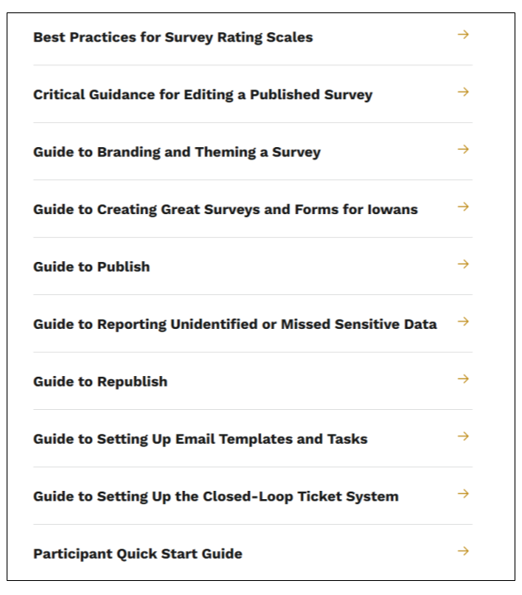
Qualtrics Guides and Best Practices
🔗Qualtrics Guides and Best Practices
A single location for essential Qualtrics guides and helpful user information.
  Qualtrics Guides and Best Practices

Slide 56
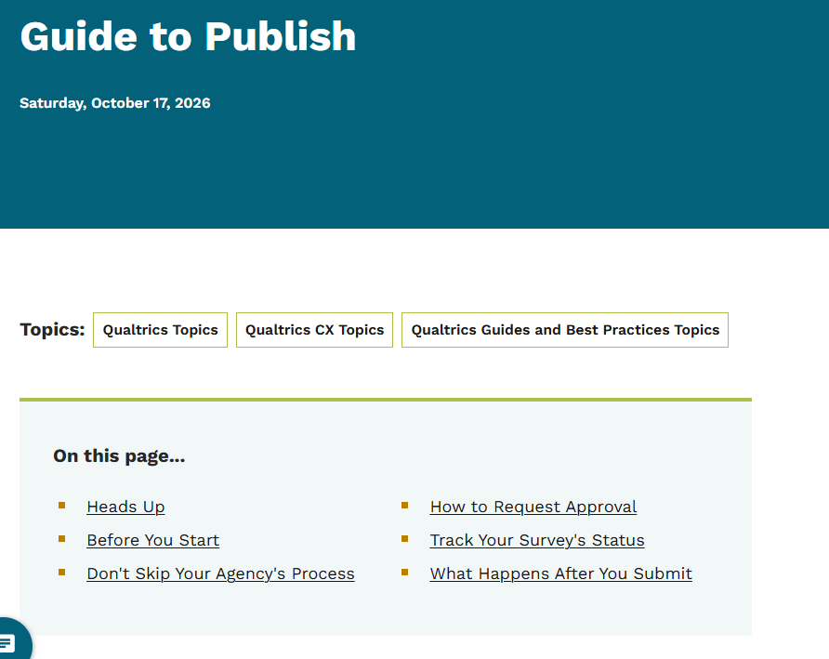
To Publish
🔗Qualtrics Guides and Best Practices
Step-by-step walkthrough of the review and approval workflow, from clicking Publish through the Choose Your Path form, AI/team review, approver decision, and final notification.
  Guide to Publish

Slide 57
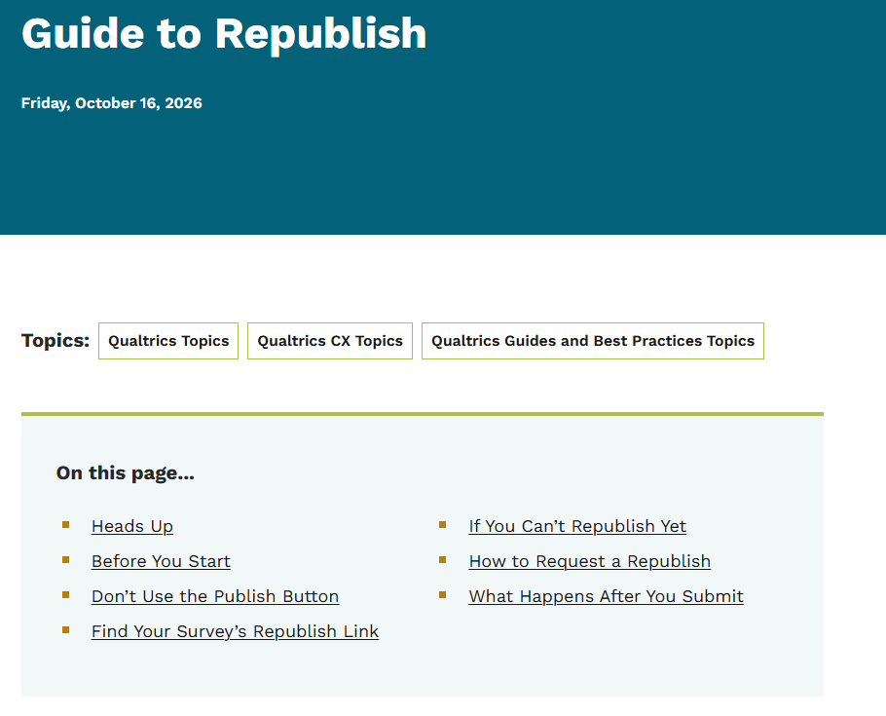
To Republish
🔗Qualtrics Guides and Best Practices
New process for requesting changes to an already-published survey via the survey’s unique Republish Link — not the Publish button — with status checks, a sensitive-data question, an optional AI review, and a required description of changes.
  Guide to Republish
Notes:
(live Nov 4, 2026, 8:00 a.m.)

Slide 58
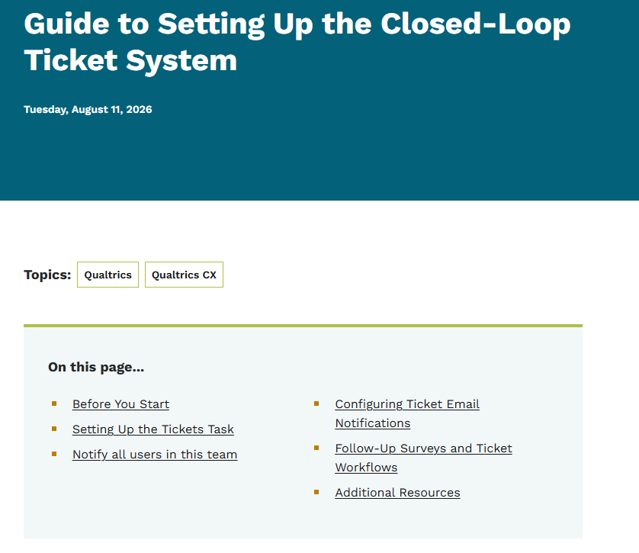
Setting Up the Closed-Loop Ticket System
🔗Qualtrics Guides and Best Practices
This guide walks agency staff through setting up the Tickets Task for the first time, covering key fields, naming conventions, and email notifications.
  Guide to Setting Up the Closed-Loop Ticket System

Slide 59
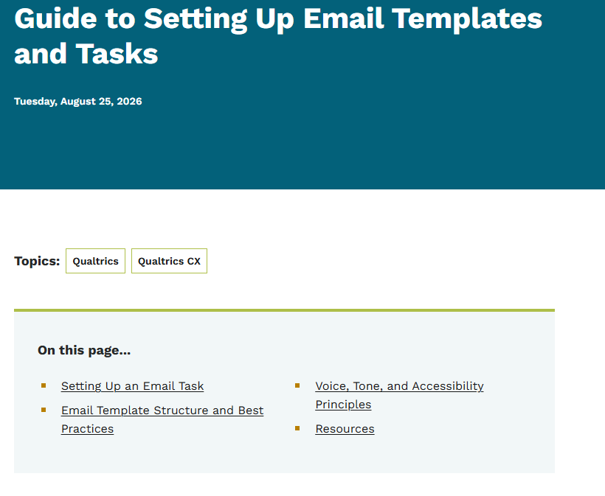
Setting Up Email Templates and Tasks
🔗Qualtrics Guides and Best Practices
This guide covers how to write clear, accessible email templates and how to set up an Email Task in a workflow.
  Guide to Setting Up Email Templates and Tasks

Slide 60
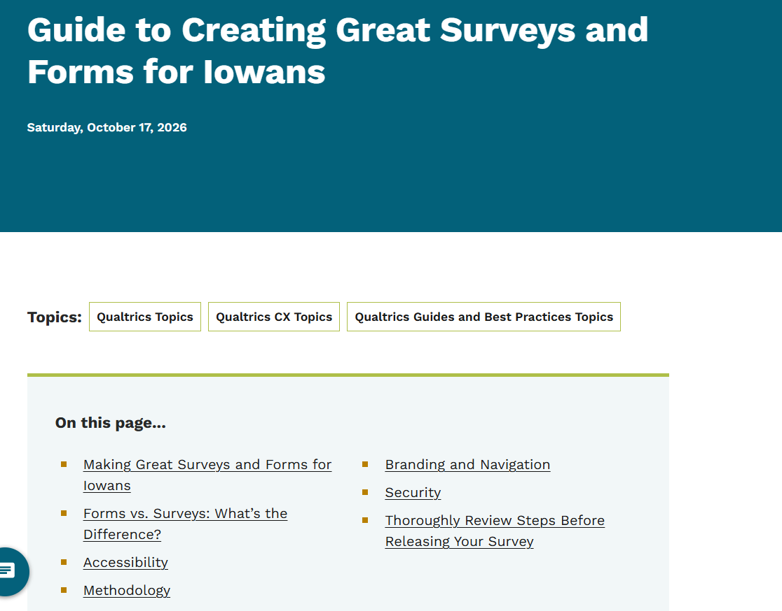
Guide to Creating Great Surveys and Forms for Iowans
🔗Qualtrics Guides and Best Practices
Core build guide covering accessibility, methodology, branding/navigation, and security best practices (help text size, end-of-survey messaging, hyperlink settings, button wording) — plus the Sensitive Number Screening and Protected Data Categories details that feed the review intake form.
Guide to Creating Great Surveys and Forms for Iowans
Notes:
(live Nov 4, 2026, 8:00 a.m.)

Slide 61
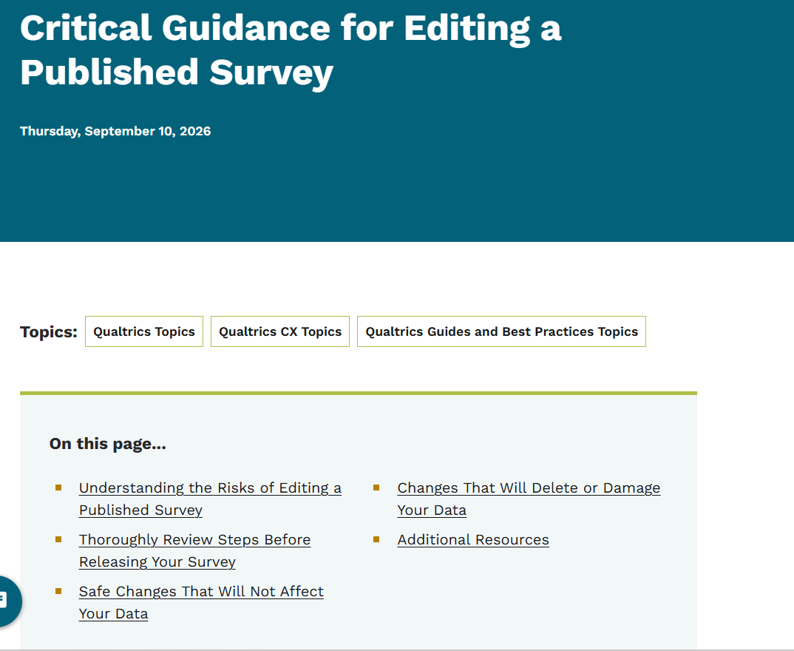
Critical Guidance for Editing a Published Survey
🔗Qualtrics Guides and Best Practices
Explains which edits are safe to make on a live survey (text fixes, adding questions, hide/unhide, reordering) versus which ones delete or damage already-collected data (changing question type, deleting questions/choices, modifying validation, copy-pasting answer choices) — essential reading before using the new republish process.
  Critical Guidance for Editing a Published Survey
Notes:
(live Nov 4, 2026, 8:00 a.m.)

Slide 62
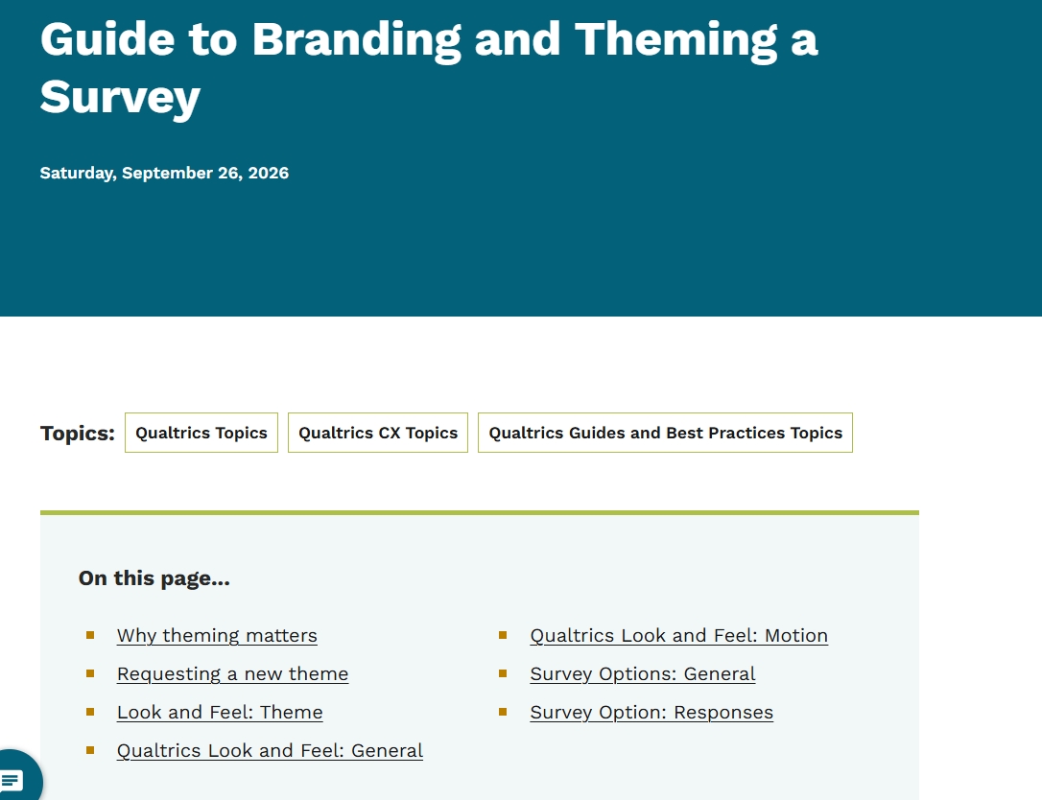
Branding and Theming a Survey
🔗Qualtrics Guides and Best Practices
Recommended Look and Feel and Survey Options settings for state-branded surveys — correct theme, Next/Back button text, progress bar placement, Heading 1 survey title, back button on, question numbers off, Expert Review on — plus how to request a new theme through your agency’s Theme Approver.
  Guide to Branding and Theming a Survey
Notes:
(live Nov 4, 2026, 8:00 a.m.)

Slide 63
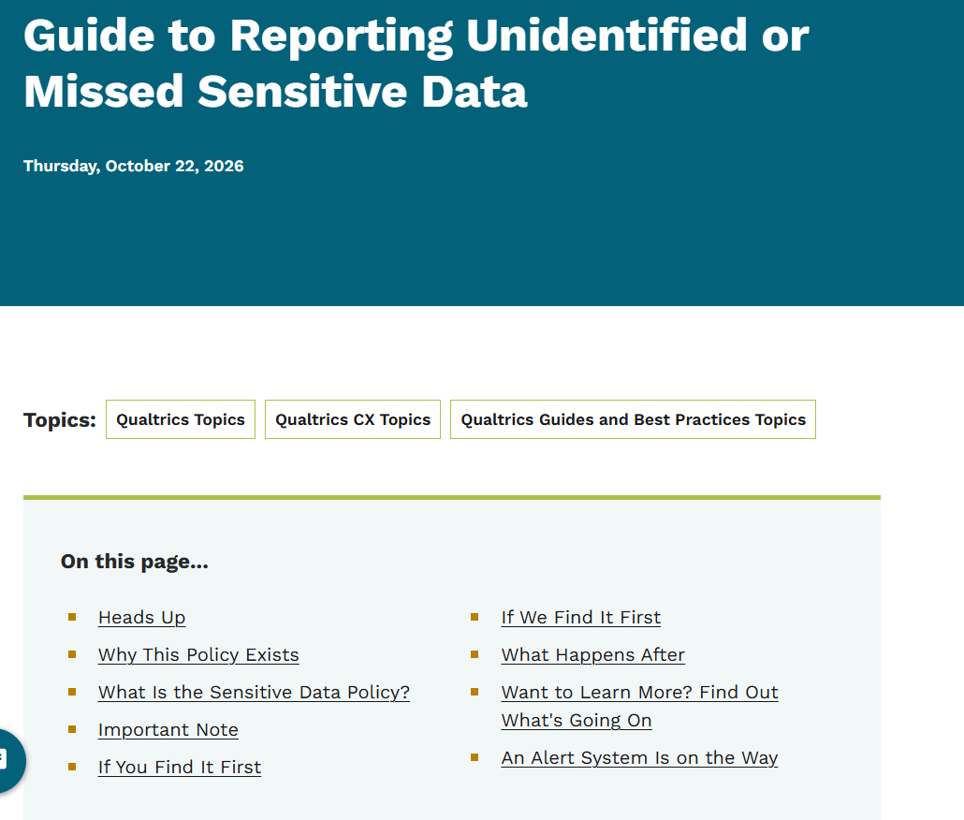
Reporting Unidentified or Missed Sensitive Data
🔗Qualtrics Guides and Best Practices
What to do when sensitive data slips past review — report it yourself via ServiceDesk Plus or get notified if the team’s audit catches it first, either way you get an exception-list grace period and a short follow-up meeting, plus how to locate flagged responses using the Q_DataPolicyViolations column; notes a redaction alert system is in scoping, not live yet.
  Guide to Reporting Unidentified or Missed Sensitive Data
Notes:
(live Nov 4, 2026, 8:00 a.m.)

Slide 64
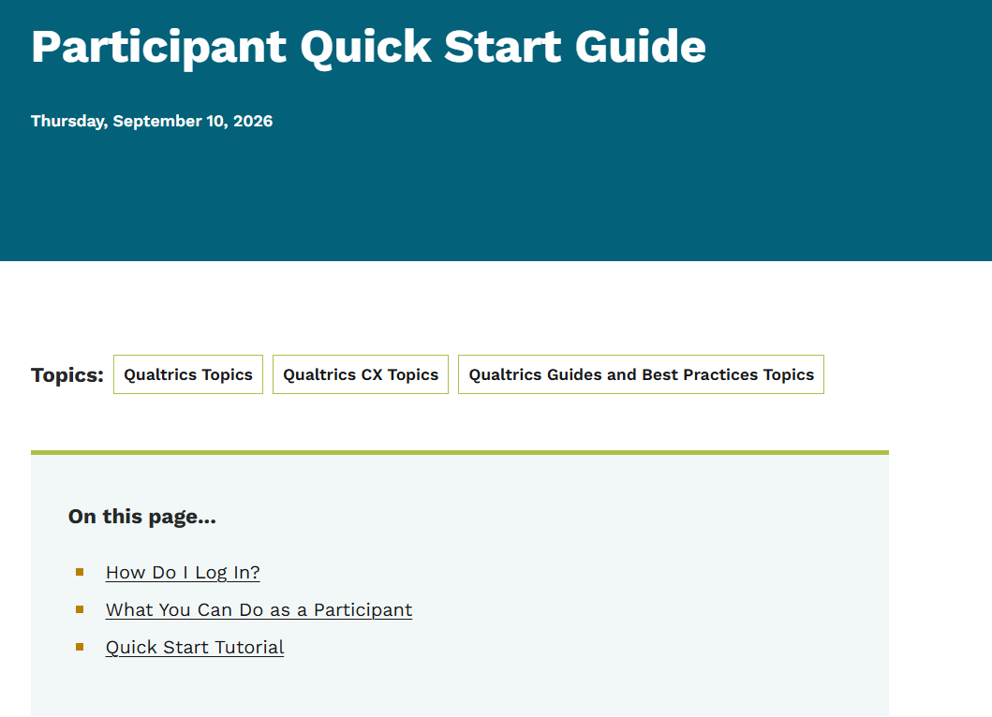
Participant Quick Start Guide
🔗Qualtrics Guides and Best Practices
Covers what the Participant user type can do in Qualtrics CX — view ticket-related survey data, view CX dashboards, and process tickets — plus a link to log-in instructions and a short tutorial video.
  Participant Quick Start Guide
Notes:
(live Nov 4, 2026, 8:00 a.m.)

Slide 65
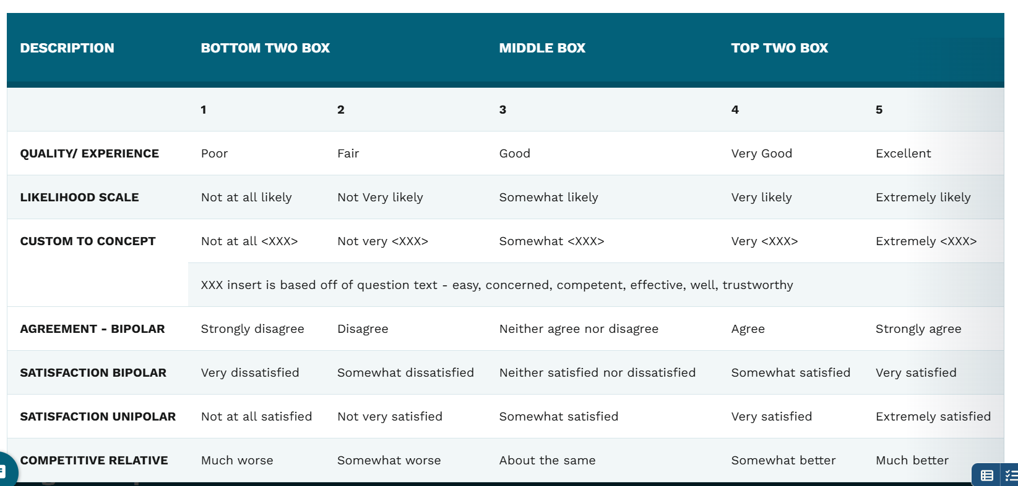
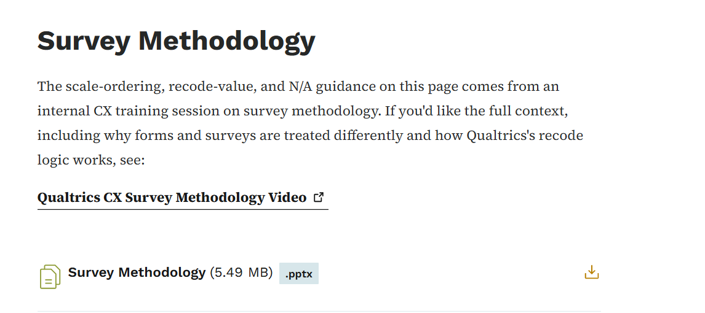
Best Practices for Survey Rating Scales
🔗Qualtrics Guides and Best Practices
Guidance for 5-point labeled scales — use text labels over numbers, an odd number of points for a true neutral midpoint, display negative-to-positive so Recode Values and Top Two Box scoring stay accurate, and place any Don’t Know/N/A option last and excluded from analysis.
  Best Practices for Survey Rating Scales
Notes:
(live Nov 4, 2026, 8:00 a.m.)

Slide 66
Support Options
Many opportunities to learn and connect
Notes:
Give people a moment to actually write these down or screenshot this slide before questions.

Slide 67
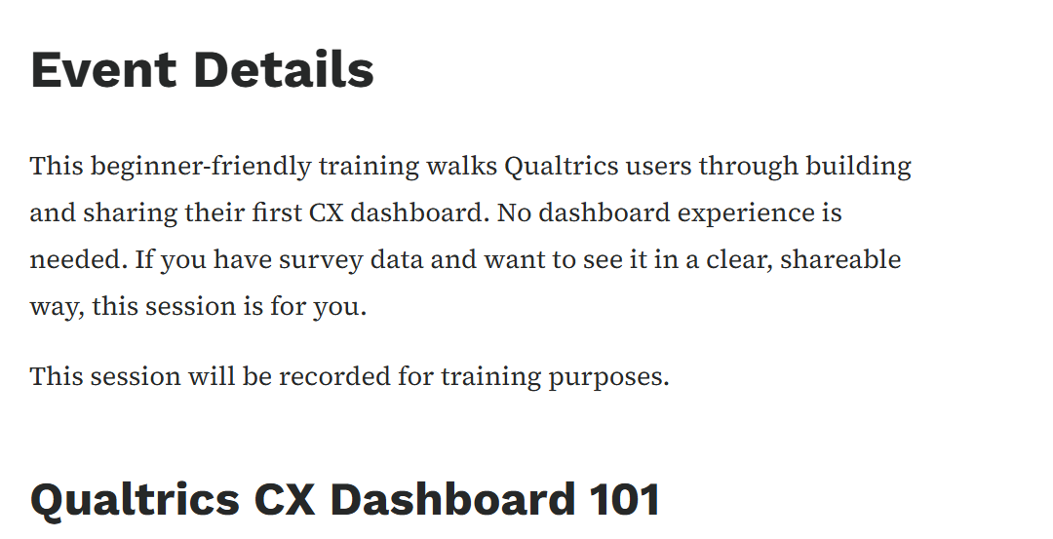
Qualtrics CX Dashboard 101 Training
🔗Qualtrics Office Hours and Training Classes
This beginner-friendly training will cover:
  Navigating the dashboard builder interface
  Core dashboard tools and widget types
  Connecting your survey data to a dashboard
  Customizing and organizing pages and widgets
  Sharing a dashboard and managing who can view it
Day: Thursday, November 12, 2026
Time: 1:00 p.m. to 3:00 p.m.
  Qualtrics CX Dashboard 101 Training
Notes:
November 12

Slide 68
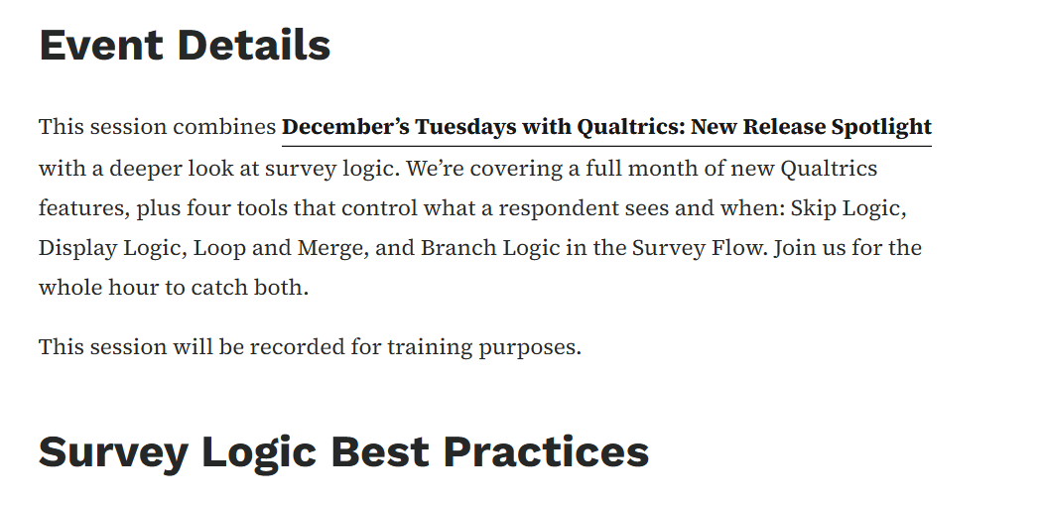
Loop and Merge, Display Logic, Block Branching, and Skip Logic Best Practices
🔗Qualtrics Office Hours and Training Classes
Survey Logic Best Practices
This training will cover:
Skip Logic: Jumping a participant past questions that no longer apply, based on an earlier answer
Display Logic: Showing or hiding a question, page, or specific answer choices based on conditions you set
Loop and Merge: Repeating a block multiple times for the same respondent, often paired with Display Logic to control what shows in each pass
Branch Logic: Sending a respondent down a different path through entire blocks in the Survey Flow, not just individual questions
Day: Tuesday, December 8, 2026
Time: 10:00 a.m. to 11:00 a.m.
  Loop and Merge, Display Logic, Block Branching, and Skip Logic Best Practices
Notes:
Decemb er 8t

Slide 69
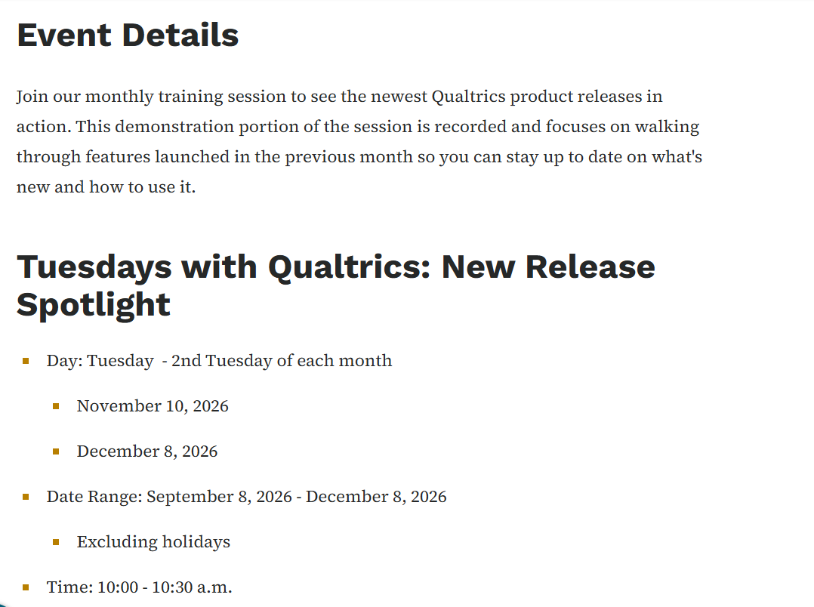
Tuesdays with Qualtrics: New Release Spotlight
🔗Qualtrics Office Hours and Training Classes
Join our monthly training session to see the newest Qualtrics product releases in action. This demonstration portion of the session is recorded and focuses on walking through features launched in the previous month so you can stay up to date on what's new and how to use it.
  Tuesdays with Qualtrics: New Release Spotlight
Notes:
2nd Tuesday of the month

Slide 70
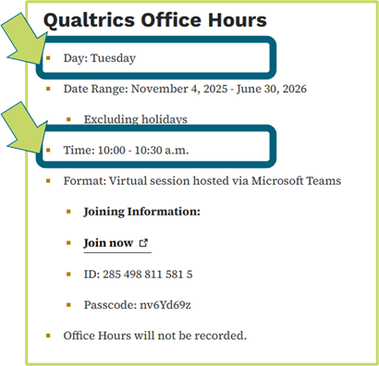

Bi-Weekly Office Hours
🔗Qualtrics Office Hours and Training Classes
Join us Tuesday and Thursday
Notes:
Friends...
Safe place
New

Slide 71

Qualtrics CX Support and Strategy - Expert 1:1 Session
🔗Qualtrics Training and Support
Book a dedicated 30-minute session with the Qualtrics CX team to receive tailored support.
  Qualtrics CX Support and Strategy - Expert 1:1 Session
Notes:
(live Nov 4, 2026, 8:00 a.m.)

Slide 72



Self Paced
🔗Qualtrics Training and Support
On-Demand
Access recorded training on a variety of Qualtrics topics - anytime, anywhere, at your own pace.
Learn More
Basecamp
Browse a wide range of easy-to-follow courses that help you build skills in survey design, data analysis, and experience management.
Learn More
Get Started with Surveys
Qualtrics has great support - search online with Qualtrics + your topic or explore all the links on this page for a more focused, step-by-step guide.
Learn More
Notes:
(live Nov 4, 2026, 8:00 a.m.)

Slide 73
Stay Connected
Bi-Monthly Bulletins

Slide 74

Qualtrics Bulletins
🔗Qualtrics Bulletins
Stay connected with the latest Qualtrics updates, announcements, and helpful info.
Subscribe to the DOMDoIT_Qualtrics topic via the subscription page or read the important updates below.
  Qualtrics Bulletins
❗ Note: All newly enrolled users, except Participants, are automatically subscribed to the GovDelivery topic to stay informed on Qualtrics CX updates.
Notes:
(live Nov 4, 2026, 8:00 a.m.)

Slide 75
Need Access and Support
Need help? Open an SD+ request and we’ll take it from there.

Slide 76

Know Your Survey ID, Because We're Going to Ask
🔗How Do I Locate my Survey ID?
A Survey ID is a unique code assigned to each survey in Qualtrics. It helps you:
  Search for surveys within the platform
  Easier to receive faster support from Qualtrics or DOM DoIT for troubleshooting or training
You can find the Survey ID in several places, including the URL when viewing or editing a survey. It always begins with SV_.
This guide will show you how to locate the Survey ID in different views so you can easily reference it when needed.
  How Do I Locate my Survey ID?
Notes:
(live Nov 4, 2026, 8:00 a.m.)

Slide 77

Submit a Qualtrics Request
🔗Qualtrics Bulletins
Notes:
(live Nov 4, 2026, 8:00 a.m.)

Slide 78
Open Forum: Your Questions & Insights

