Slide 1
Sharean Morishita
Web Content Architect
Division of Information Technology
Updated 07/11/25

Slide 2
Intro to DX for Content Managers
How to Access & Navigate the DX Platform

Slide 3
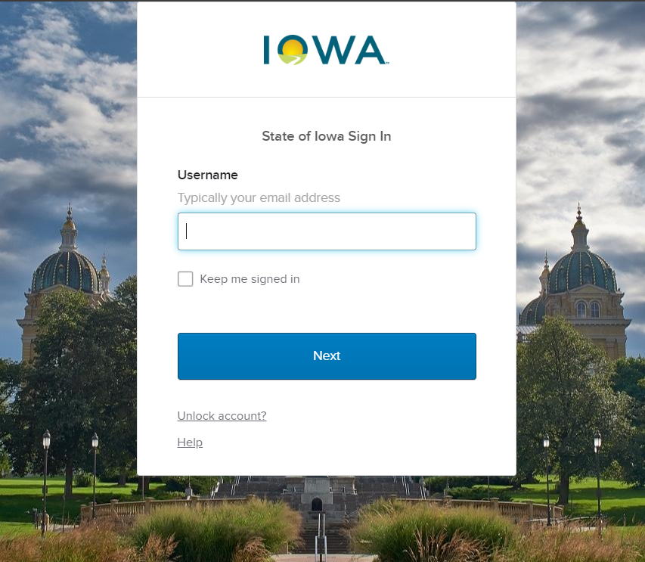
Accessing Your DX Site
There are two ways to get access to your DX website:
Login using OTKA at login.iowa.gov
Or
Add “/user” at the end of your website url
EX: dps.iowa.gov/user

Slide 4
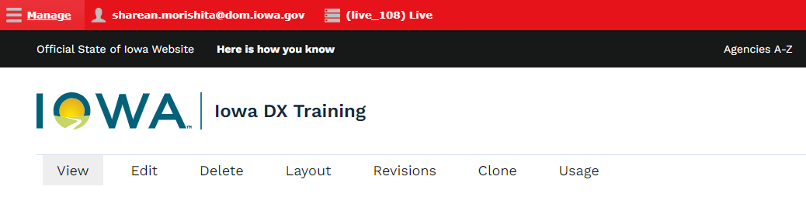
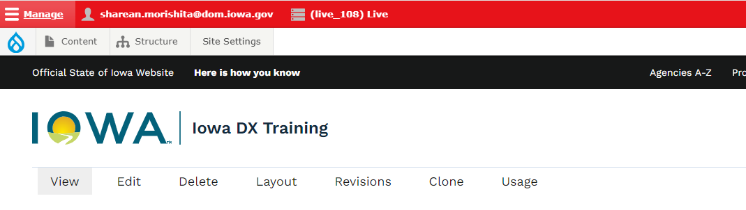
Navigating Your DX Site
If you see the red banner bar but don’t see the content toolbar you can select the 3 horizontal lines next to the word “Manage” and that will make the toolbar appear.

Slide 5
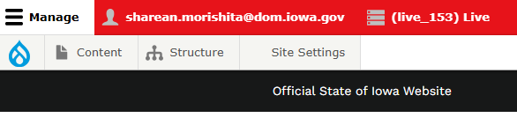
How to View the Front Page of Your Site
When you are logged into your site you can quickly navigate back to the front page of your site by selecting the little blue teardrop icon in the upper left corner.

Slide 6
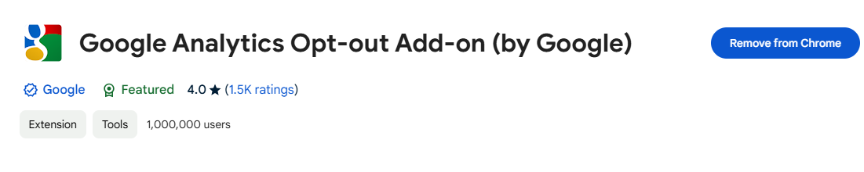
How to Keep internal Traffic Separate
When you are logged into your site you can quickly navigate back to the front page of your site by selecting the little blue teardrop icon in the upper left corner. It’s also important to remember to have the google analytics Opt-out Add-on extension added to your chrome browser so your internal traffic isn’t tracked within the traffic report

Slide 7
How to Submit a Ticket Support Request
Bug Report or ServiceDesk Plus

Slide 8
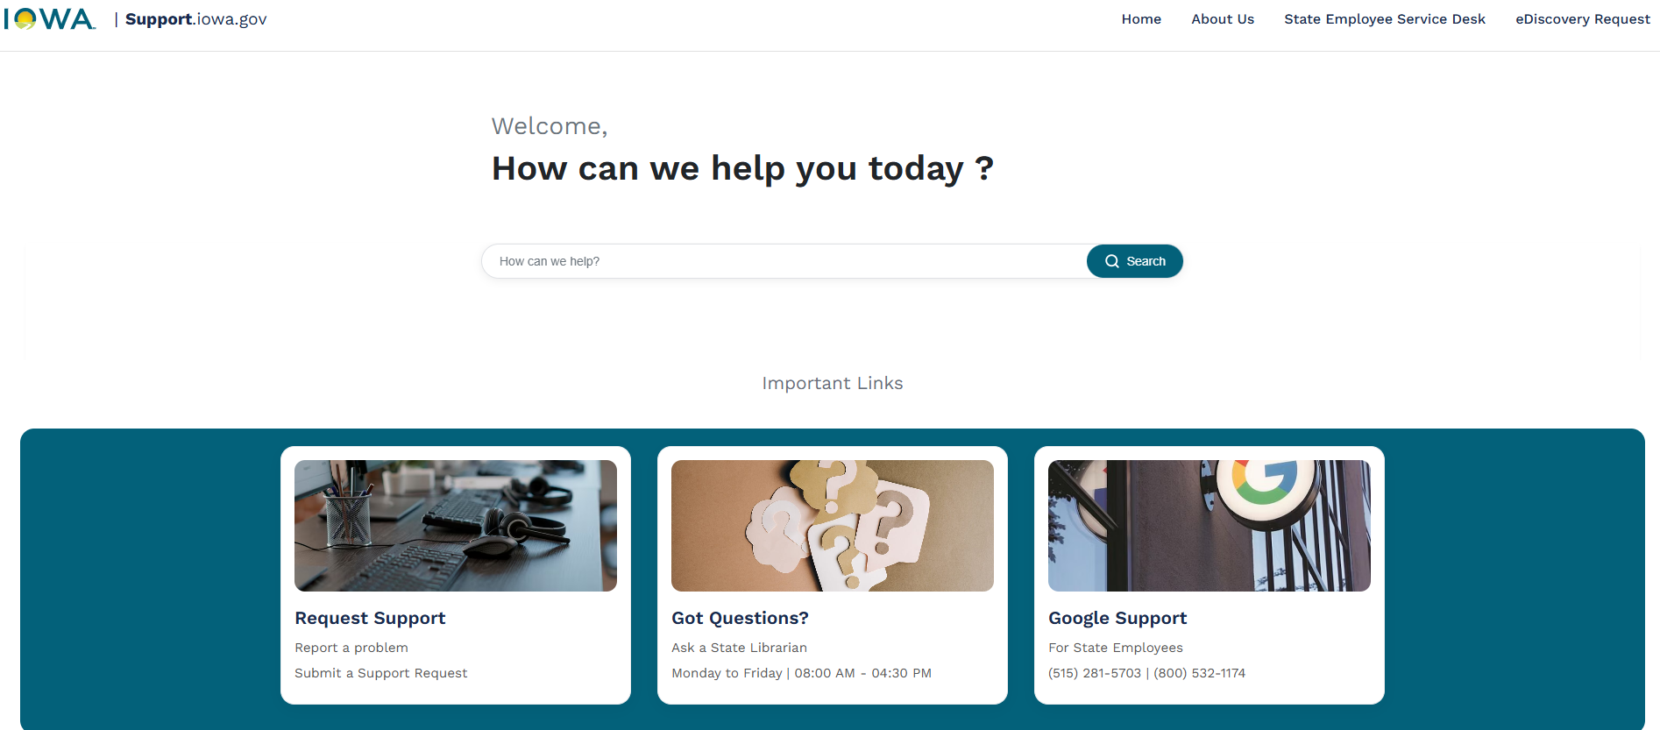
Submitting Tickets
You can submit a support ticket at https://support.iowa.gov/ if you come across a bug on your site or if you need assistance from the DX team.

Slide 9
Intro to Content Types & Author Roles
Types of Content & Author Roles

Slide 10
Author Roles
Authors will typically have the role of a "Writer" or "Editor" to be able to submit content to their agency website.
Only authors with the role Publisher and Agency Manager are able to publish and delete content from the site. It’s important that you have a full understanding of the best practices when building your site so you don’t end up breaking your site or negatively impacting your sites accessibility. Agency Managers are able to access the site settings were the reports are located.

Slide 11
Content Types
If you are unsure of which content type to use we have a breakdown of each content type. Below is a list of what each content type looks like when being used on the platform:
Basic Page
Book Page
Contact
Event
FAQ List
How Do I
Landing Page
Listing Page
Location
News

Slide 12
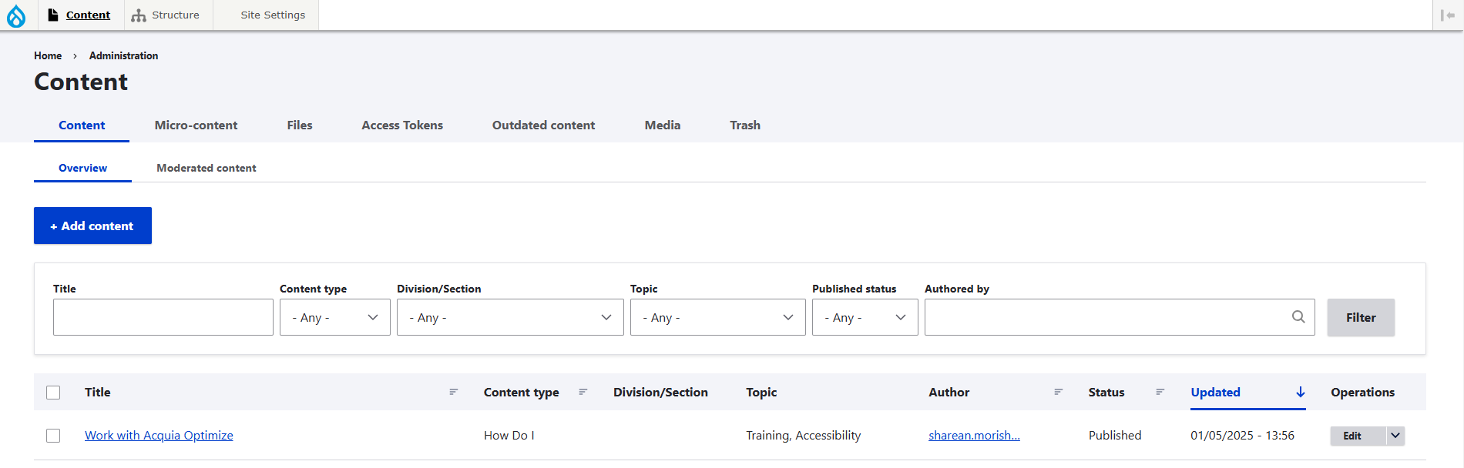
How to View Your Content Library
All content that is created on the site can be found by it’s title or item name and can be edited from the library section. To get to the library, select the content button and you will see the content, microcontent, and media library tabs.

Slide 13
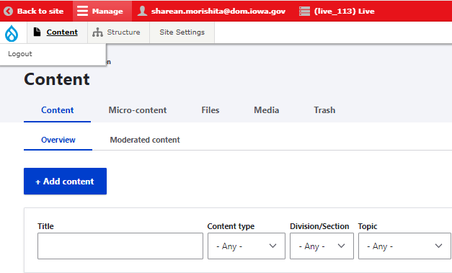
How to View Your Site
If you are within the backend of your website and you want to go back and view your site, click the little blue tear drop and it will take you back to the front page of your site. You can also click the logout button within the dropdown if you want to see how your site will look to the public.

Slide 14
How to Create a Page
How to Create, Edit, Publish, Unpublish, and Schedule Pages

Slide 15
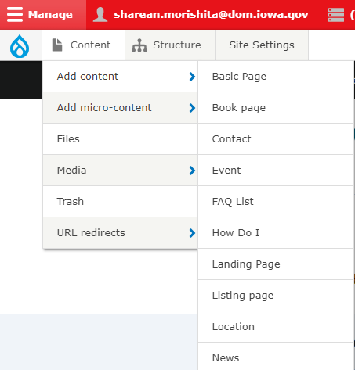
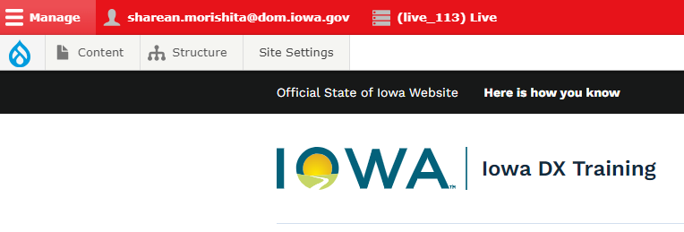
Basic Pages
Basic Pages are the main content type you will be using for your agency website. One way to create a Basic Page is to make sure you are logged into your OKTA account and then you will see the red bar at the top. From there you will click the “Content” tab and then the “Add content” button.

Slide 16
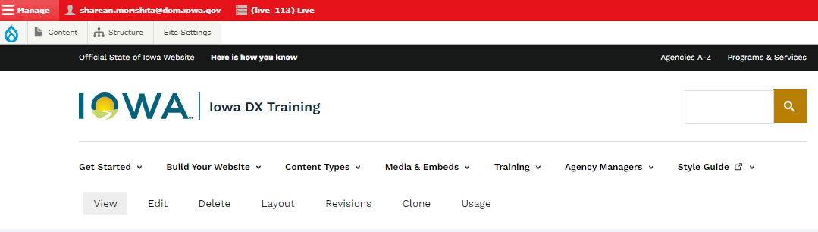
How to Edit a Basic Pages
If you are signed in you will also be able to see the edit button of any Basic Page that you have editing access to or created. This edit button will appear right under the main navigation.

Slide 17
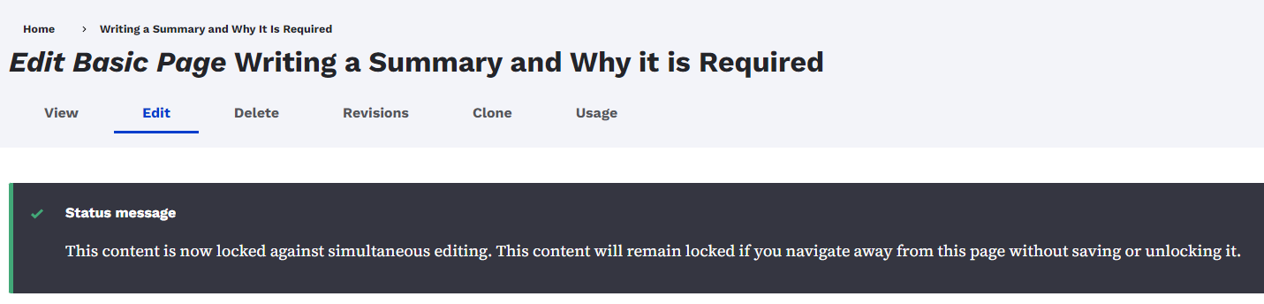
Working with Basic Pages
If someone else happens to try to make changes while you are in the middle of working on that page, there is a lockout feature to let them know it is locked for them. If they do need to make edits they can unlock it by selecting the Unlock button next to the Save button.

Slide 18
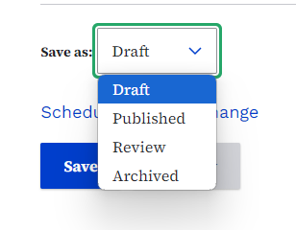
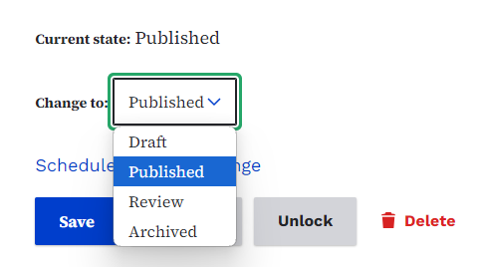
Changing the Status of Basic Pages
Only certain authors will have access to publishing and scheduling their or other team members pages.
Pages that are in the Draft state will not be seen by the public nor will it be index on Google until it is set to published.
To hide a page from the public and Google you can also use “Archived.”

Slide 19
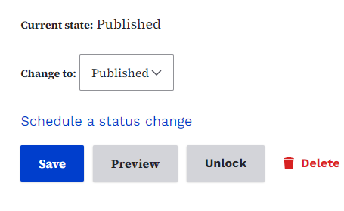
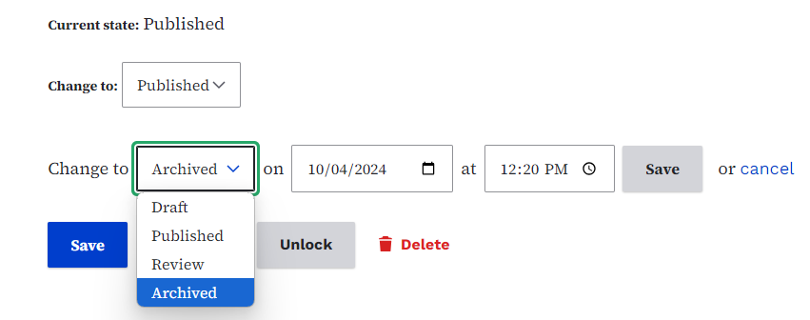
Automatic Scheduling of Basic Pages
You can schedule your page to automatically be published and go live for the public to see or automatically archive it so it’s no longer available for the public to see. This is done with the “Schedule a status change link.”
Here you can pick the new status and the time and date it should change.

Slide 20
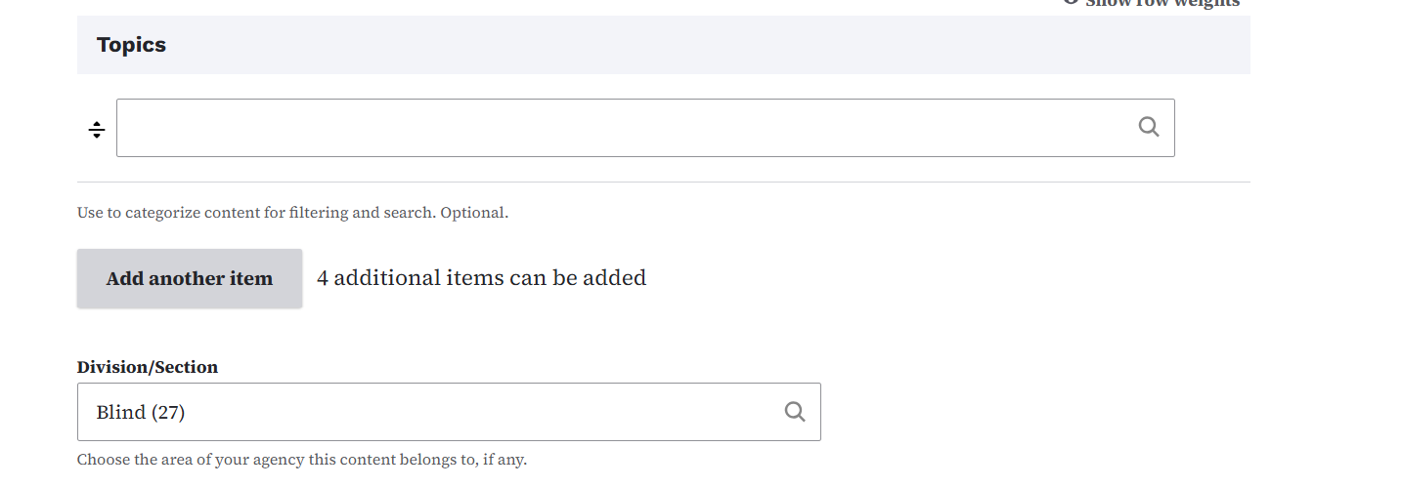
Tagging Your Pages
You can use the Topic and Divisions field to help sort your pages based on the subject matter of the page (Topic) and the Agency (Division). Doing so will help your content be sorted and easier to filter in the content library section and listing pages

Slide 21
How to Use the Basic Page Summary Field
How to write a Summary for Search Engines & Accessibility

Slide 22
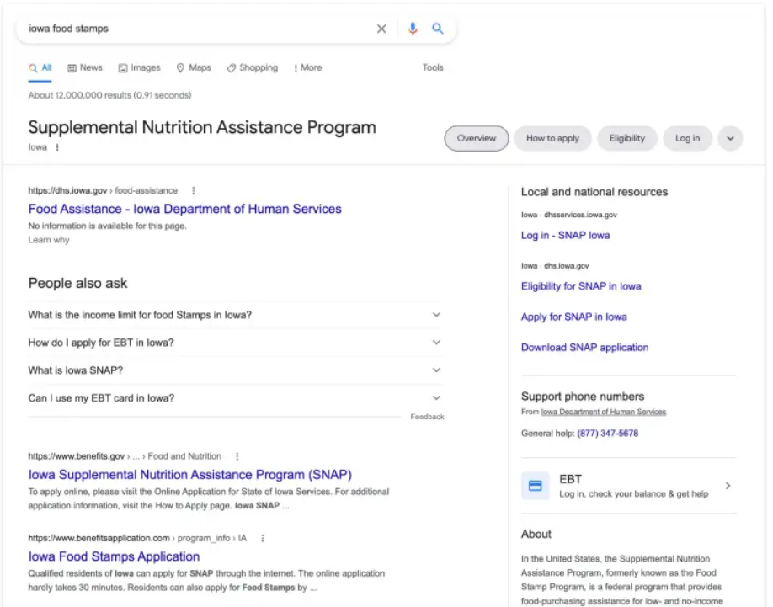
What are Summary Fields Used For?
Summary Field is a teaser - 160 characters maximum
This is the meta description used for search engine optimization.
Appears on Google Search
Displays in lists

Slide 23
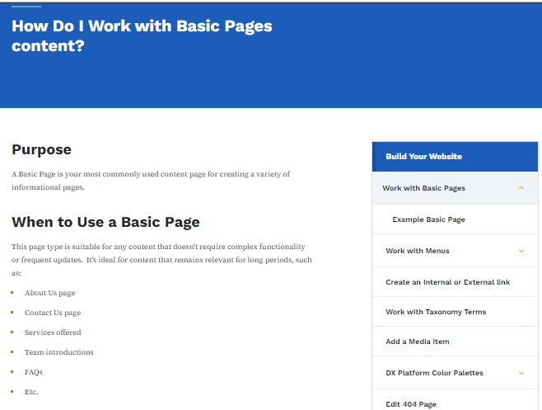
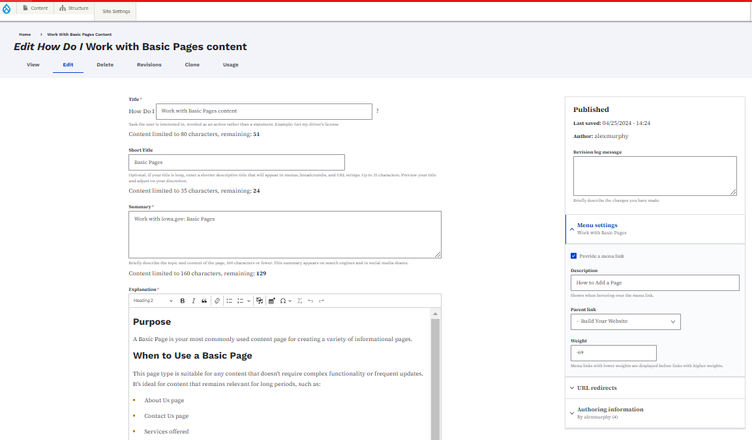
Basic Pages Setup
The title of the Basic Page and summary field are very important for search engines and for locating content on your site. The summary is the metadata so this won’t appear on the Basic Page itself but is just sitting in the back end for search engines.

Slide 24
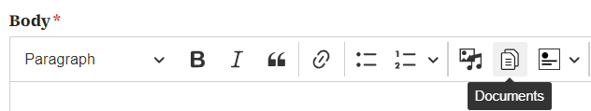
How to Add Media to a Basic Page
These buttons allow you to add images and documents.

Slide 25
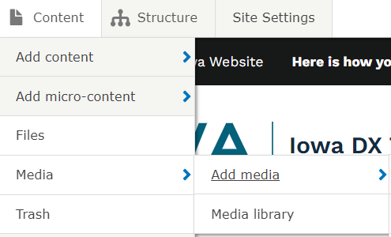
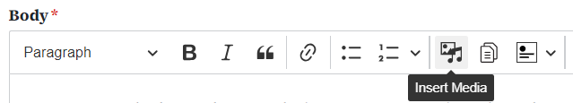
How to Add Media/Documents
You can create and embed media and documents the same way that you do content and microcontent, just with the Media tab.
Media and Documents are also added to a Media library as well for easy reuse.

Slide 26
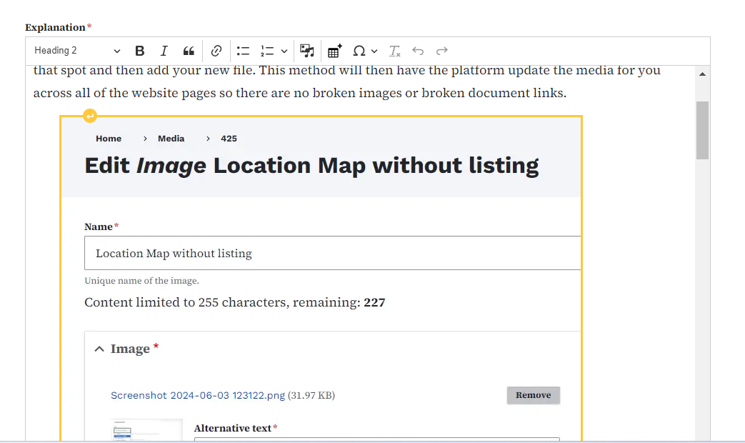
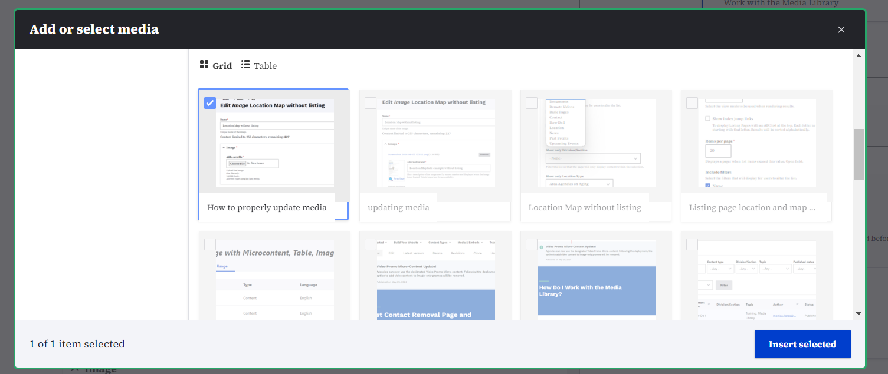
Will Deleting Media from a Page Remove it From the Library?
Media that you add within the body of a Basic Page and then delete from the body of the Basic Page can still be found in the Media Library.

Slide 27
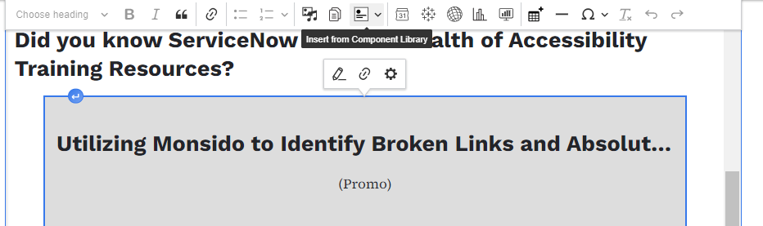
Editing the Grey Box “Microcontent”
Within the body field of a Basic Page you may see a grey box. This is an embed, either a document or a microcontent. An easy way to edit this microcontent is by clicking on the grey box and selecting the little gear icon that appears at the far right side.

Slide 28
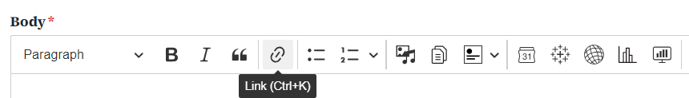
How to Use Links in a Basic Page
How to create Internal/External linking with the linkit tool

Slide 29
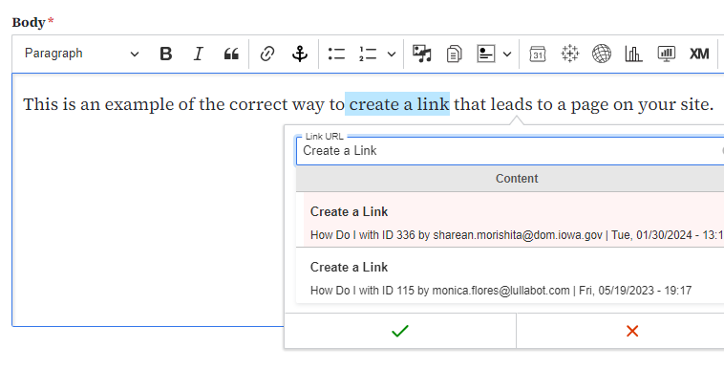
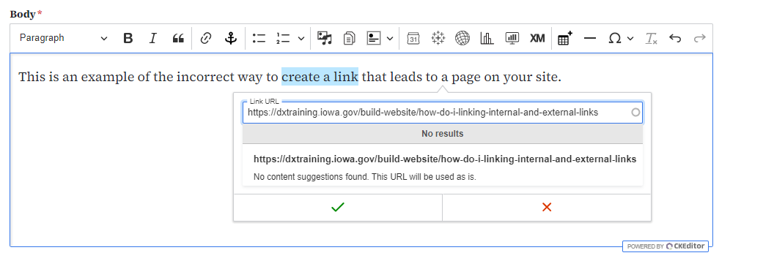
How to Link to Internal Pages
In order to correctly link to an internal page on your site, you will use the “Title” of that page and not the “URL” of that page.
Pasting the URL of your sites internal page within the “Link URL” field will create an “Absolute URL” and negatively impact your sites accessibility score.

Slide 30
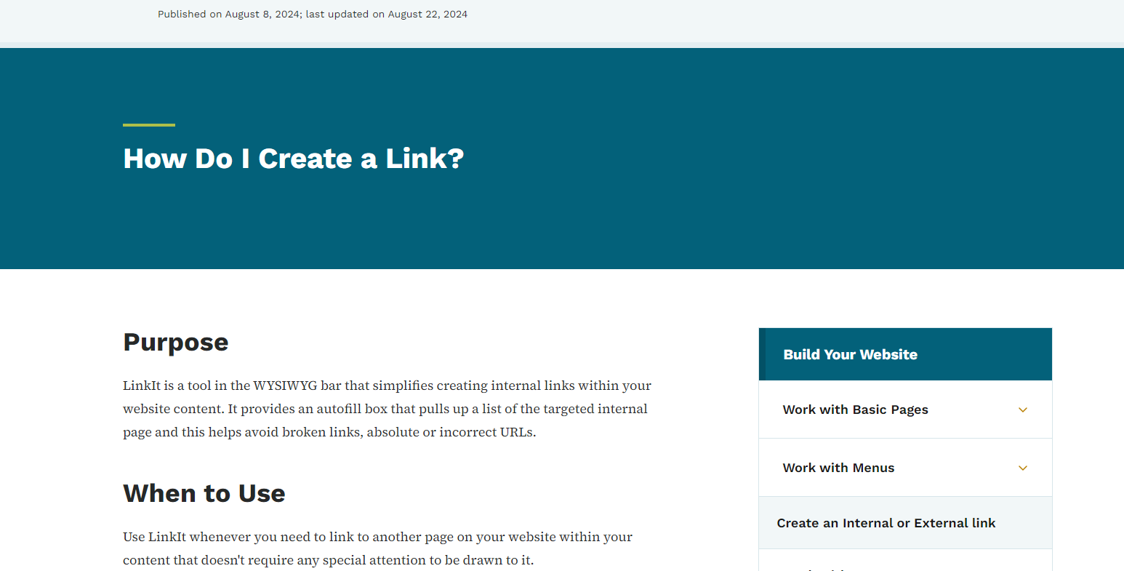
Example of Correct Internal Linking
Here is the title of an internal page called “Create a Link.”
In order to link to this page, select the title of the page, which is “Create a Link” and add it into the Link URL field and then select it from the drop down.
(If some of the results are highlighted in Pink that means the page status is in draft. White means it is published.)

Slide 31
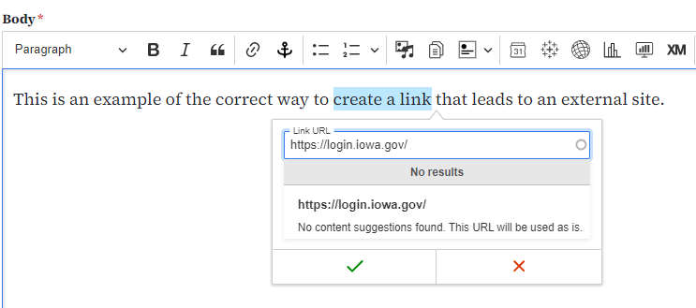
How to Link to an External Site
For linking to and external website or pages on other department’s websites, you can safely paste the URL of that page or site within the “Link URL” field.

Slide 32
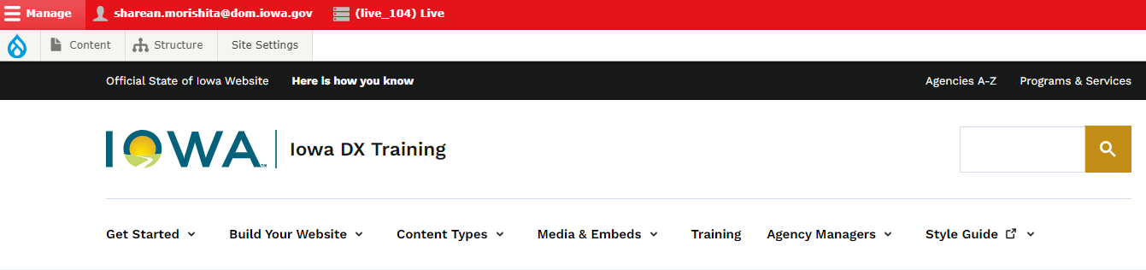
How to Link a Basic Page to the Top Menu
How to Add to the Menu Navigation

Slide 33
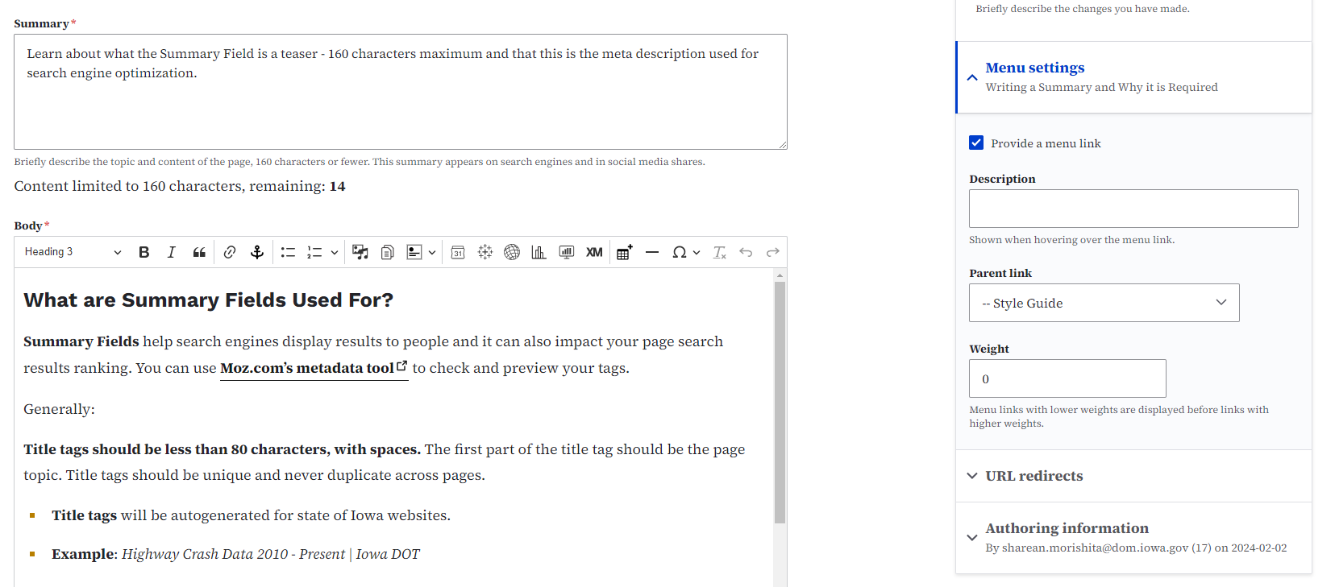
Adding a Basic Page to the Menu
You can add your pages to the main navigation within the menu settings dropdown field in the page you are editing and then selecting where you want it to appear in the Navigation Menu or the sidebar menu.

Slide 34
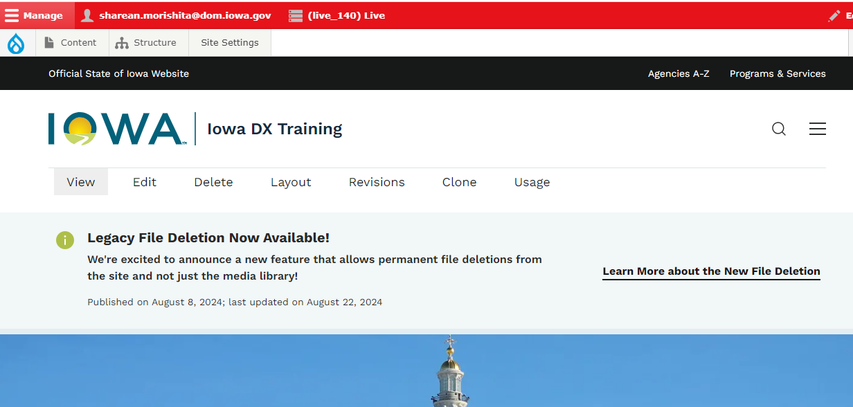
Adding a Basic Page to the Menu
Keep in mind that the Main Menu Navigation can have 6-7 links or it will condense into 3 little lines that will appear in the right top corner (hamburger menu).

Slide 35
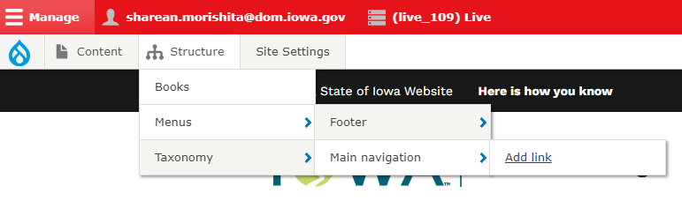
Adding External URL to the Menu Bar
A quick trick to add an external URL to your menu navigation is using the “Add Link” button found within the Structure tab and within the Menu and Main Navigation dropdown field.

Slide 36
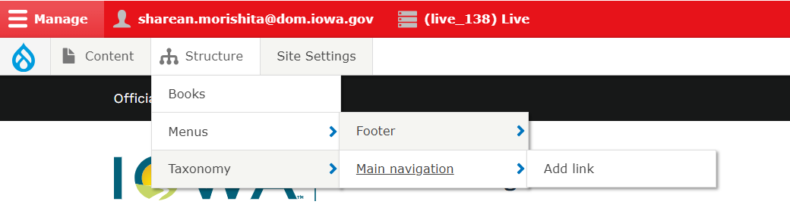
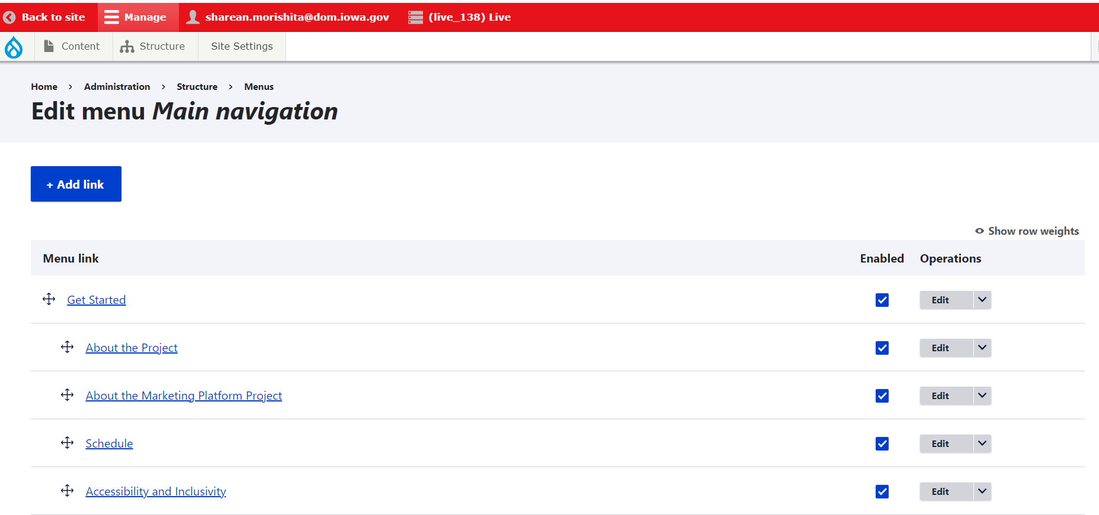
Moving Menu Navigation Links
Within the same Main Navigation setting you can also manually move the menu navigation around with the cross arrows for both the top navigation as well as the menu sidebar navigation (the sidebar menu only appears on Basic Pages Content Types)

Slide 37
How to Use the Basic Page Revisions
How to See/Revert Page Revisions

Slide 38
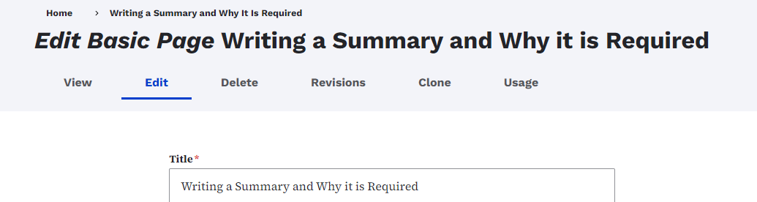
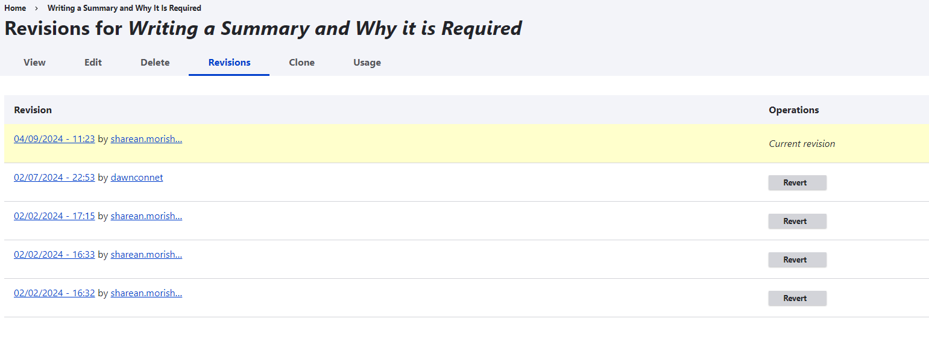
Revisions
If you ever make a change on your page and save it but you want to revert back to any older version of that page this is where the revisions field is helpful. Just click revert in the Revisions section and it will pull up the past page.

