Slide 1
Sharean Morishita
Web Content Architect
Division of Information Technology
Updated 03/03/25

Slide 2
Intro to DX Course 2
Understanding & Picking Content Types

Slide 3
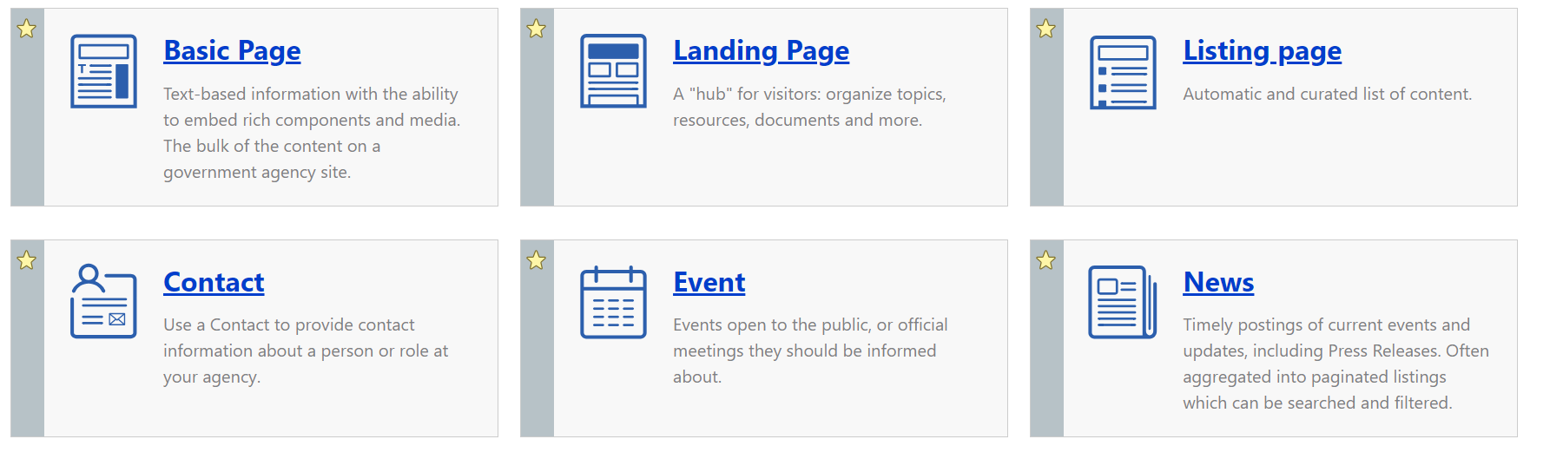
Which Content Types are used the Most?
Which Content Type Should I Use?

Slide 4
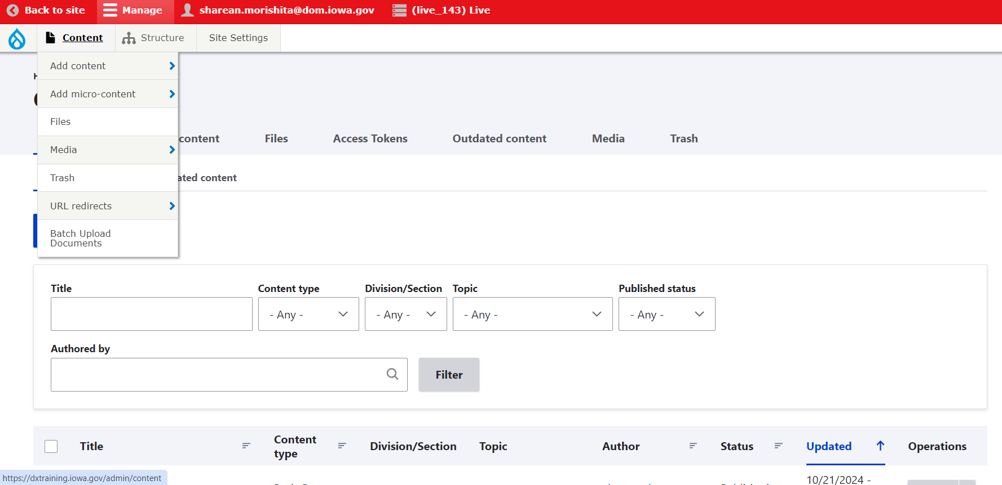
What are Content Types
Content Types are just a fancy way to say web pages.
You can see the library of all of the pages/content types that are currently on your site by clicking the content button.

Slide 5
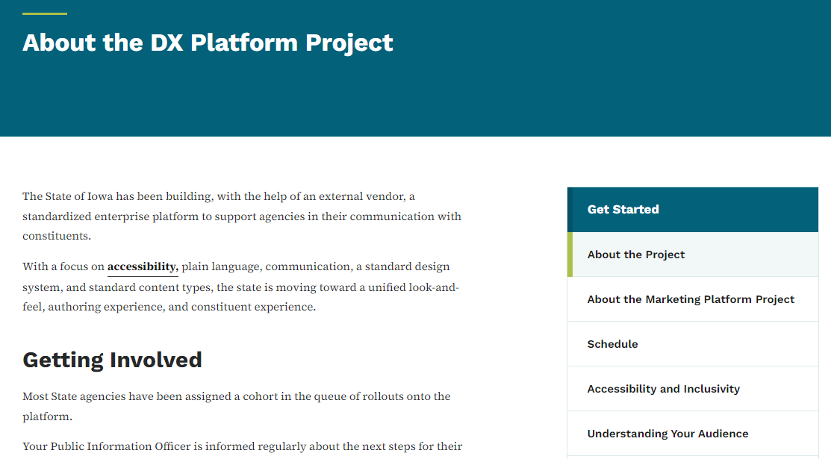
When to use Basic Pages
Use the basic page content type for text information, it will have the menu navigation on the side. You can style text bold and italic, and create headers, lists, and tables. You can also embed images and add microcontent components like promos, lists, and link collections.

Slide 6
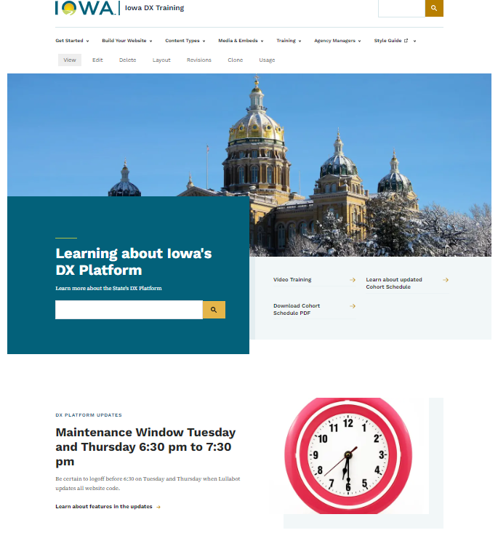
When to use Landing Pages
Use the landing page content type to create a hub of related content with a custom layout. Landing pages give an overview of a site section, grouping and prioritizing content. Often links in your site's primary navigation will be landing pages.

Slide 7
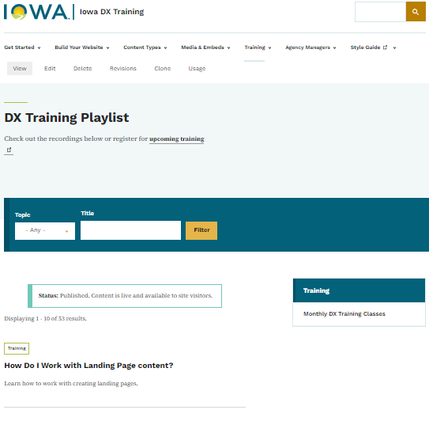
When to use Listing Pages
Use the listing page content type to create automated lists of content. For example, you can create a list of all public agency office locations, or a list of documents about a topic. Lists are updated automatically as you add or remove content. Site visitors can search and filter lists you create.

Slide 8
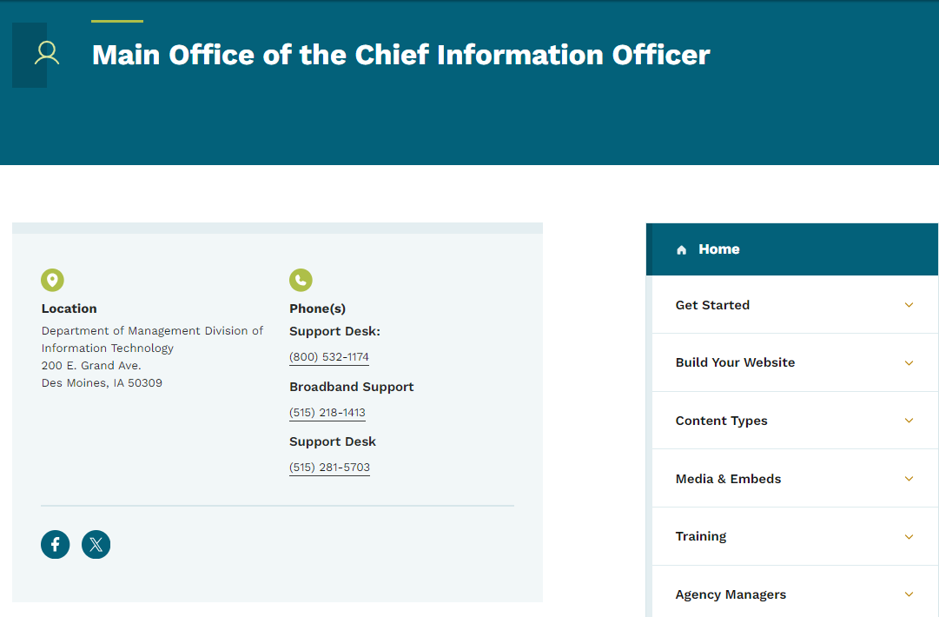
When to Contact Pages
Use the contact content type to provide contact information for a person or a role at your agency. A contact can be a specific person, or a role, like Help Desk. Embed a contact in another content type, like a basic page, to provide easy access to contact information for a topic or service. This can also be added to the footer for the social media icons to appear.

Slide 9
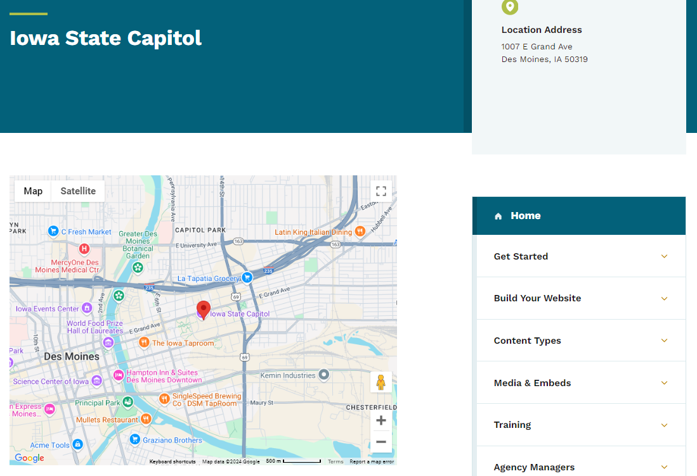
When to Location Pages
Use the location content type to provide information about a place that the public can visit. You can include hours of operation, areas served, contact information, and other details. This is also the content type that you can add within the footer menu for your agency address to appear

Slide 10
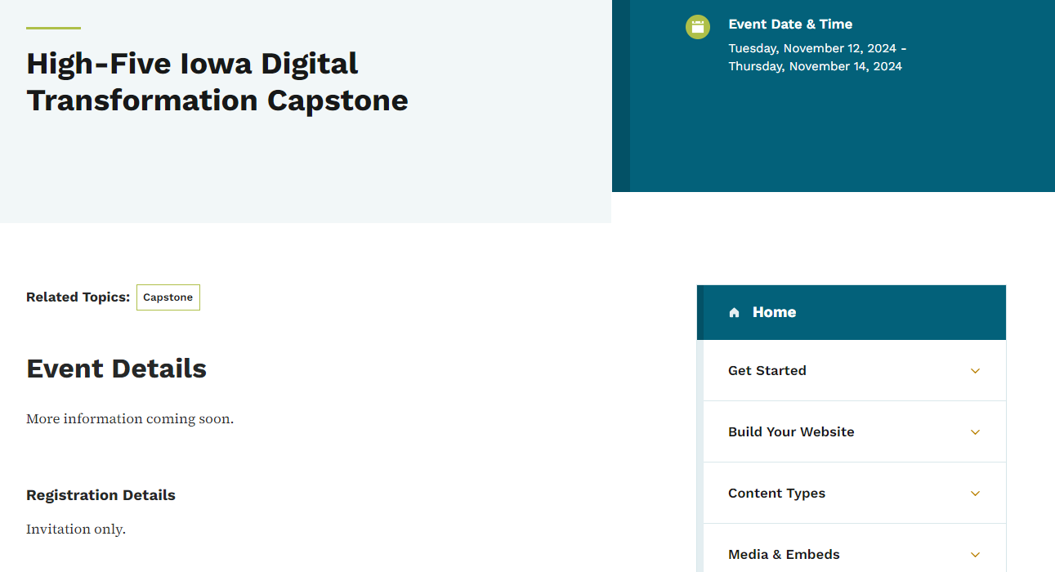
When to Event Pages
Use event content type for meetings and other events with a scheduled date and time. Events can be in person or online, and allow you to link to a page where people can register. You can also create lists of events using the listing page content type or the automatic list micro content type.

Slide 11
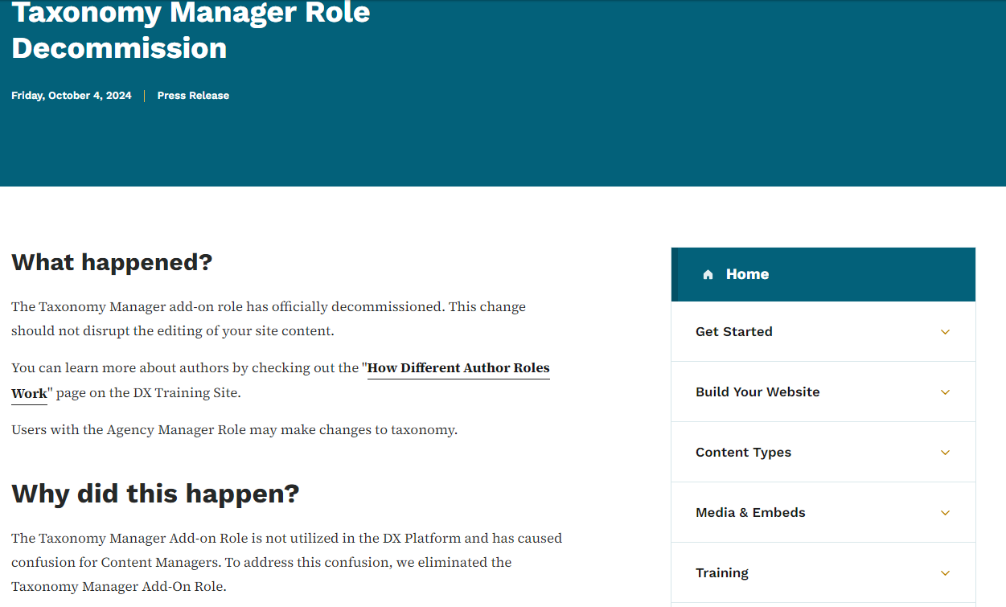
When to News Pages
Use the news content type to create timely, interesting, and noteworthy content. While they are similar to Basic Pages you can not embed micro-content into a new’s content type.

Slide 12
WYSIWIG Editor Tool Bar Differences
Basic Page Content Type Tool Bar:
Not all content types will have this same toolbar.
New’s Page & Micro Content Tool Bar:

Slide 13
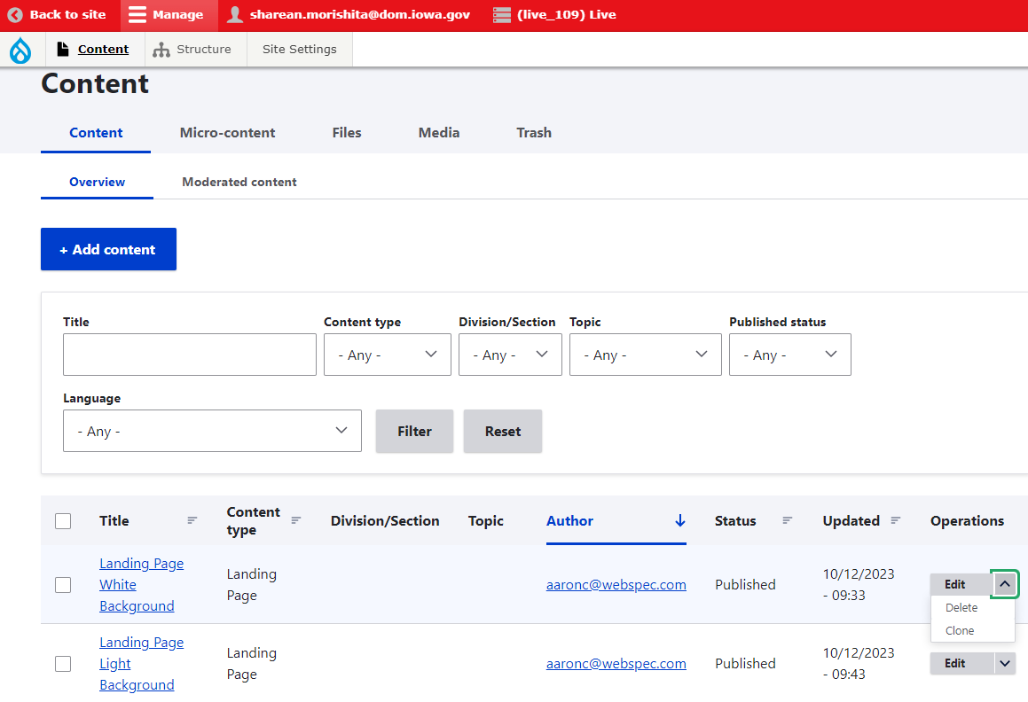
How to Delete Content Types
You can delete content types that you made within the library by clicking the arrow beside the edit BUT only if you have that author access. Any content that is unpublished won’t appear within search results only published Content Types will.

Slide 14
How to Create Micro-Content
What is a Micro-Content?
Where can they go?

Slide 15
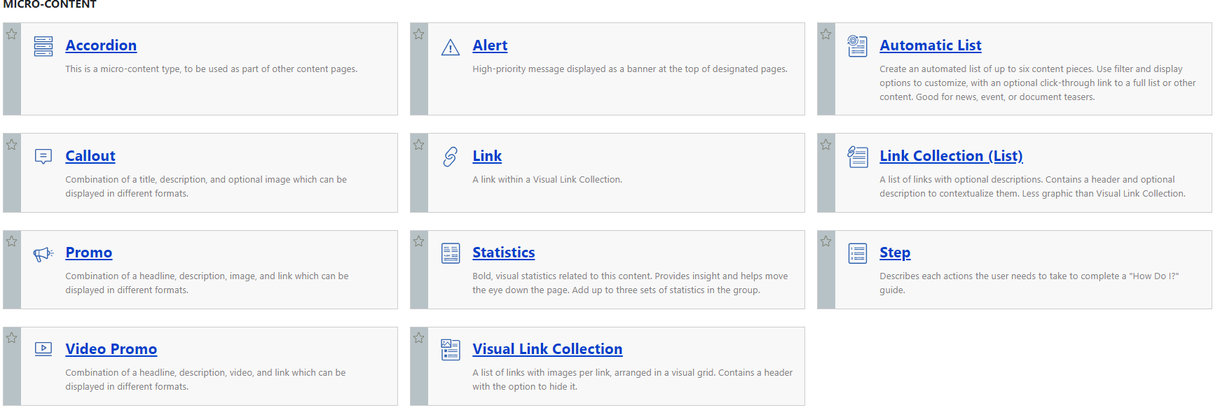
What are Micro-Content used for
These are great for using to highlight information on your site. They make it easier to add image button links and videos that will be used in multiple spots on your site
Micro-content can not be linked to directly with a URL it can only be used as an embed within a content type.

Slide 16
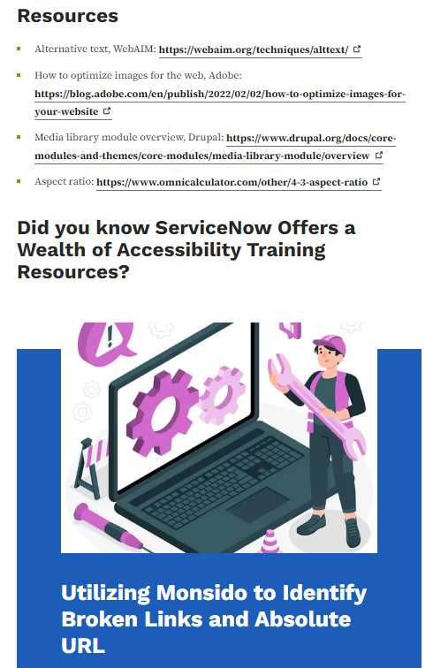
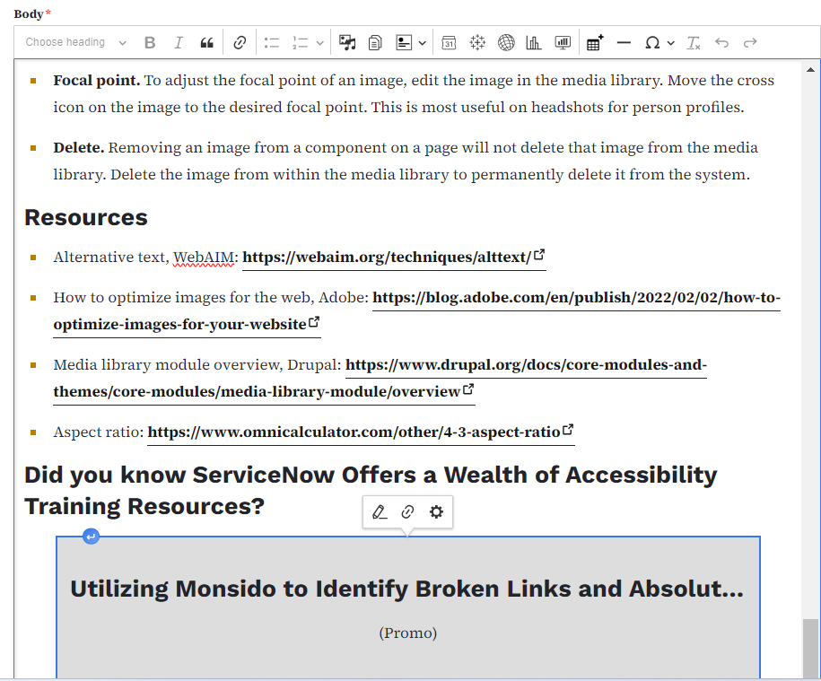
Example
Live Page
Edit Page
This is what the micro content will look like on the live site verse what it looks like when you’re editing.

Slide 17
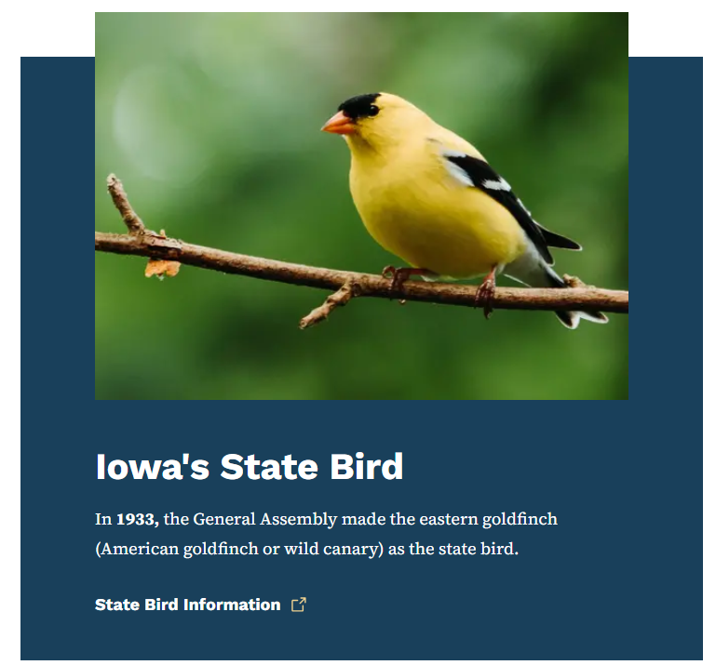
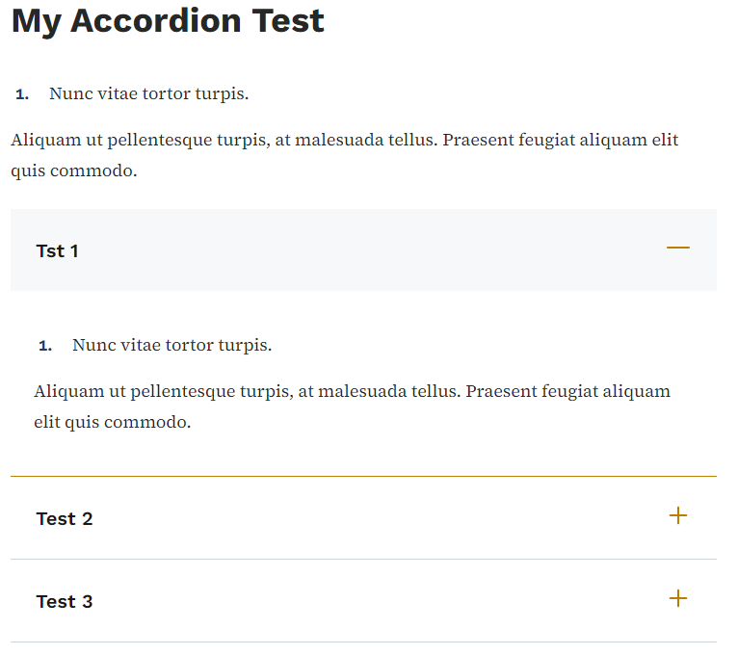
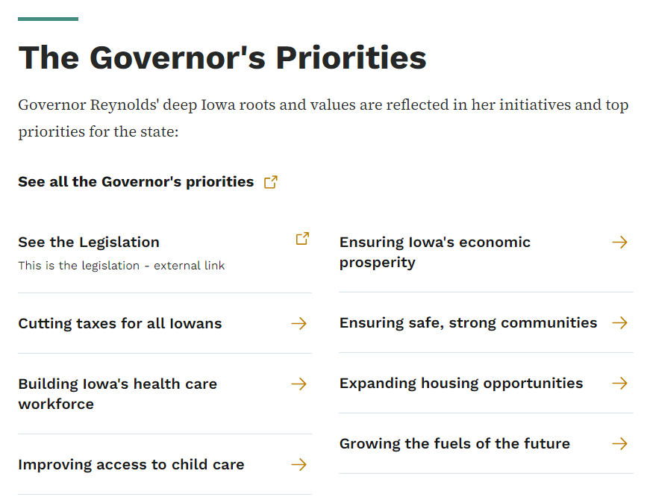
Which Micro Content is mostly used?
For most authors creating informational pages the micro content you will be using the most would be: Promo, Accordion, Automatic List and Link Collection List.
Promo Accordion Link Collection

Slide 18
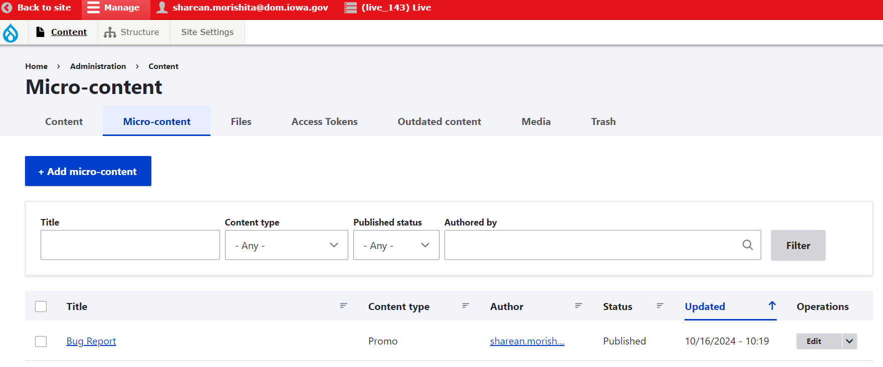
Where to locate the Micro-Content Library
When you create Micro-Content it is added to the Micro-Content library field.
This way you only need to make and edit something once and it can be used/updated across multiple pages

Slide 19
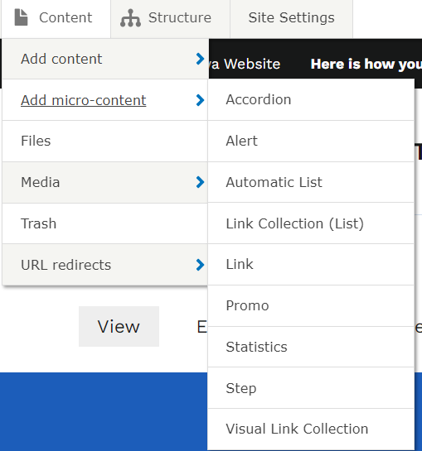
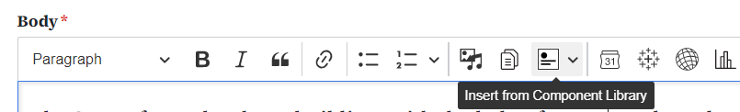
Introduction to adding Micro Content Types to the Library & Basic Pages
You can add micro-content to the micro-content library a few different ways:
Add from the content tab using the “Add Micro-Content” Button
Add from the “insert from Component library” in a Basic Page

Slide 20
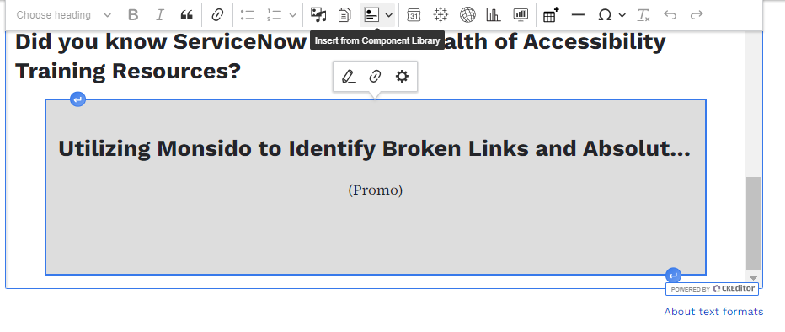
Micro-Content embeds appearance
Within the body field this is where you can add the text, links and micro content for your page. Embed micro content will look like a lovely grey box. To edit micro content you click the gear not the pencil

Slide 21
How to Work with the Media Library
You can add, update or delete media directly in the media library

Slide 22
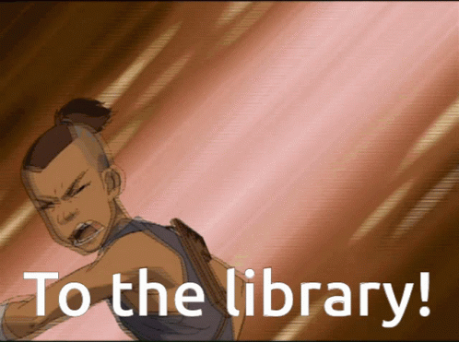
Why does the library matter?
The library helps with accessibility because you don’t have to re-create any of the micro content over and over for each individual page but instead you can just paste it from your library and any updates you make to the library micro content then populates everywhere else.

Slide 23
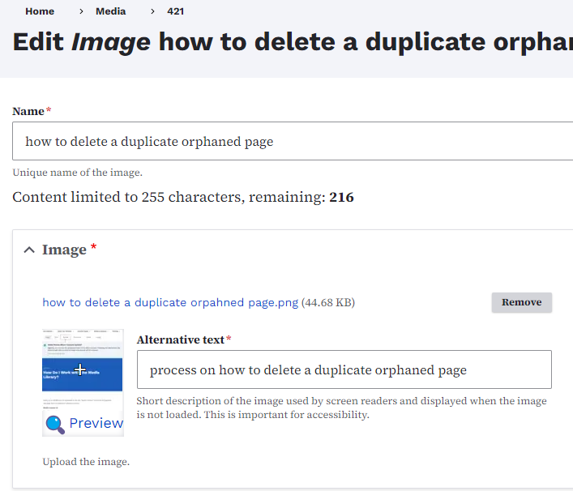
Updating Images & Media
You can use the edit button within the media library to access the edit section where the remove button is located for you to remove and update the images/document files or embed links that have been added within the site.

Slide 24
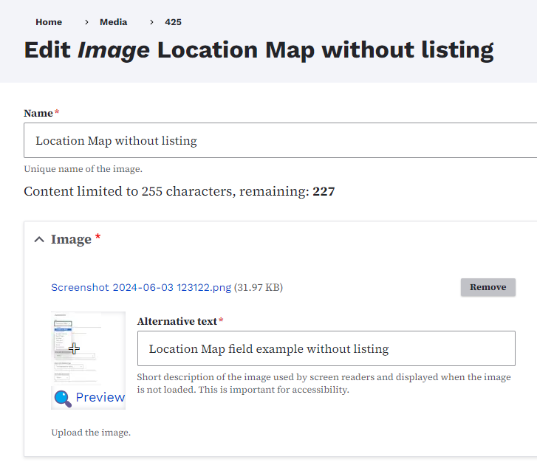
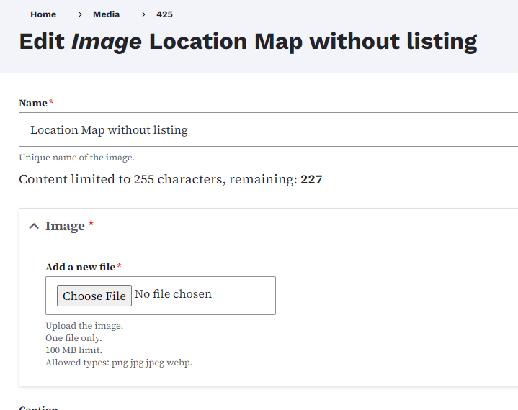
How to Update Media/Documents
When you click the remove button and then upload the updated file and press save, it will populate across the rest of the site. This way we avoid lost or broken images.

Slide 25
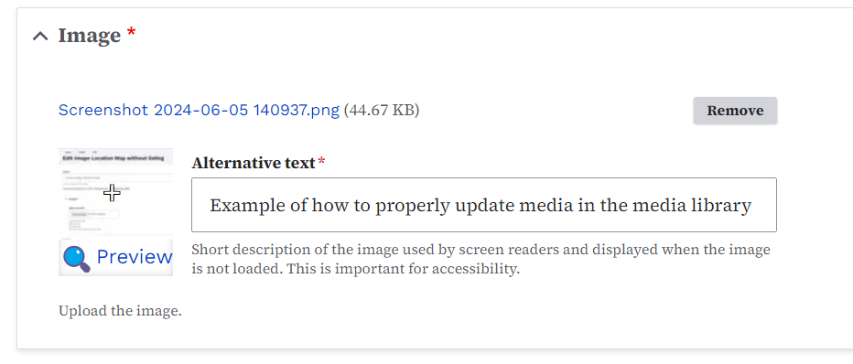
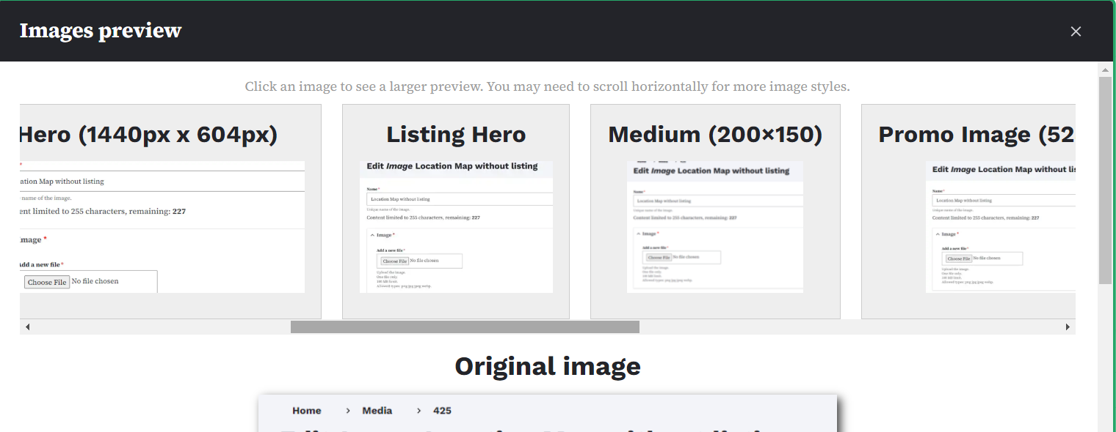
How to Adjust the Image Preview
You can adjust the preview/thumbnail of the image you uploaded into the media gallery by selecting edit and then within the Image field you will see the Preview magnifying glass. You can see how it will look across all the page types within the image preview popup window.

Slide 26
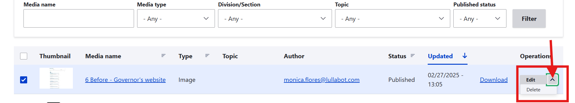
How to Permanently Delete Media from the Site
In order to permanently delete media from your site you can select the media in the media library and then select the arrow on the right of the edit button to locate the delete option.

Slide 27
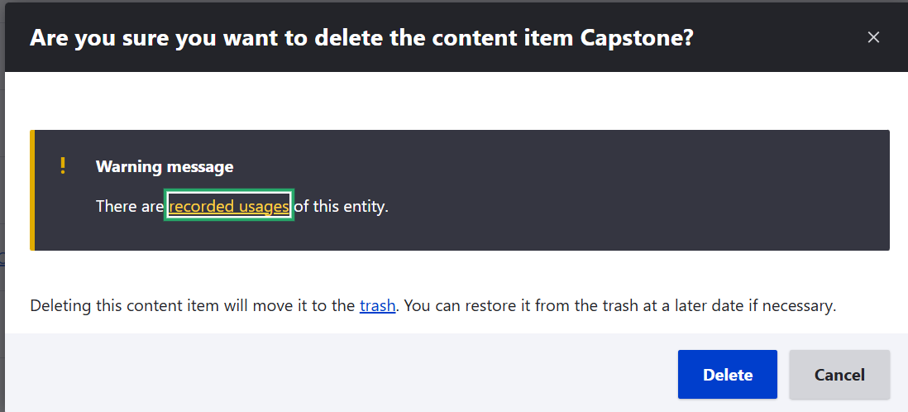
How to check if it’s safe to delete?
When you delete something a pop up window will appear letting you know that it is being used. You can click the “recorded usage” link to find the list of where it is being used at to update it. It’s safe to delete if it is only being used in a revisions or if the usage popup doesn’t appear.

Slide 28
Image Best Practices
Learn about image & media updating best practices

Slide 29
Image Ratio Resources: Google Drive
Hero image (1440 x 604)
Graphic Promo Image (704px x 608px)
Promo Image (528px x 384px)
Visual Link Collection (405px x 304px)
Stock photography
All major Iowa Cabinet level agencies will have direct access to Shutterstock. Smaller agencies can access Shutterstock via DOMDoIT Service Now.

Slide 30

Course 2 is All Done!

