Slide 1
Sharean Morishita
Web Content Architect
Division of Information Technology
Updated 03/03/25

Slide 2
Intro to DX Course 2
Understanding and Choosing Content Types

Slide 3
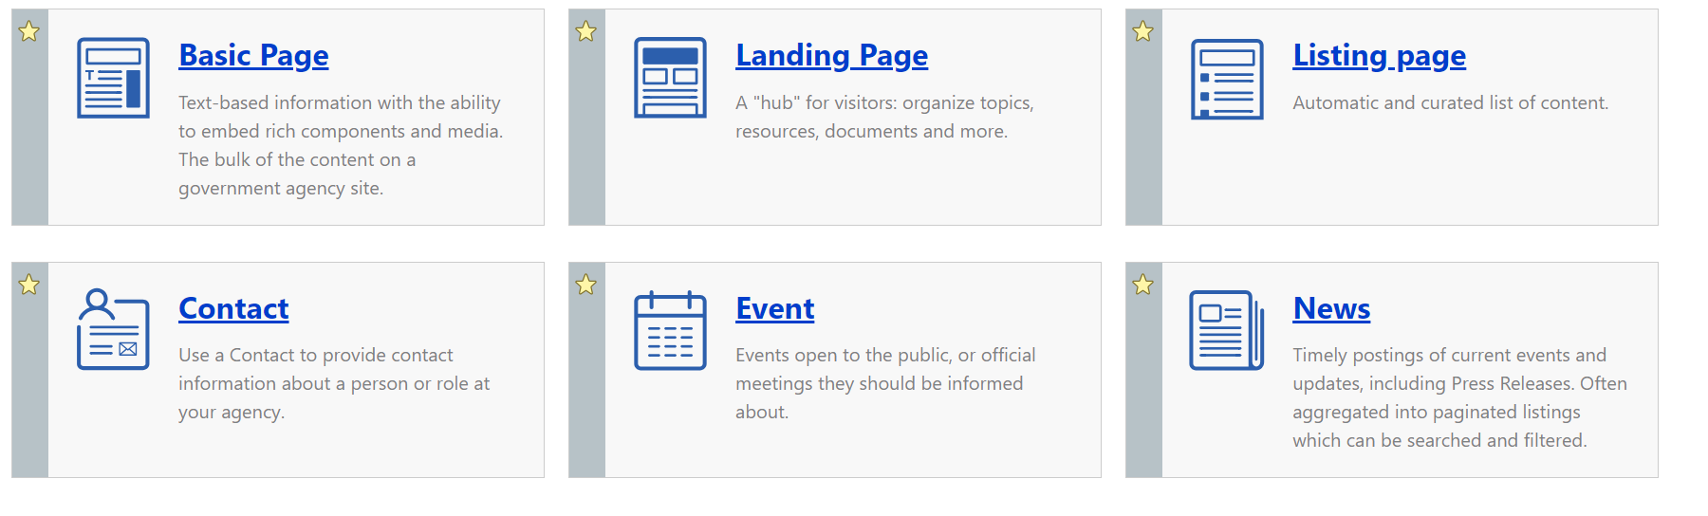
Which Content Types are Used the Most?
Which content type should I use?

Slide 4
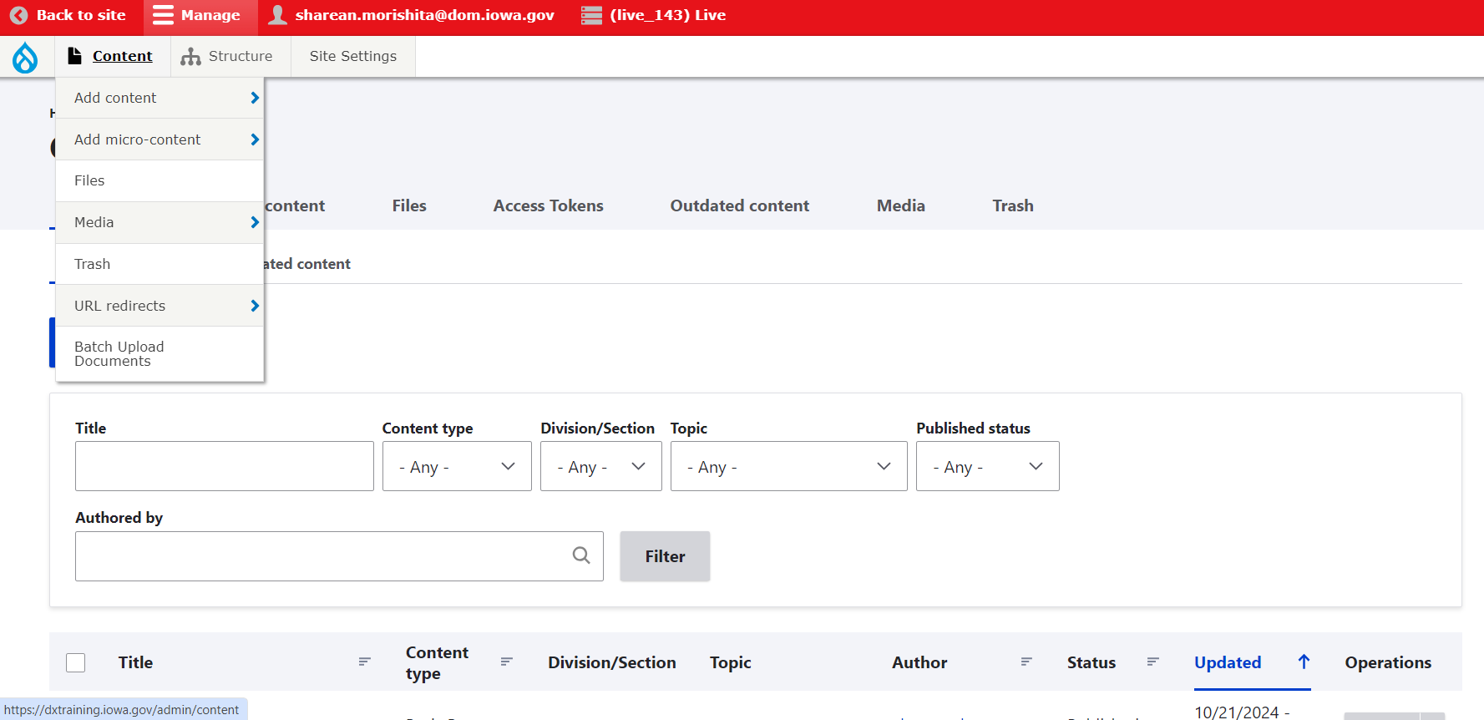
What are Content Types?
Content Types are web pages. Each has specific content that can be applied, added, or embedded.
You can see the library of all of the pages/content types that are currently on your site by clicking the ‘Content’ button.

Slide 5
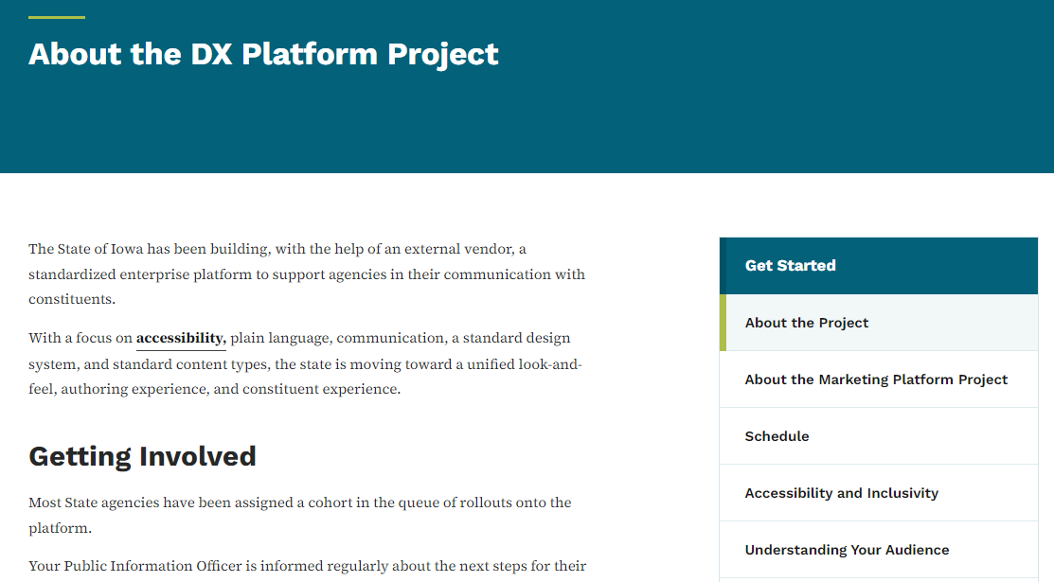
When to Use Basic Pages
Use the Basic page content type for text information. Basic pages will have the menu navigation on the right side. You can style text bold and italic, and create headers, lists, and tables. You can also embed images and add microcontent components like Promos, Lists, and Link Collections.

Slide 6
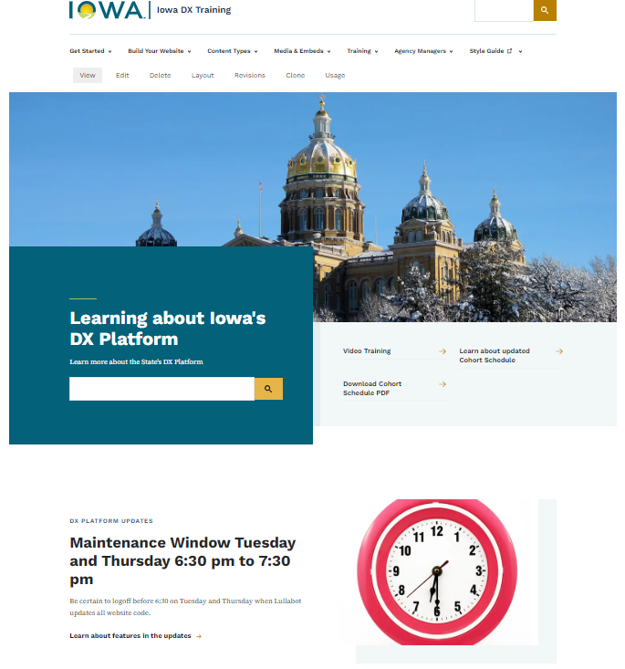
When to Use Landing Pages
Use the Landing page content type to create a hub of related content with a custom layout. Landing pages give an overview of a site section, grouping and prioritizing content. Often links in your site's primary navigation will be landing pages.

Slide 7
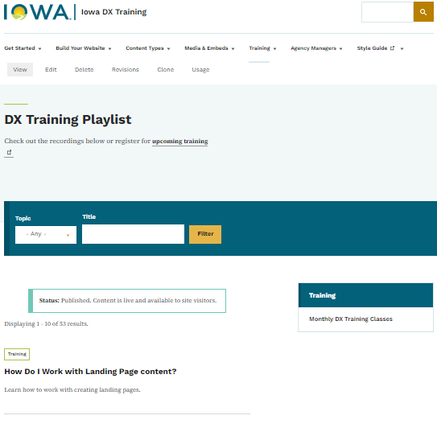
When to Use Listing Pages
Use the Listing page content type to create automated lists of content. For example, you can create a list of all public agency office locations, or a list of documents about a topic. Lists are updated automatically as you add or remove content. Site visitors can search and filter lists you create.

Slide 8
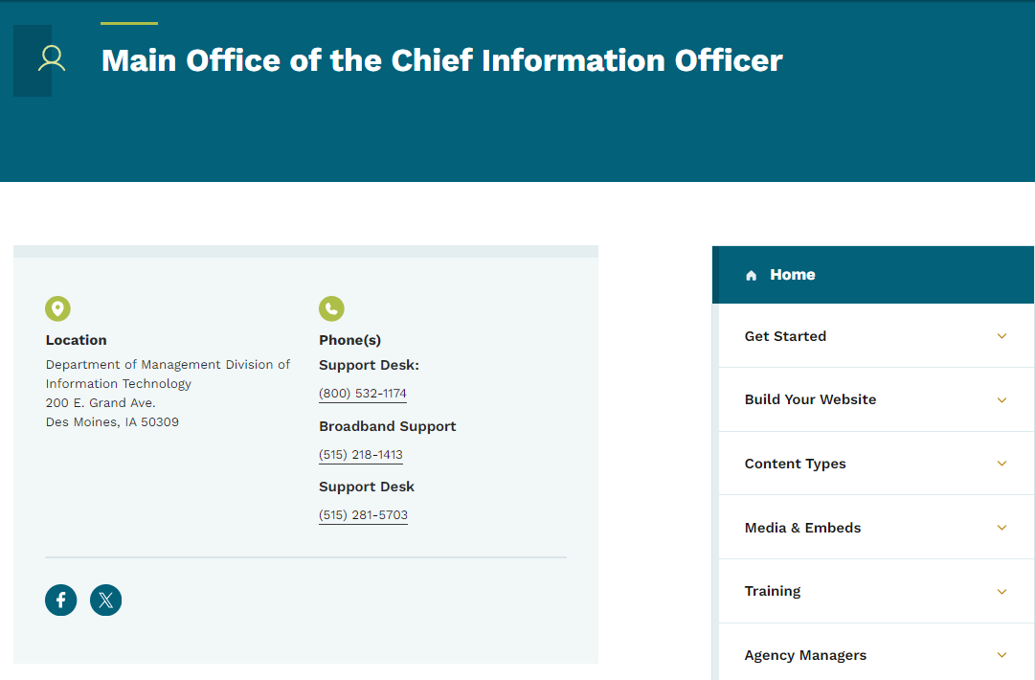
When to Use Contact Pages
Use the Contact content type to provide contact information for a person or a role at your agency. A contact can be a specific person, or a role, like Help Desk. Embed a contact in another content type, like a Basic page, to provide easy access to contact information for a topic or service. This can also be added to the footer for the social media icons to appear.

Slide 9
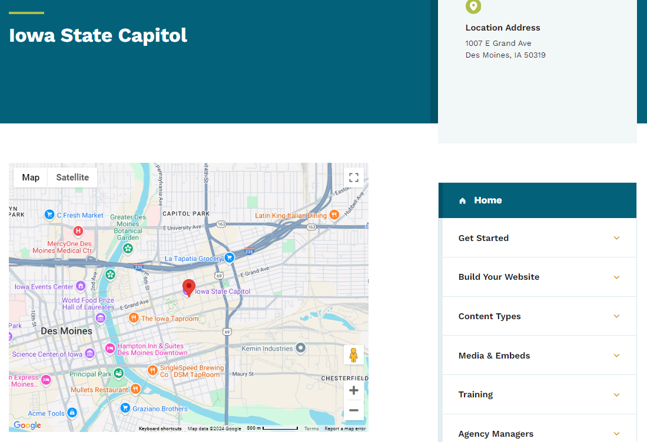
When to Use Location Pages
Use the Location content type to provide information about a place that the public can visit. You can include hours of operation, areas served, contact information, and other details. This is also the content type that you can add within the footer menu for your agency address to appear

Slide 10
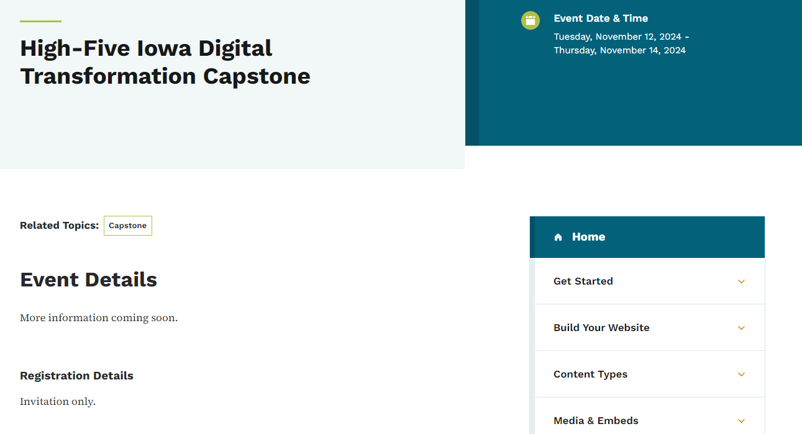
When to Use Event Pages
Use Event content type for meetings and other events with a scheduled date and time. Events can be in person or online, and allow you to link to a page where people can register. You can also create lists of events using the Listing page content type or the Automatic list microcontent type.

Slide 11
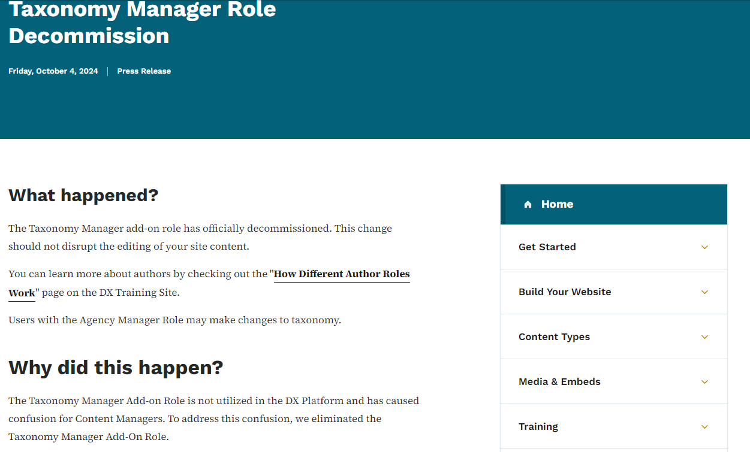
When to Use News Pages
Use the News content type to create timely, interesting, and noteworthy content. While they are similar to Basic pages, you can not embed microcontent into a News content type.

Slide 12
WYSIWYG Editor Toolbar Differences
Basic page content type toolbar:
Not all content types will have this same toolbar.
News page and microcontent toolbar:

Slide 13
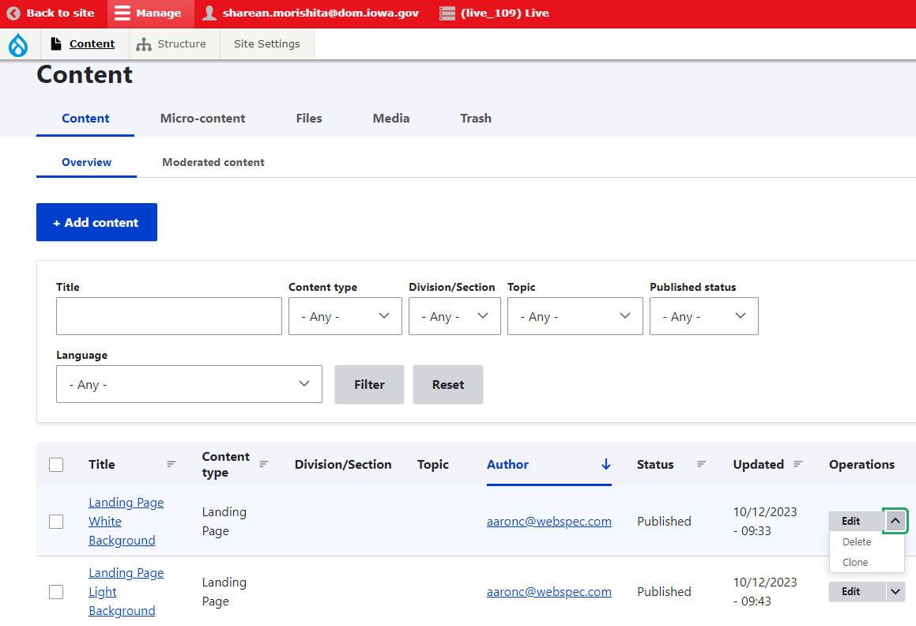
How to Delete Content Types
You can delete content types that you’ve added to the Library by clicking the arrow beside the ‘Edit’ dropdown only if you have that author access. Any content that is unpublished won’t appear within search results. Only published content types will.

Slide 14
How to Create Microcontent
What is Microcontent?
Where can they go?

Slide 15
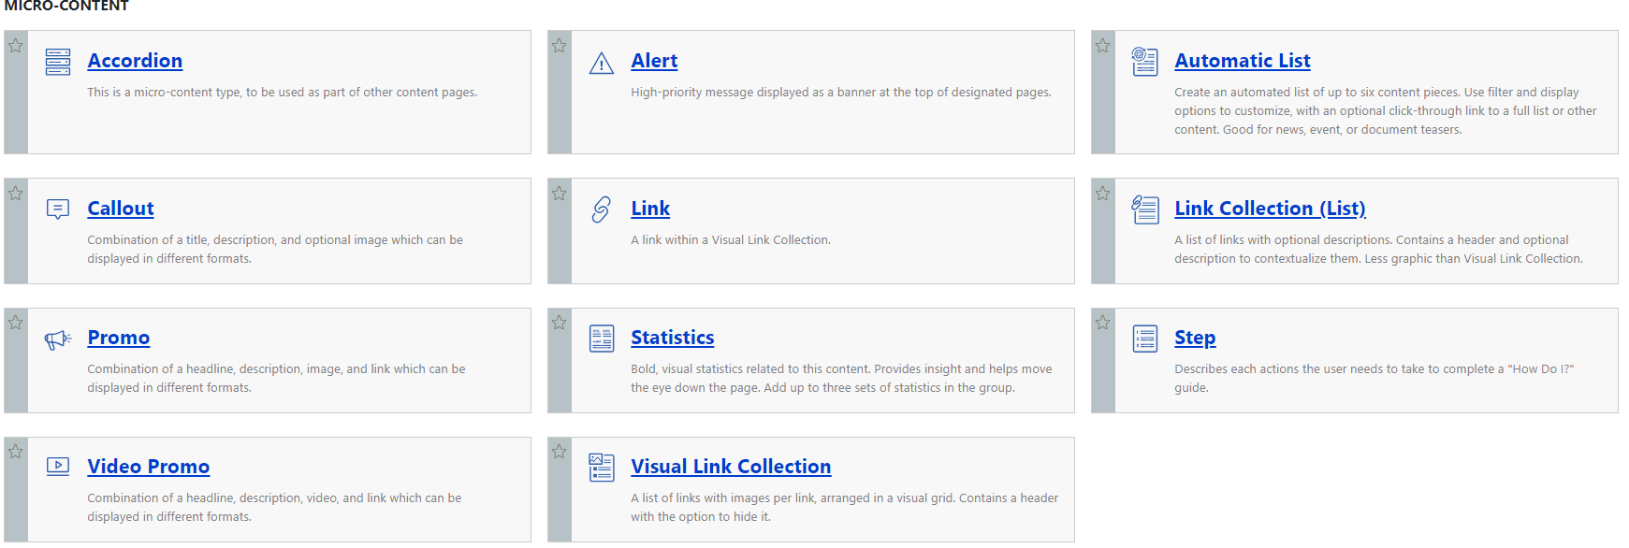
How is Microcontent Used?
Microcontent is great for highlighting information on your site. It makes it easier to add image button links and videos that will be used in multiple spots on your site.
You can’t link directly to microcontent. It can only be embedded within a content type.

Slide 16
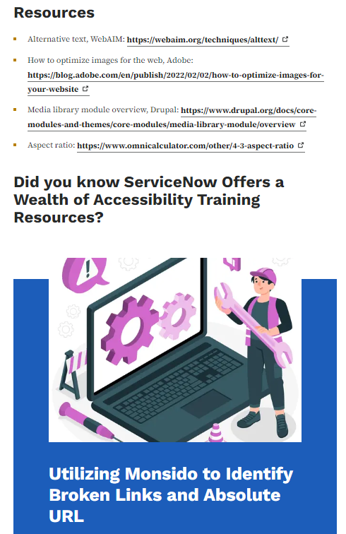
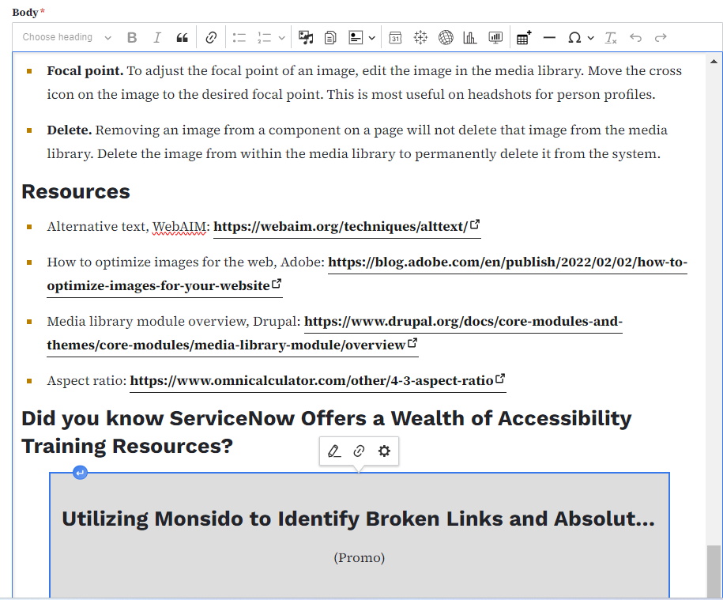
Example
Live page
Edit page
This is what microcontent will look like on the live site versus what it looks like when you’re editing.

Slide 17
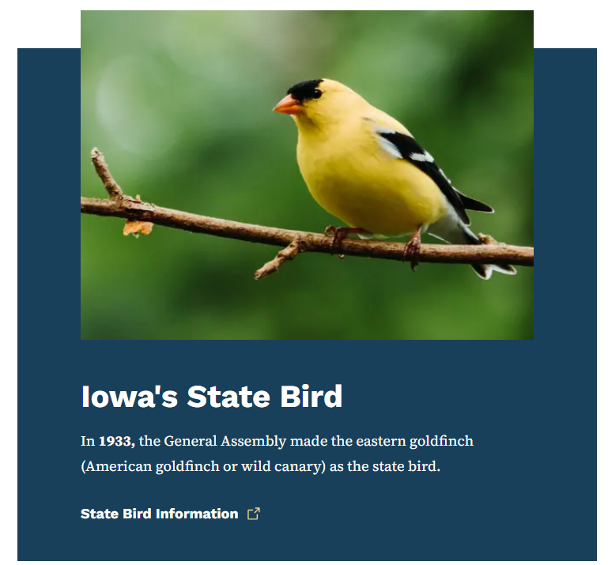
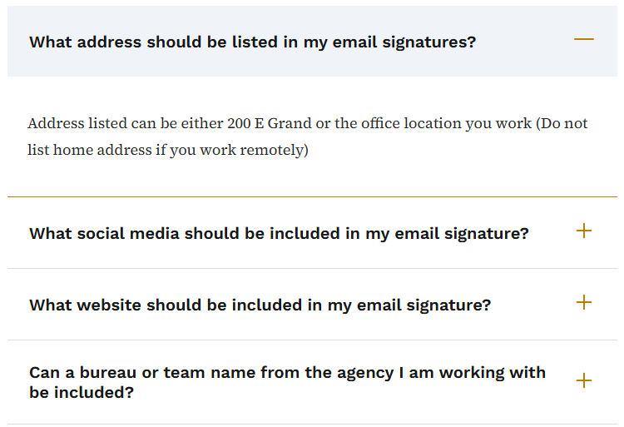
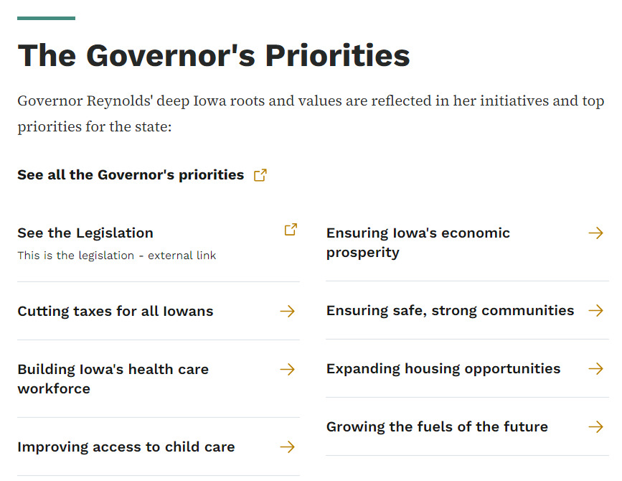
Which Microcontent is Most Used?
For most authors creating informational pages, the microcontent you will use the most are Promo, Accordion, Link Collection List, and Automatic List.
Accordion
Link Collection
Promo

Slide 18
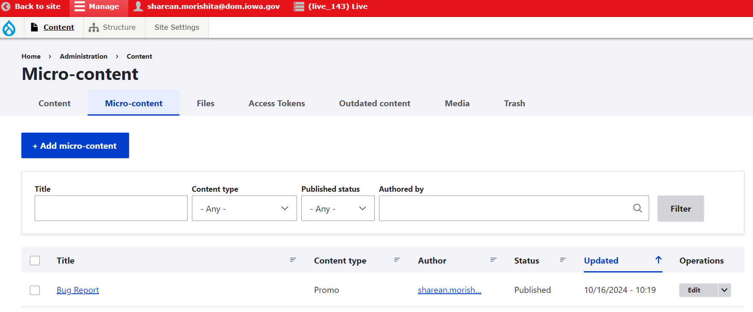
Where to Locate the Microcontent Library
When you create microcontent, it is added to the Microcontent library field.
This way you only need to make and edit something once and it can be used/updated across multiple pages.

Slide 19
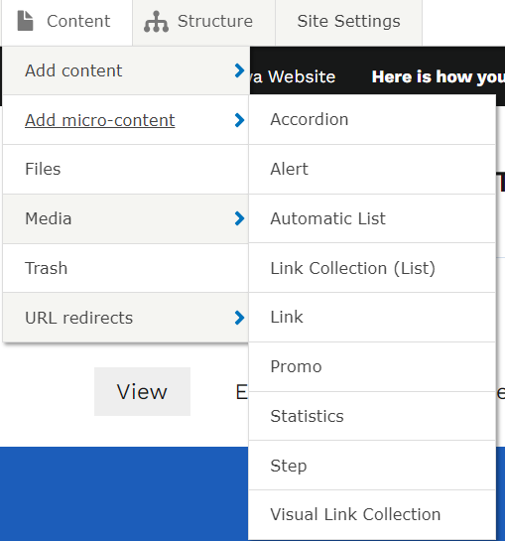
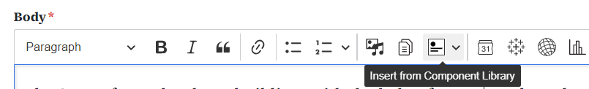
Introduction to Adding Microcontent Types to the Library and Basic Pages
You can add microcontent to the Microcontent library a few different ways:
Add from the Content tab using the “Add microcontent” link
Add from the “insert from Component library” on a Basic page.

Slide 20
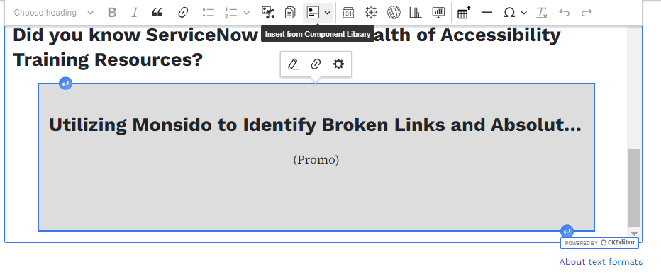
Microcontent Embeds Appearance
Within the body field you can add text, links, and microcontent to your page. Embedded microcontent will look like a grey box. To edit microcontent, click the gear icon, not the pencil icon.

Slide 21
How to Work with the Media Library
You can add, update, or delete media directly in the Media Library.

Slide 22
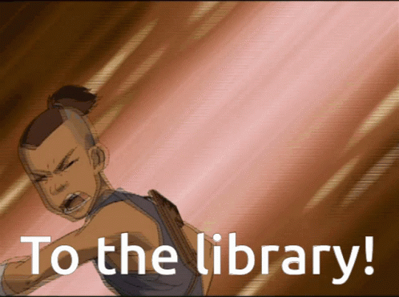
Why Does the Library Matter?
The library helps with accessibility because you don’t have to re-create any of the microcontent over and over for each individual page. Instead you can add it from your library. Any updates you make to the library microcontent then updates everywhere that microcontent is used.

Slide 23
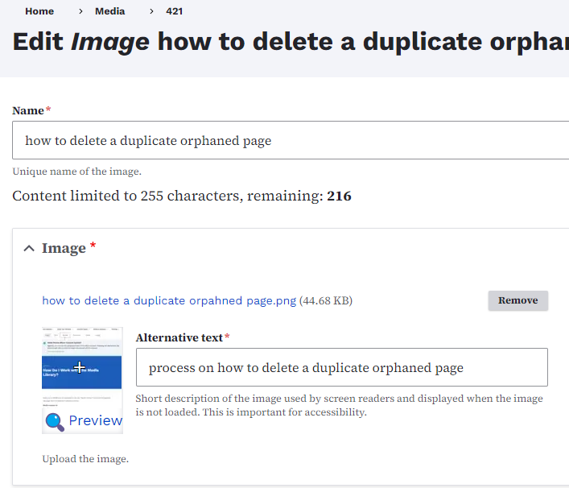
Updating Images and Media
Use the edit button within the Media Library to access the edit section for a media item. Locate the ‘Remove’ button to update images or document files or embedded links that have been added within the site. Once you’ve clicked the ‘Remove’ button, you’ll be asked to choose a new file to replace the old one.
Learn about image and media updating best practices

Slide 24
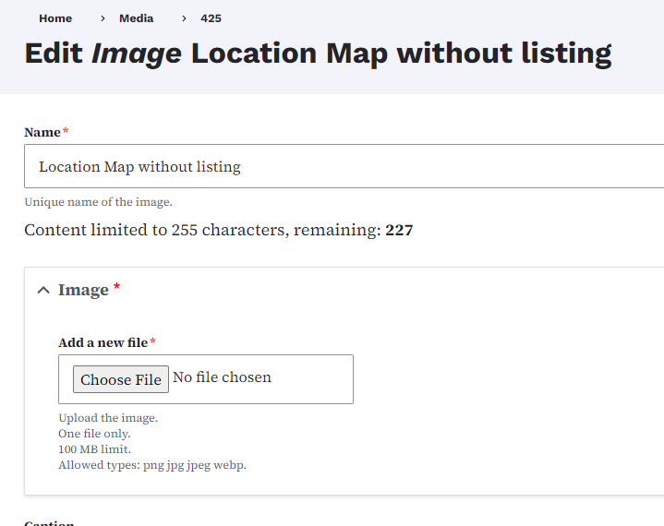
How to Update Media/Documents
When you click the ‘Remove’ button and upload an updated/replacement file and press ‘Save,’ the replacement file will update across the site anywhere that file is being used. This avoids lost or broken images.

Slide 25
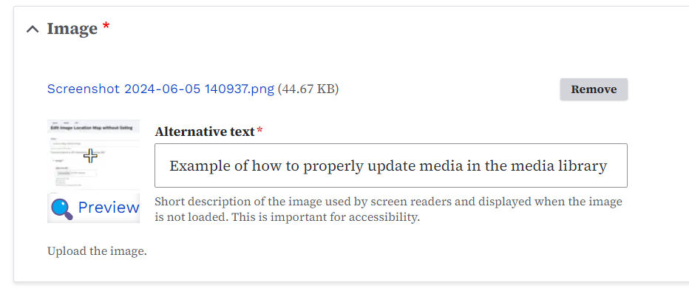
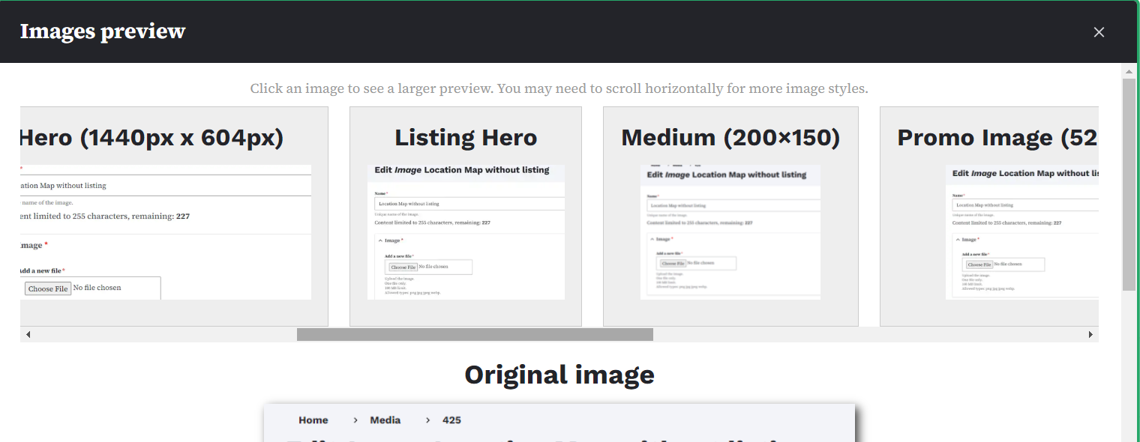
How to Adjust the Image Preview
You can adjust the preview/thumbnail of any image you uploaded to the Media Library by selecting ‘Edit.’ Within the image field you will see the ‘Preview’ magnifying glass. You can see how your image will look across all the page types within the image preview popup window.

Slide 26
Image Ratio Resources: Google Drive
Hero image (1440 x 604)
Graphic Promo Image (704px x 608px)
Promo Image (528px x 384px)
Visual Link Collection (405px x 304px)
Stock photography
All major Iowa Cabinet level agencies have direct access to Shutterstock. Smaller agencies can access Shutterstock via DOMDoIT ServiceDesk Plus.

Slide 27
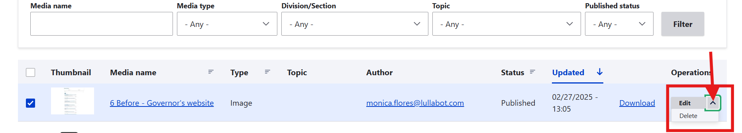
How to Permanently Delete Media
In order to permanently delete media from your site, select the media in the Media Library. Select the arrow on the ‘Edit’ button to the far right. Use the dropdown to select the delete option.

Slide 28
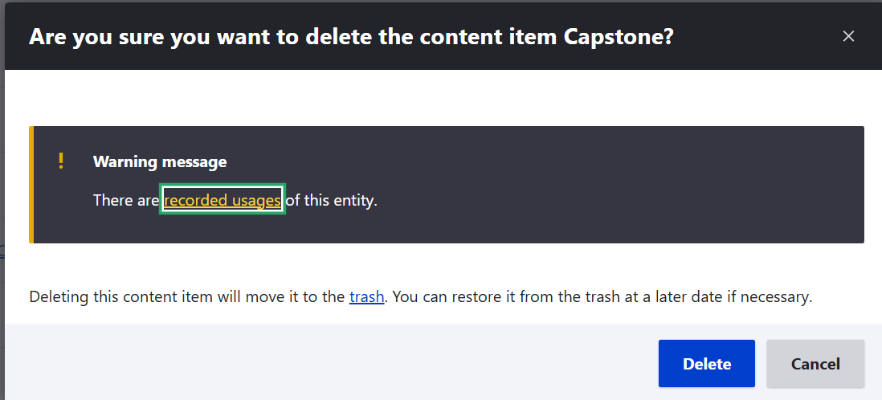
How to Check if it’s Safe to Delete?
When you try to delete a file from the Media Library, a pop up window will appear letting you know if that file is being used on your site. You can click the ‘recorded usages’ link to find the list of where it is being used. It’s safe to delete if it is only being used in a revision or if the usage popup doesn’t appear.

Slide 29

Course 2 is All Done!

