Slide 1
Sharean Morishita
Web Content Architect
Division of Information Technology
Updated 03/31/25

Slide 2
Intro to DX for Content Managers
Course 3 - Taxonomy, Working with Listing Pages, Landing Pages, Accessible Links, Accessibility Site Scans, URL Redirects, and Google Analytics

Slide 3
All About Taxonomy
How to add Taxonomy terms

Slide 4
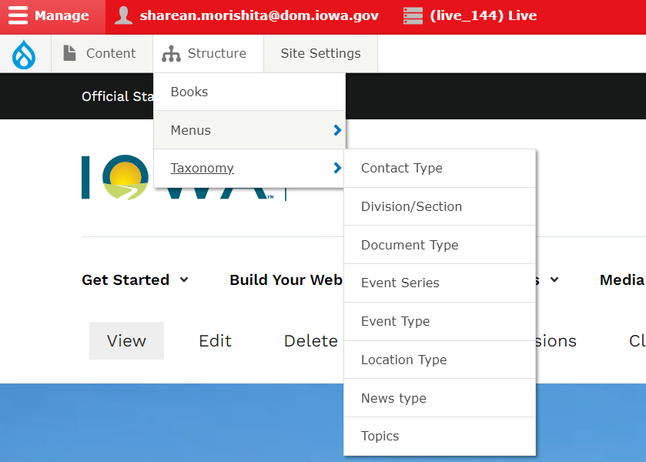
How to Add Taxonomy
You can add new taxonomy to a selection of content and media types by navigating to the structure tab. Within the dropdown that appears you can select which item you would like to make a taxonomy term for.

Slide 5
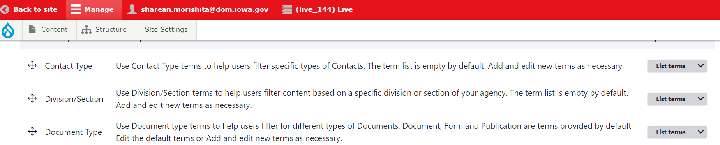
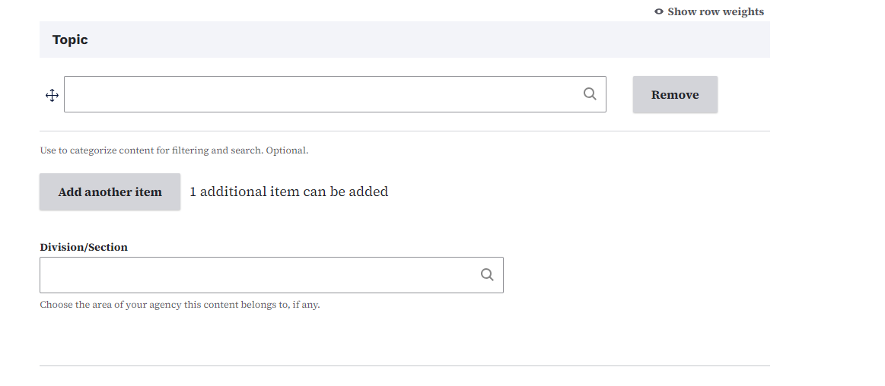
How to Edit Taxonomy Terms
You can also edit the taxonomy terms that you create by selecting the Taxonomy button within structure to pull up the library of all the taxonomy fields. Then selecting the list button to view and edit each taxonomy within each type.

Slide 6
Taxonomy Usage
Make sure to properly categorize your content using the Topic field taxonomy. This helps for Listing Page filtering.
If your site has multiple agencies within it, use the Divisions/Sections field.

Slide 7
Introduction to Listing Pages
Learn about Listing Pages and
how they are used

Slide 8
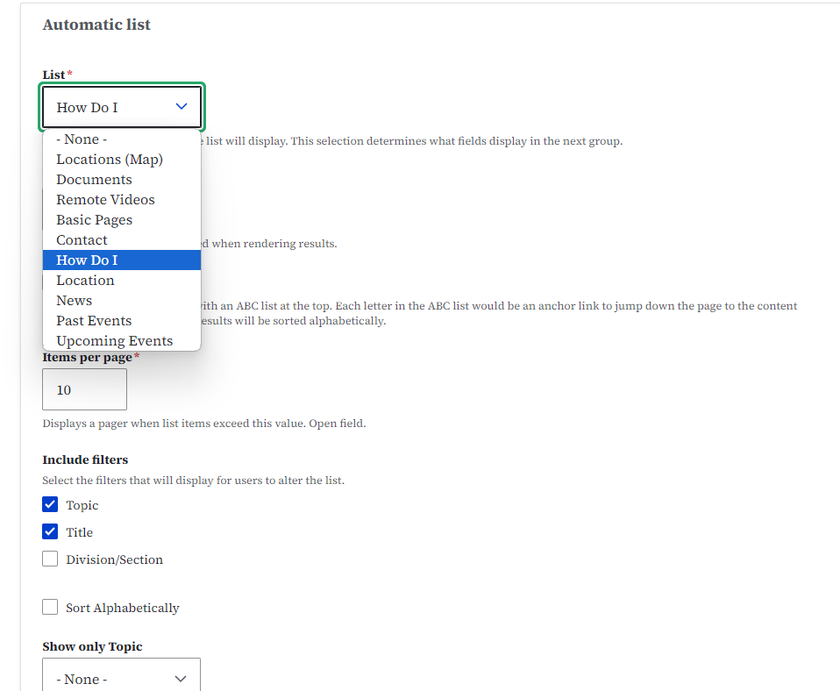
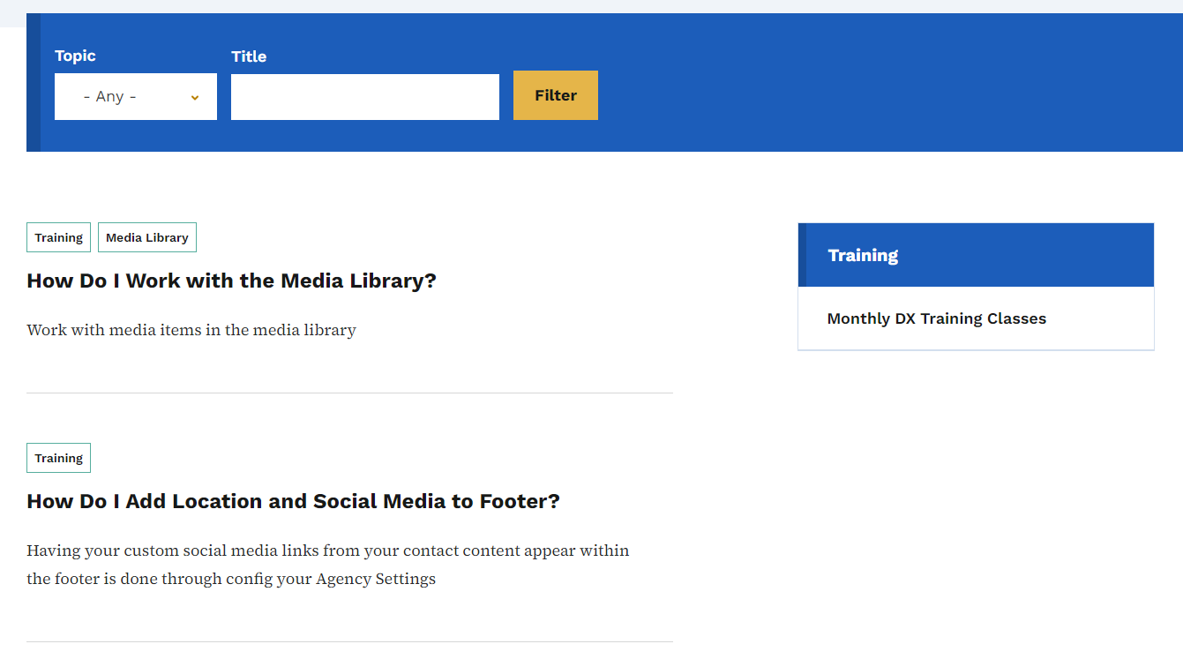
Listing Pages
You can use Listing Pages similar to how we use Training Listing Pages to shows all of the pages on our website that cover all things within the training taxonomy topic or content types.

Slide 9
Introduction to Landing Pages
Learn about Landing Pages
and how they are used

Slide 10
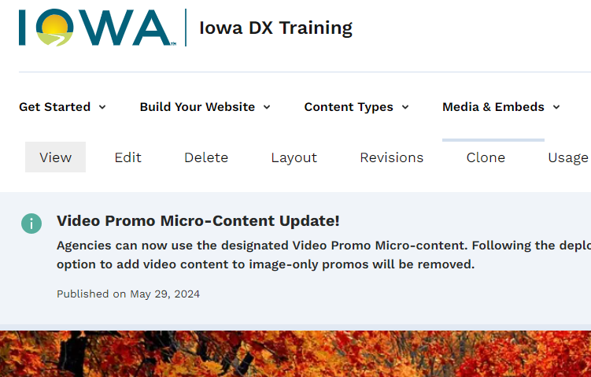
How to Add Microcontent to a Landing Page
In order to add Microcontent to a landing page, first you’ll need to create and save your Landing Page. Then the Layout button will appear. This is where you will add microcontent to build out your page.

Slide 11
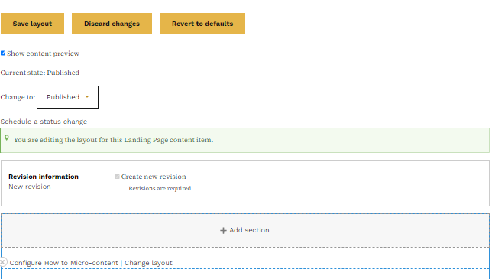
How to Add Microcontent to a Landing Page
You will have to click the ‘add section’ button. After you’ve picked the color you would like that section to be, you can then click the Add block button to start adding Microcontent.

Slide 12
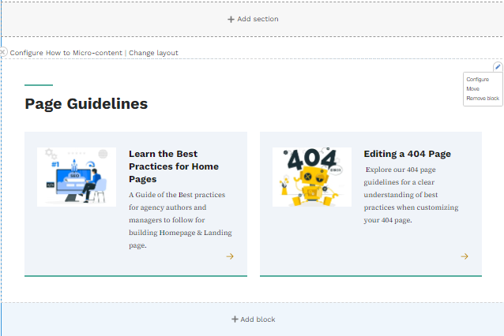
How to Edit Microcontent on a Landing Page
To edit the Microcontent, you can select the tiny pencil icon in the upper corner of the Microcontent block and select configure.

Slide 13
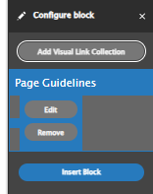
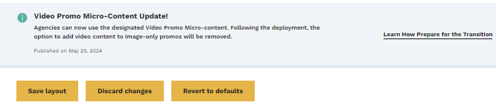
How to Edit Microcontent on a Landing Page
From there you select the edit button and the Microcontent will open in the same window. After you click save, it will direct you back to the Landing Page. Then you will need to click ‘save layout’ for the update to be saved here as well.

Slide 14
Introduction to Link Accessibility
Writing for All People
Writing for accessibility is more than writing with correct spelling and grammar. It also means organizing content in a way that's scannable and readable.

Slide 15
Use Descriptive Links
Instead of using the words “click here” or “learn more,” it’s encouraged to use descriptive text links. Descriptive text links help people understand the context of the link before they take action. Describe links that highlight the subject, not the action.
Good descriptive link example: Contact our agency for more information about local services.
Non descriptive link example: Click here to contact our agency for information about our services.

Slide 16
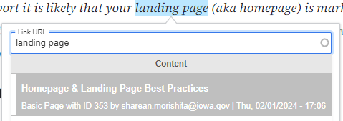
Proper Internal Page Link to Avoid Absolute URLs
Do: Use the title of the page within the Link URL field to locate and link the correct page when using the linkit tool.
Don’t: Use the actual URL of the page within the Link URL field. (You only need the URL for external pages not within your site.)

Slide 17
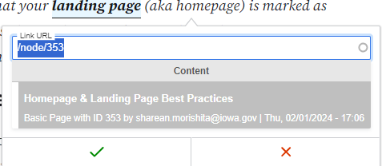
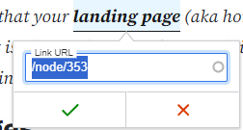
Internal Page Linking Cont’d
You will know that the Linkit tool has located the correct page if you see the name of the page you want to link within the Content field. It will show the node and number “/node/353/.”

Slide 18
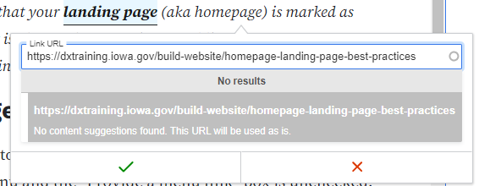
Incorrect Internal Page Linking
Using the URL of the page will not help the Linkit tool locate the page that you want to link. This is only used for external website linking like Google or other external website pages.

Slide 19
Five Accessibility Checks for Content Governance
Page title is appropriate length - Target less than 75 characters
Acquia Optimize Accessibility Error Scan - Example of an error message would be “Title is short”: Title Error Video
Title describes the document - title of the document must be unique and descriptive of the document. Naming Convention Resources
Link text is meaningful when read out of context - text is specific to the page or document. Link Text Video

Slide 20
Accessibility Site Scans
Learn how to work with Acquia Optimize (formerly Monsido)

Slide 21
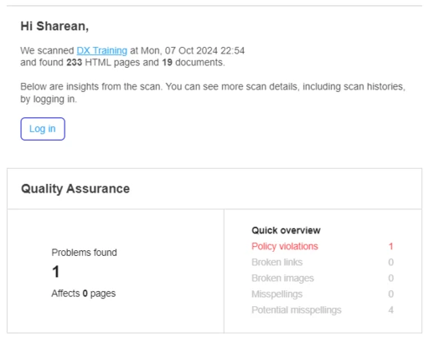
What are Accessibility Site Scans?
For the agency websites that are within our team, we currently have them set up to run a weekly Acquia Optimized scan. From that scan a report is sent out to the agencies’ emails that show the broken links and accessibility errors that were identified by Acquia Optimize and need to be corrected.

Slide 22
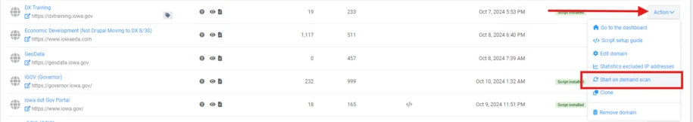
How to Run a Scan
If you just made changes to your website and need to run a scan of your website with Acquia Optimize, you can do that using the "Start on Demand Scan" within the Admin Settings section within the Action button dropdown.

Slide 23
Introduction to URL Redirects
Learn about creating and editing URL redirects

Slide 24
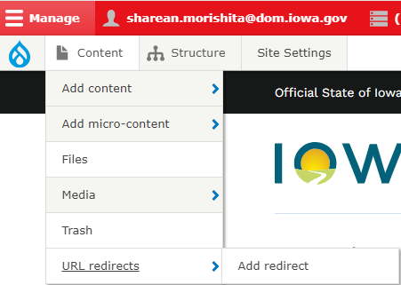
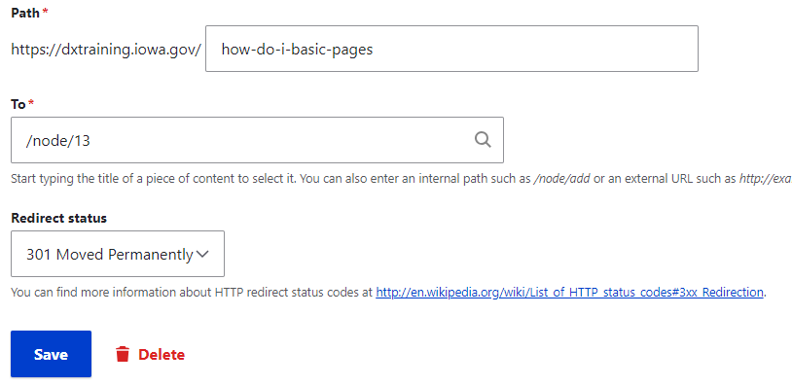
Creating URL Redirects
You can create URL redirects easily within the Content drop down menu. This is great to use to lead users to new pages from old URLs that may be sending them to the 404 page.

Slide 25
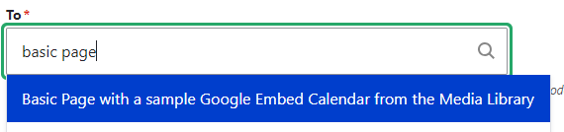

Correct Linking URL Redirects
Just like with the Linkit tool, within the “To” field you will want to make sure not to use the URL but instead actually search for the title of the page so that it can find the node and number.

Slide 26
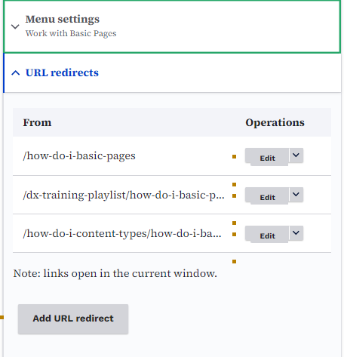
Creating a URL Redirect in a Page
An easier way to create URL redirects for a page on your site is to go into the “edit” field of your page and then within the sidebar navigation under “Menu Settings” you will also see the “URL redirect” field.

Slide 27
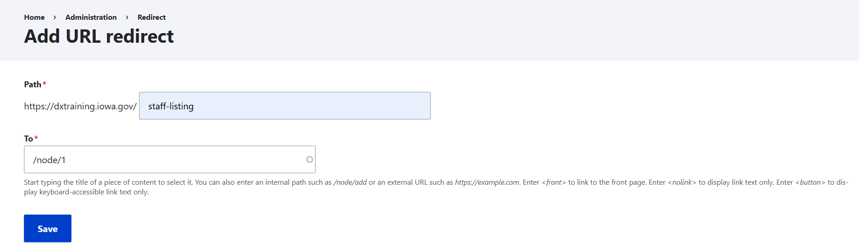
Faster URL Redirect Method
When you click the Add URL button, a new window will pop up and will already have the correct node page number within the to field. All you have to do is create the new URL extension.

Slide 28
Google Analytic Pageview Report
Learn how to create reports of Document clicks and 404 page traffic.

Slide 29
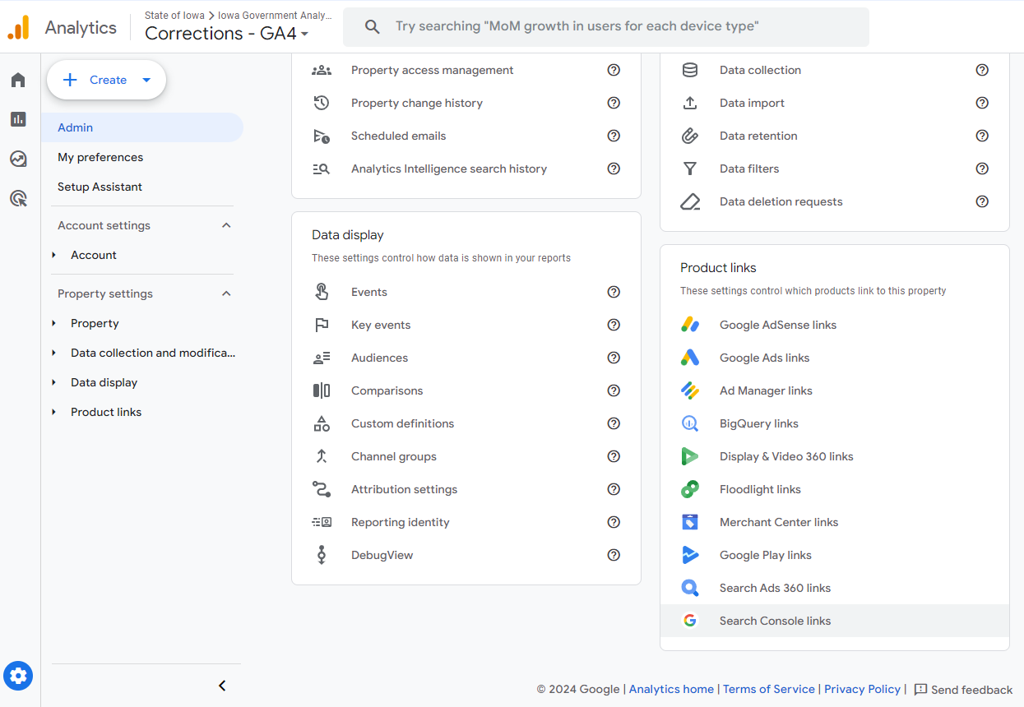
Step 1: Connect Google Search Console to Google Analytics
Select the gear icon on the bottom left of the page. Then locate the Product Links section to select Search Console to Connect it to Google Analytics.

Slide 30
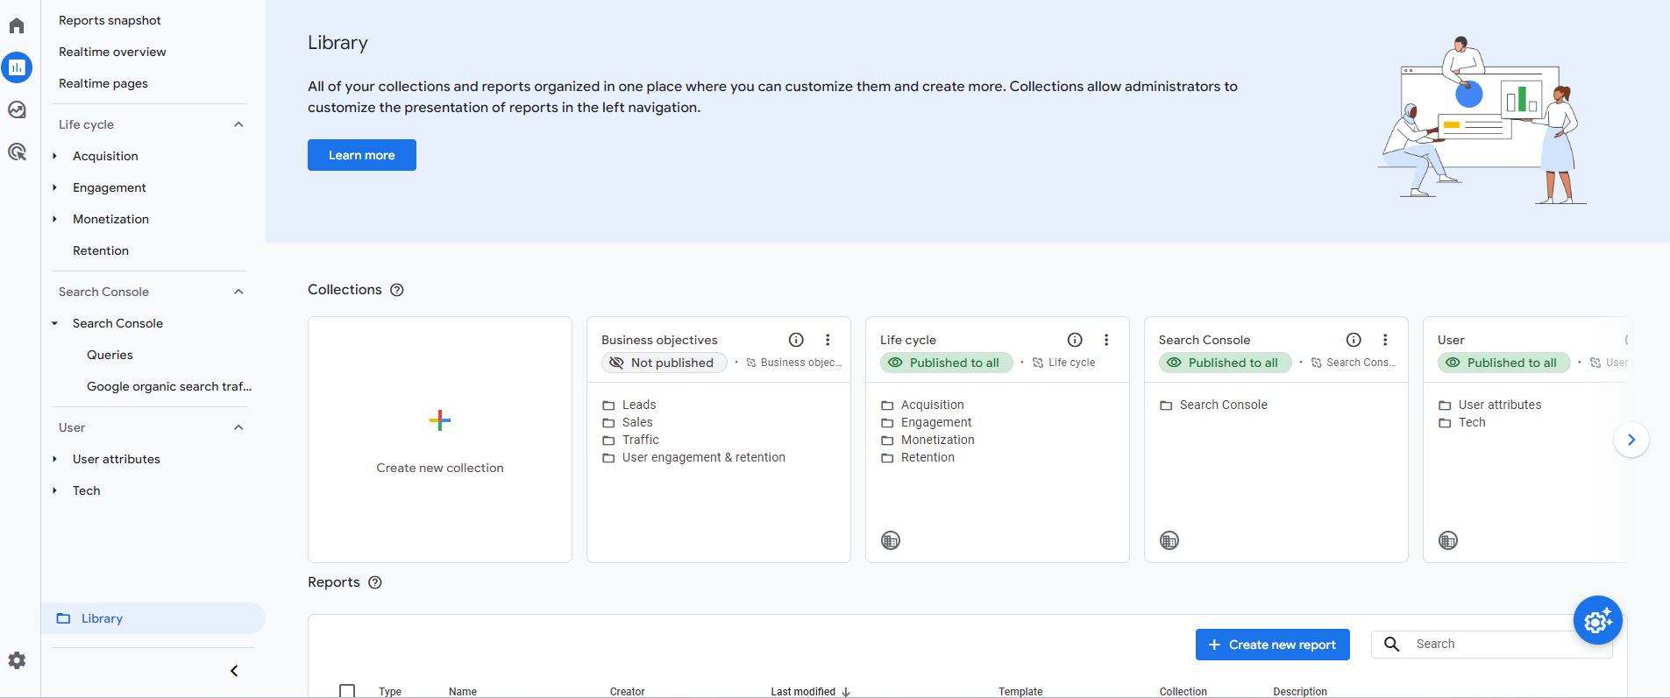
Step 2: Publish the Search Console Box in the Library Folder Under the Report Tab

Slide 31
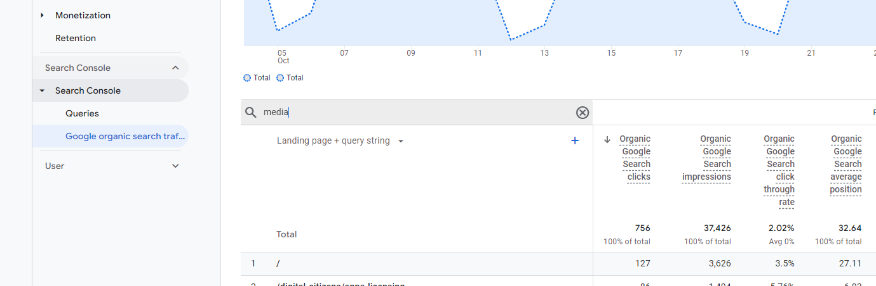
Step 3: Search for the Word “Media”
Within the Report section, select the Search Console to open the drop down. Then select the “Google Organic Search Traffic.” This is where you can export the report by searching for the word “media” in the search field.

Slide 32
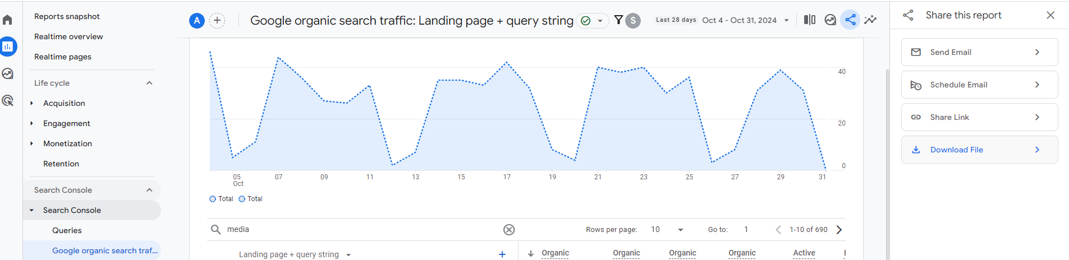
Step 4: Download the Report
After you have your information searched, you can download this report by selecting ‘share this report’ symbol on the upper right corner of the screen. A side menu will appear where you can click the “Download File” button.

Slide 33
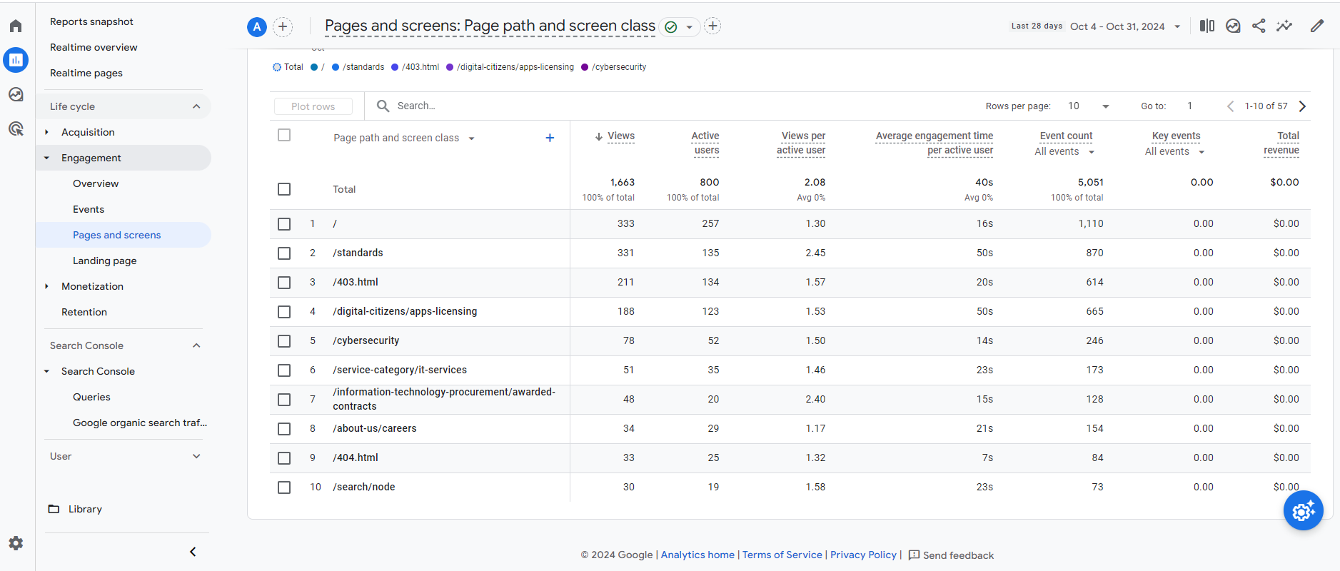
Locate the 404 Pages Users Received
Within the Engagement section dropdown you will select the “Pages and Screens” button to see what are the top 10 pages users are accessing on your site.

Slide 34
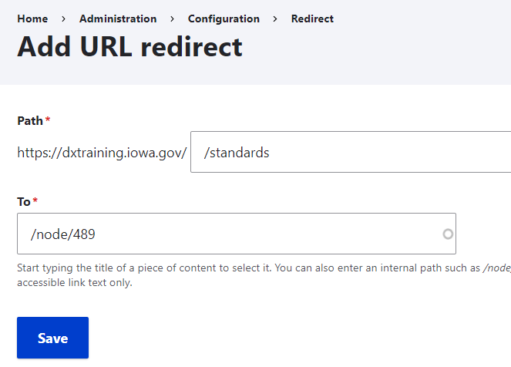
Use the Page Path and Screen Class
If that page is leading to a 404 or leading to an outdated page, then you can select that path and use it to create the URL redirect on your site.

Slide 35

Congratulations! You’ve Finished the Training!

